Slide 1


Black History Month

Slide 2


During this assembly you will be developing your understanding of what it means to be growing up in modern Britain.
You will also be considering the various communities that have shaped our island nation.

Slide 3


TOLERANCE
DEMOCRACY
INDIVIDUAL
LIBERTY
RULE OF LAW

Slide 4
In Britain there are 4 values that underpin our society.
Tolerance – this means respecting other people, their uniqueness and their lifestyle (as long as it is within the law).
Rule of law – in Britain we must respect and adhere to the laws of our society.
Individual liberty – we should all be free to make our own decisions and have freedom of speech (as long as what we say is not against the law).
Democracy – we all have a right to vote and choose who we want to represent us in Parliament and in local councils.

Slide 5

Wealth
Gender
Religion
Sexuality
Ethnicity
Disability
Ability

Slide 6
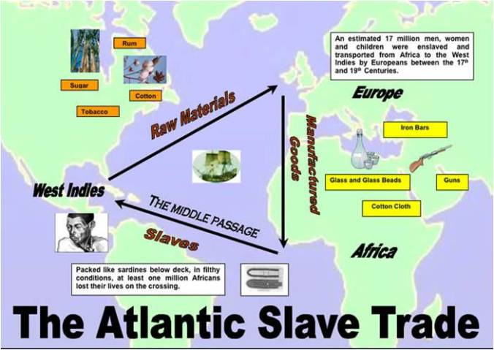
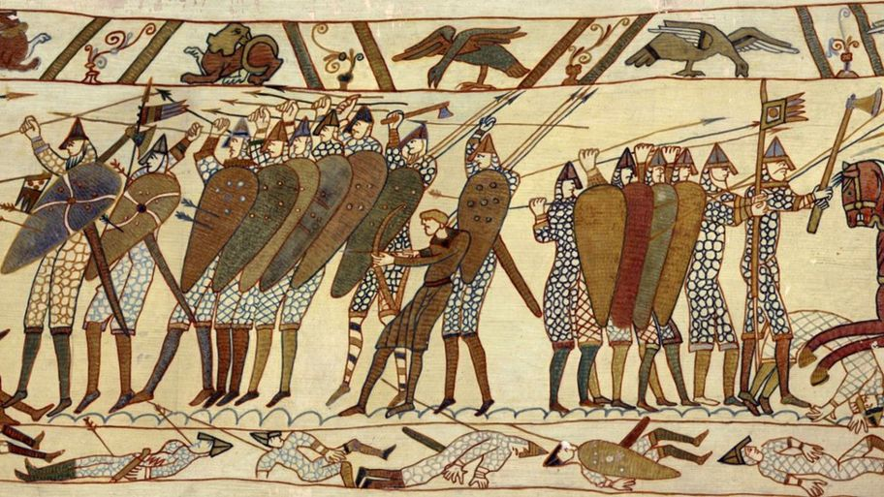
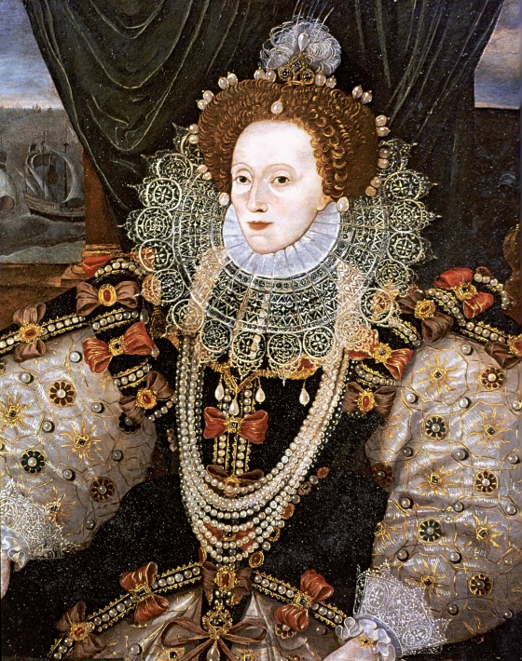
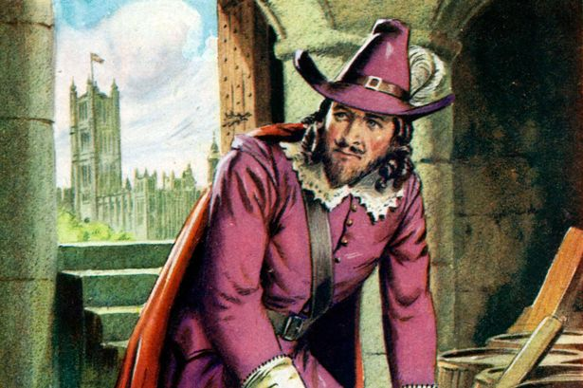
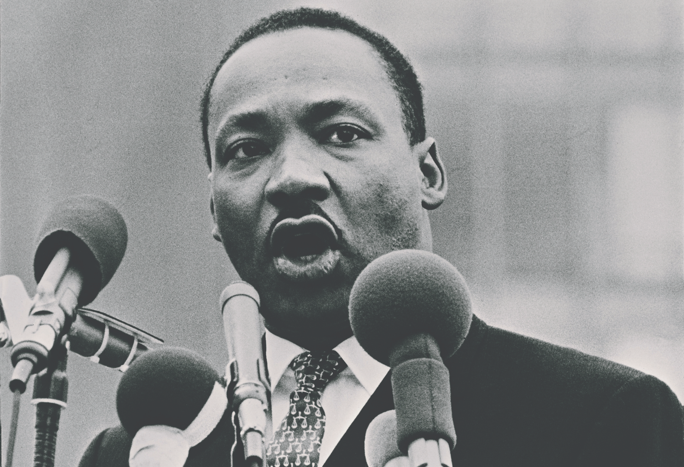

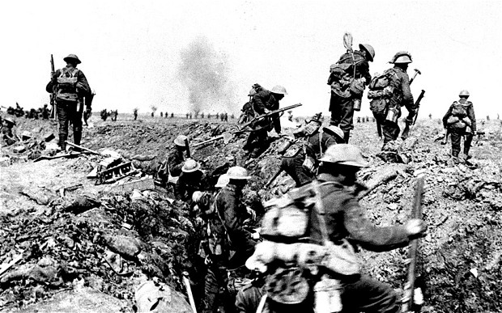
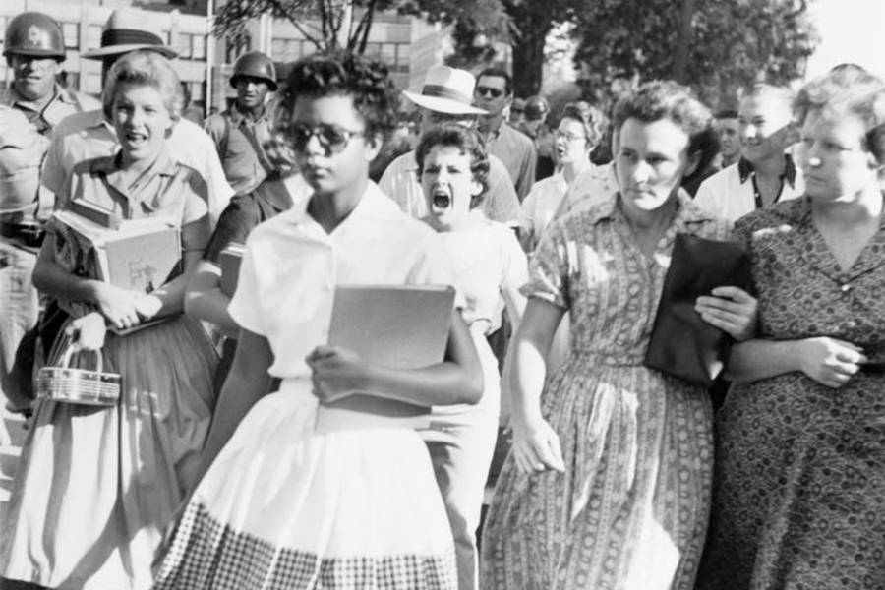

Slide 7
Black History Month (BHM) is celebrated in Britain in October every year and with good reason.
Growing up in Britain, your History lessons largely refer to white people, which is understandable in as much that the black communities did not develop widely in the UK until the 20th Century.
The black History taught, quite rightly, focuses on the Triangular Slave Trade and Civil Rights. Whilst these topics are important to learn, there is much more to black history. So BHM gives us a chance to consider and celebrate the contributions to British life from the black community.

Slide 8
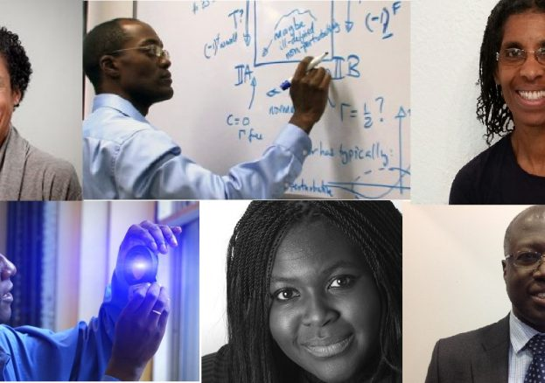
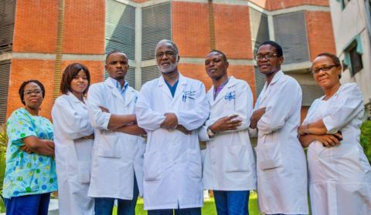

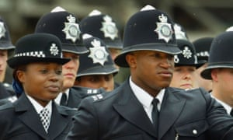


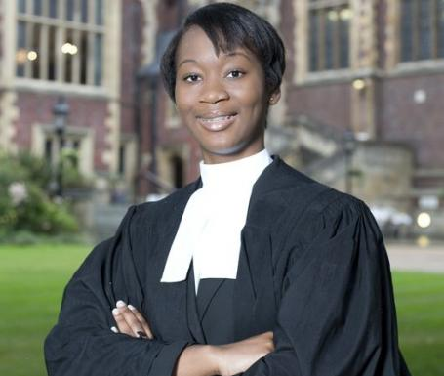




Slide 9
During BHM there will be a number of celebrations around the country and many films and documentaries on TV. These allow us to consider the challenges faced by the black community and also allow us to reflect upon the benefits of Britain being a multi-cultural society.
Each year the theme is slightly different and this year the theme is
“Archiving the past, reflecting the future.”

Slide 10
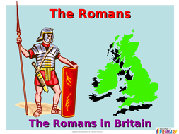
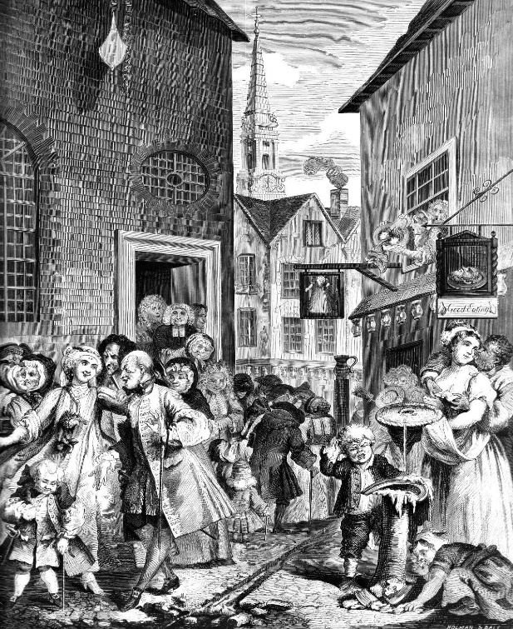
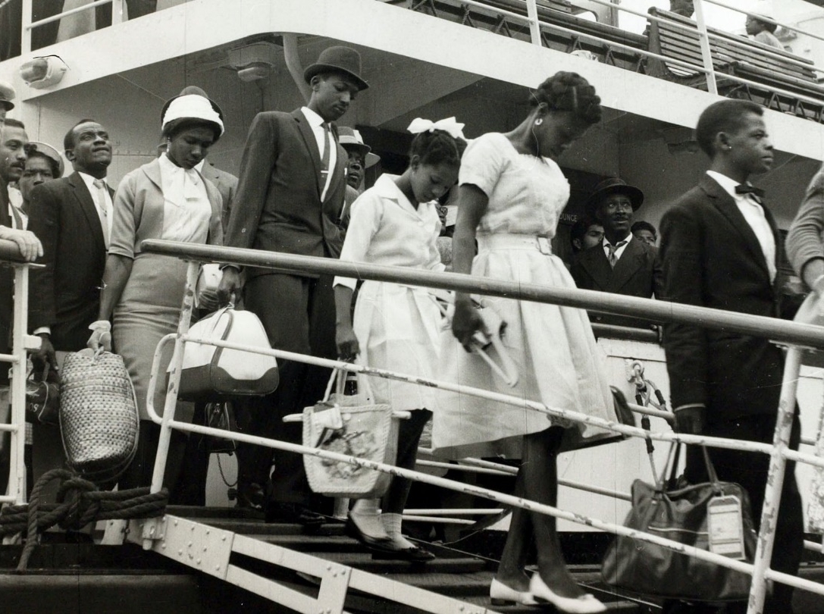
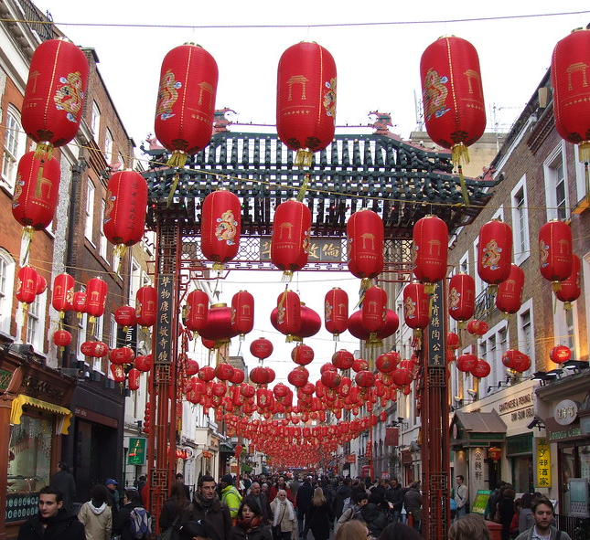
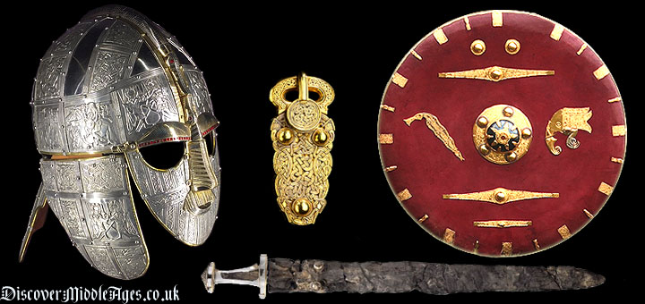


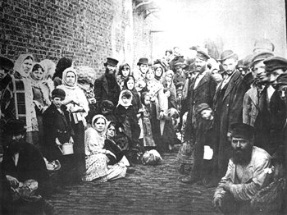
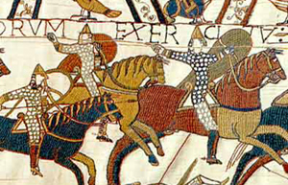
“Archiving the past, reflecting the future”

Slide 11
“Archiving the past, reflecting the future”
Understanding the past and appreciating how we all came to be here at EPA, in one community, where there are “No Outsiders,” is really important and helps us respect and tolerate each other.
Britain is an Island and many people have settled here over the years: the Romans, the Anglo-Saxons, the Normans and more recently from France, the French Huguenots. In the early 20th Century: Irish, Germans, Russians and Polish people all settled in the East End of London.
In the mid 20th Century, as we rebuilt Britain after WW2: the Afro-Caribbean, Chinese and Asian communities settled in Britain.
Most recently Europeans have settled here.

Slide 12
“Archiving the past, reflecting the future”
So – how can we celebrate Black History Month and the diversity within our community?
We are going to create a display of where our ancestors come from, so that we can “archive the past.” This will enable us appreciate the journeys and stories that are behind the EPA community and consider each others’ diverse backgrounds.
Additionally, we will be able to “reflect on the future” and move forward together as a community with improved mutual respect and toleration for each other.

Slide 13
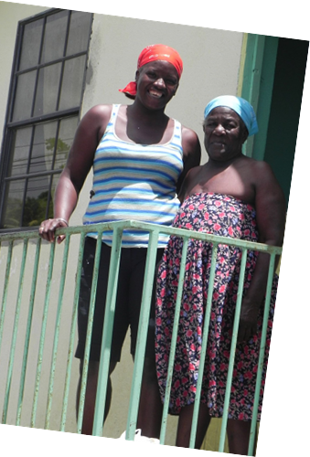
Archiving the past, reflecting the future.
As it is Black History Month, we are going to start by asking people of Afro-Caribbean heritage to bring in photos of relatives that were not born in the UK.
The display will not mention any names, it will just have a caption such as:
“My cousin and grandmother in St. Lucia”
Later in the year we shall ask people of
Asian, European, Australasian and American heritage to bring in photos of their relatives too.

