Slide 1

Classrooms to Care Homes

Slide 2
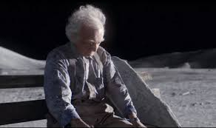
John Lewis Advert - 'Man on the Moon'
As you watch the above video link, think about the following questions:
Have you experienced loneliness during each lockdown?
Have you seen a decline in your mental health, or in those around you, during lockdown?
How do you think residents of care homes feel when they cannot see their family and friends for months on end?
What might life be like to live in complete isolation for 6 months?

Slide 3
How many older people are affected by loneliness?
Over 1 million older people report feeling lonely all the time, or often
49% of over 65s cite television or pets as their main source of company
49% of over 75s live alone
12% of older people state they never spend time with family
9% of older people feel trapped in their own home
600,000 leave the house once per week or less

Slide 4
Relationship between care homes and loneliness
Most studies to-date have focused on the relationship between loneliness and the residential care system.
Rates of ‘severe loneliness’ reported by people living in a care home (22–42%) are more than twice that of residents in the wider community
Over 80% of older care home residents with mental health problems said they felt lonely in their care home and that this could be eased if staff were able to spend more time with them. Many enjoy the company of care home staff, but see their workload as preventative to further social interaction.
In the wider population, more than 2m over 75s live alone in the UK, with over half regularly going for more than one month without conversing with a friend, neighbour or family member.

Slide 5
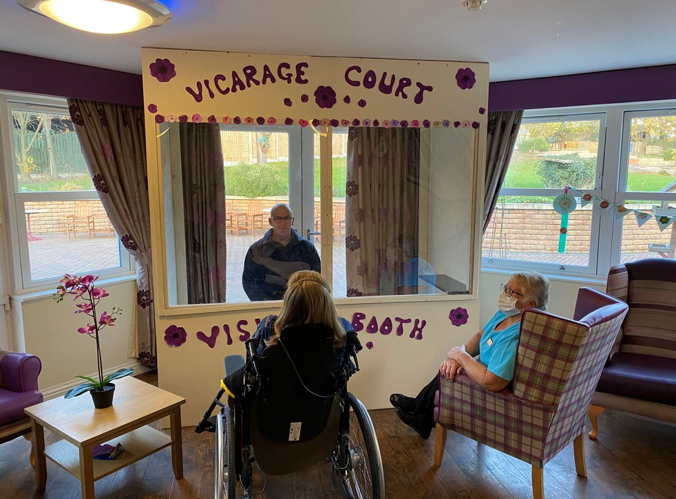
What are some care homes doing?
Care homes are building sealed-glass pods for safe face to face visits
The booths vary from home to home but typically allow visitors to sit inside the home while remaining entirely separated from vulnerable loved ones by glass or Perspex.
Speaker systems ensure they can talk clearly to each other.
Unfortunately, not all care facilities have the funds to implement this amazing initiative.

Slide 6
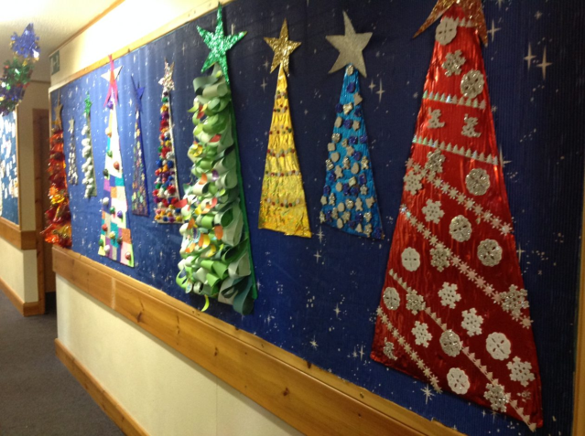
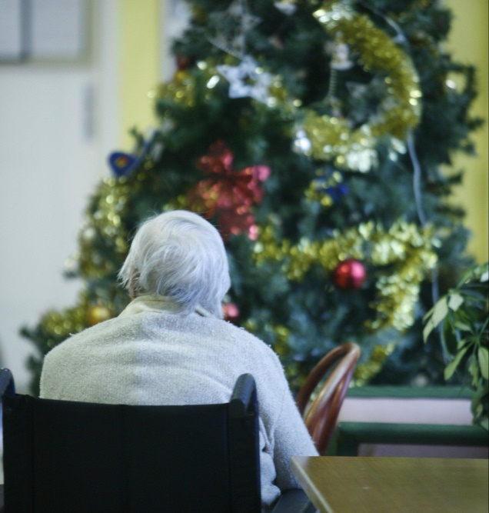
Classrooms to Care Homes: Spreading festive cheer
As the festive season begins, school classrooms typically transform into mini grottos, with tinsel draped around the whiteboard and a wonky Christmas tree in reception. But this year our festive celebrations will look a little different due to the COVID restrictions.
In care homes, celebrations will be even more unrecognisable. Unable to have visits from friends and family this winter, care home residents and their workers will be more isolated than ever before.

Slide 7

How can we help?
By getting involved with a nationwide initiative launched by TES
www.carehome.co.uk (finding local care homes to work with)

Slide 8

Classrooms to Care Homes is all about spreading festive cheer!
Lockdown has been hard for everyone, but care home residents and care home workers have been particularly isolated.
Essentially, TES are encouraging schools to help out by getting children to ease the loneliness for those in care homes by writing letters or sending video letters in which they share poems, drawings, jokes, riddles and stories about their festive celebrations. And our hope is that this will not just be a connection forged for Christmas, but beyond.

Slide 9
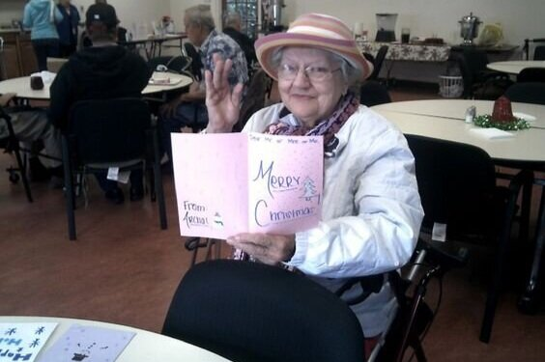
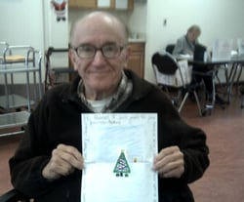
Classrooms to Care Homes: Spreading festive cheer
Suggestions
A description of how you will celebrate Christmas this year
A festive poem
A joke or riddle
A video message
A drawing or painting of a festive scene
A recording of you playing a musical instrument/drama piece
A video of you singing a Christmas Song
Please let your form tutor know what you would like to do – they have a sign-up sheet which we will collect Friday after school

Slide 10


Other initiatives EPA will be involved in…
Police Christmas Present appeal
FoodBank Christmas present appeal

