Slide 1
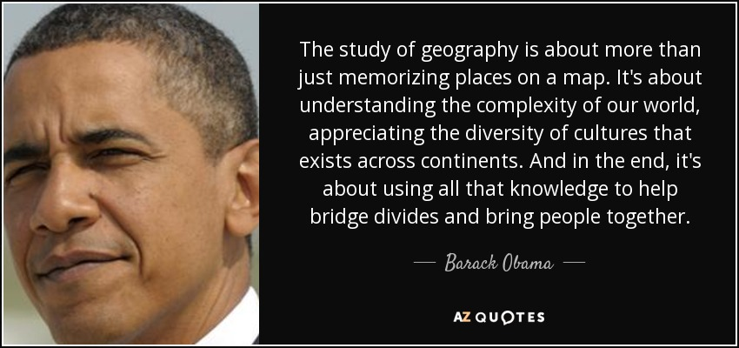

Slide 2
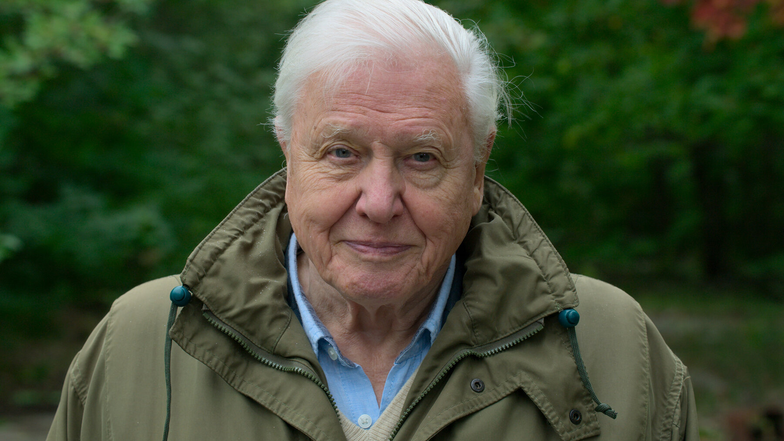
(107) A Message From Sir David Attenborough | A Perfect Planet | BBC Earth - YouTube

Slide 3
The geography team
Mr Cannon
Miss Landy-Till
Mr Thurley
Mr Hope

Slide 4

GCSE Geography (8035)
“the study of the physical features of the earth and its atmosphere, and of human activity as it affects and is affected by these, including the distribution of populations and resources and political and economic activities”.
So what will I study?
You will study 6 detailed topics all currently playing a role in our world and moulding our future…
https://vimeopro.com/user743483/trailers-1/video/303134384

Slide 5
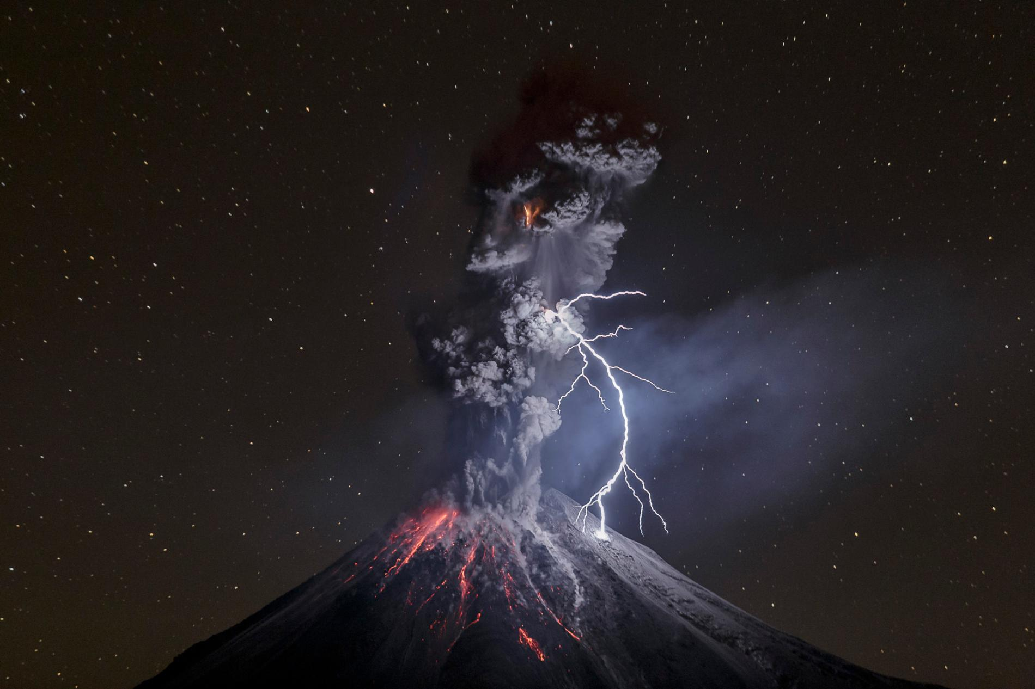
The restless earth: Physical
Areas of study:
Tectonic hazards
Earthquakes
Volcanos
Tsunamis
Weather Hazards
Hurricanes
Cyclones
Typhoons
Climate change
Melting glaciers
Real world case studies and examples

Slide 6
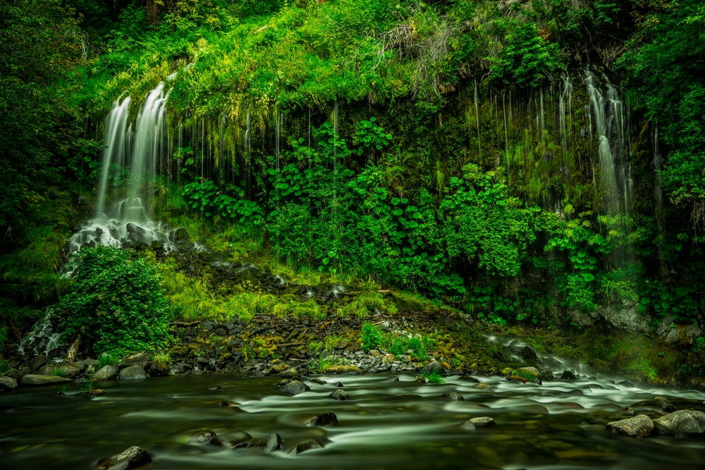
The living world: Physical
Areas of study:
Rainforests
Deforestation
A range of ecosystems
Hot deserts – Challenges, environments
Cold environments
Real world case studies and examples

Slide 7
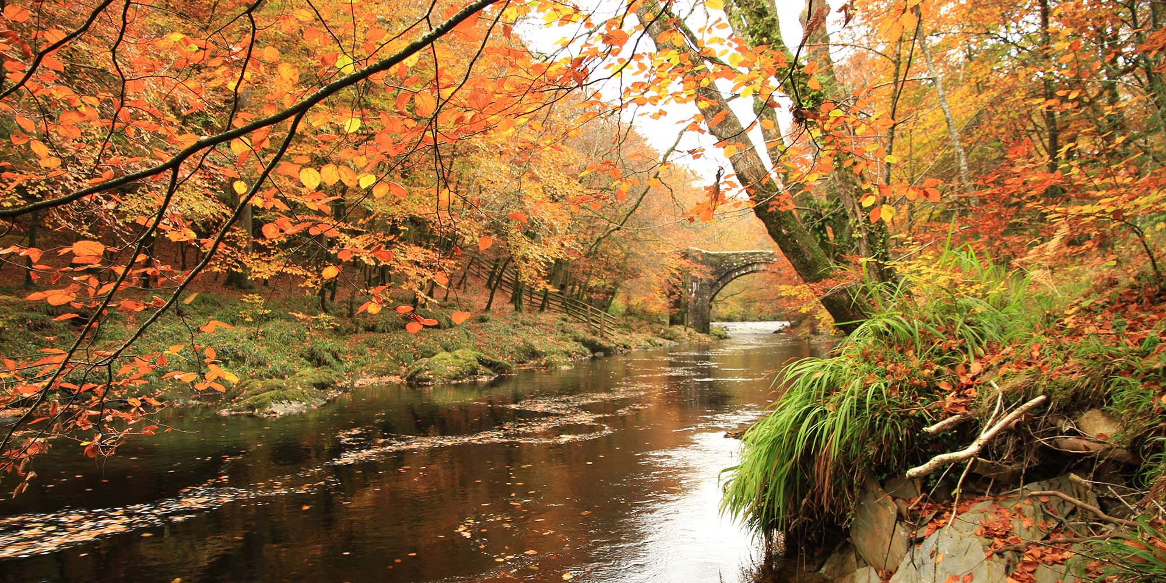
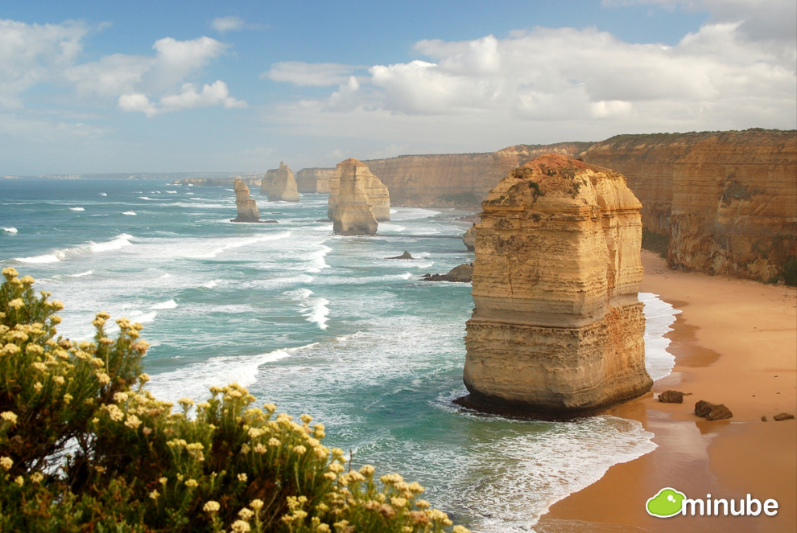
Changing UK Landscapes: Physical
Areas of study:
Flooding
Erosion
Changing coastlines
Flood protection
Flooding and erosional impacts
How is our local area changing?
Real world case studies and examples

Slide 8
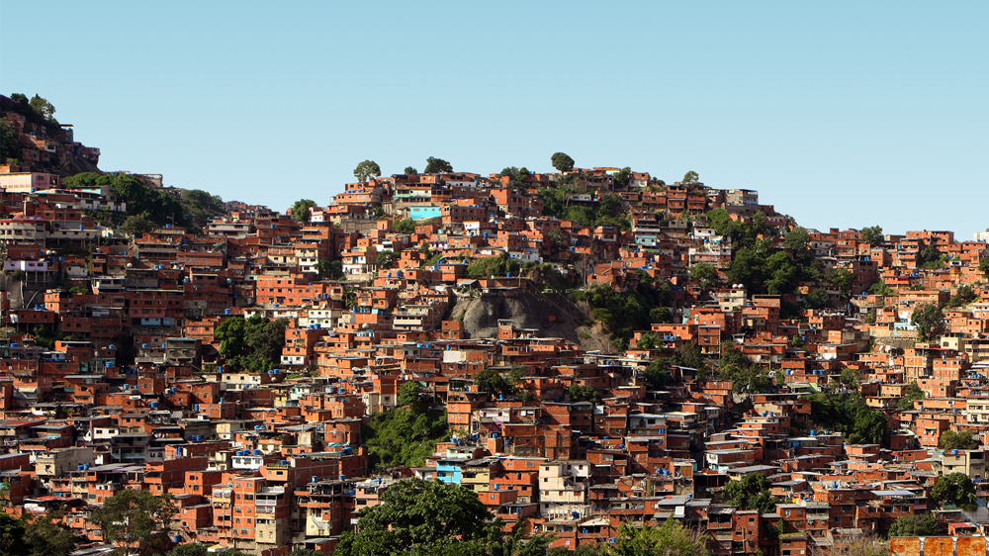
Urban issues and challenges: Human
Areas of study:
Population changes and pressures
Megacities
Urban opportunism
Growth of slums
Water and energy pressures
Regeneration
Transportation systems
Looking at cities such as London!
Real world case studies and examples

Slide 9

Global economic systems: Human
Areas of study:
Applicable to all modern businesses!
Economic development and quality of life
Uneven development
GDP and salary
Global business
Reducing development gaps
TNC – Trade, business, finance
Political relationships
How the UK is adapting to a new business world
Real world case studies and examples

Slide 10
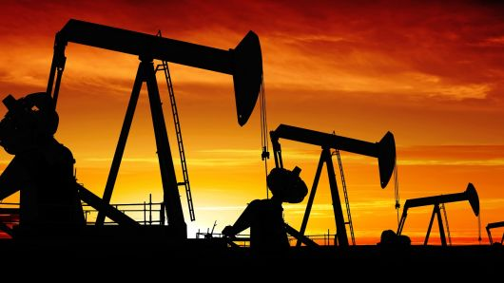
The challenge of resource management: Human
Areas of study:
Significance of food, water and energy
Global consumption, supply and trade
Food – Trade, technology, patterns, types of food, why is food important.
Water – Crises, war, solutions
Energy – Renewables, trade, solutions to fossil fuel usage.
Real world case studies and examples

Slide 11
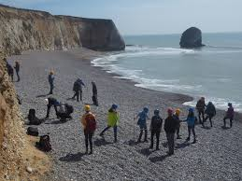
Fieldwork studies: Human and Physical
Areas of study:
Getting out in the field to study geography in the real world in a human and physical aspect, conducting experiments and studies to help prove our hypothesis!

Slide 12


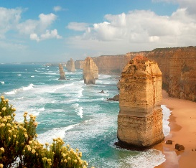


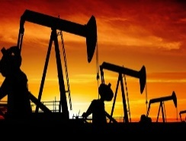
How will I be assessed?
All written exams, no controlled assessments.
Paper 1: Physical geography 1.30hr
Paper 2: Human geography 1.30hr
Paper 3: Geographical application1.15hr

Slide 13
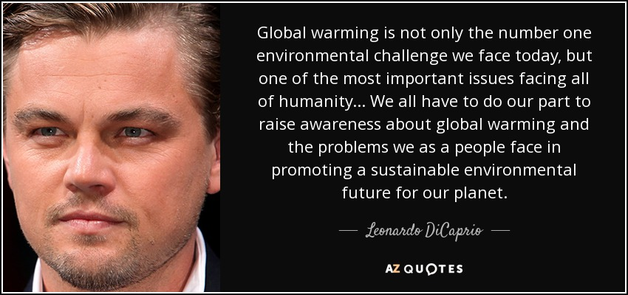
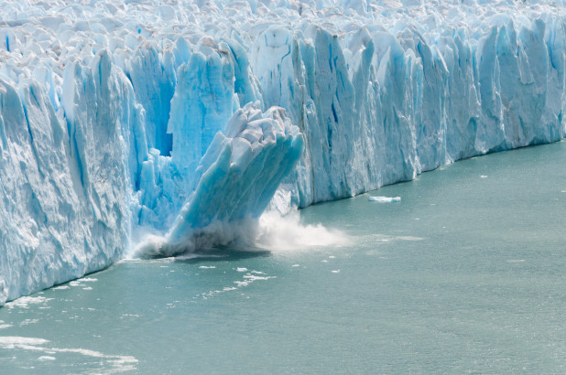
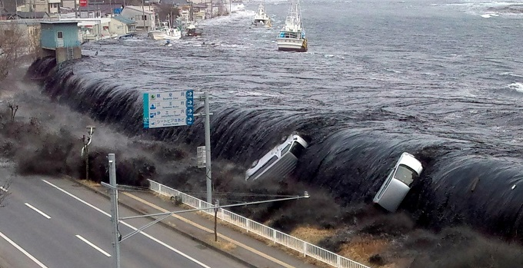
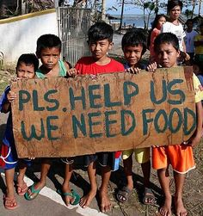
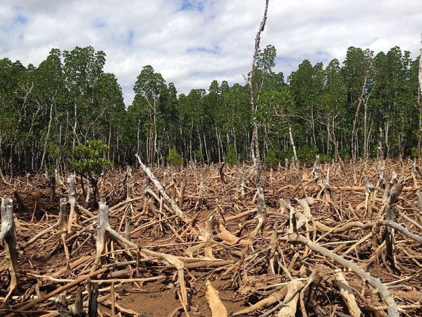
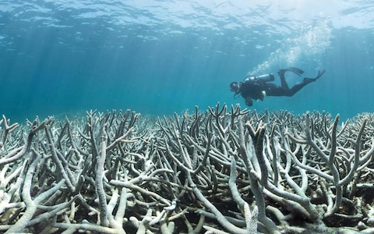
“Geography is a subject which holds the key to our future!”
Still need convincing we need to start solving issues?

Slide 14
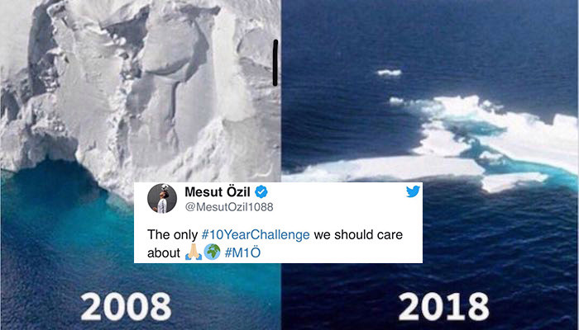
More?
Notes:
10 year challenge related to current social media trends

Slide 15
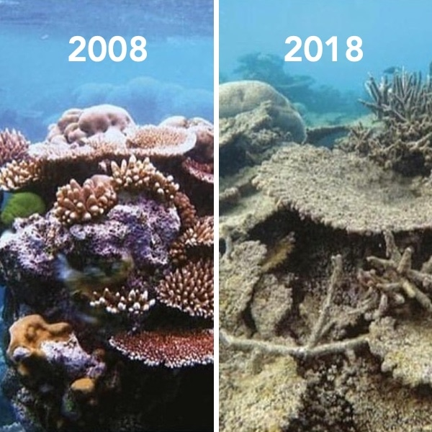

Slide 16
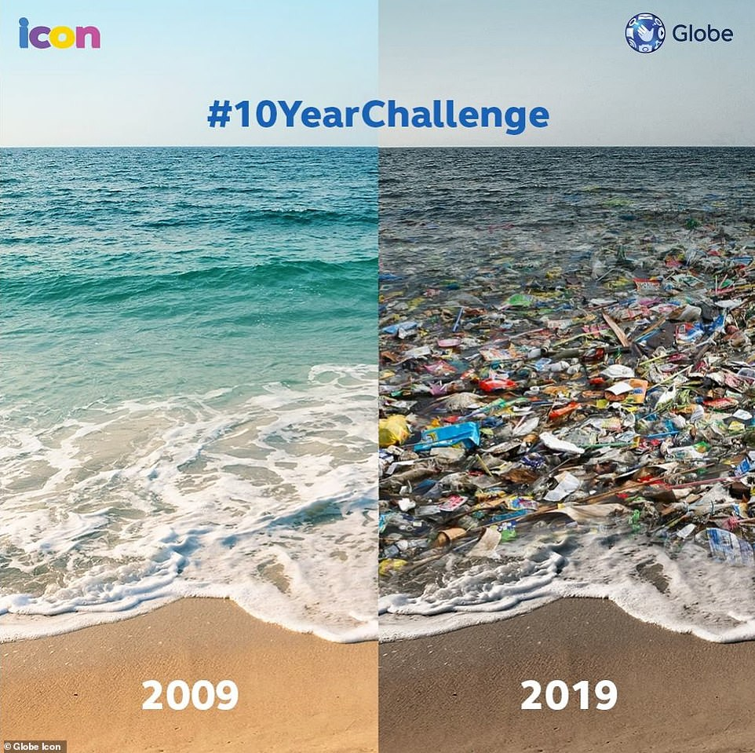

Slide 17
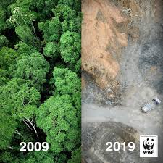

Slide 18
What skills can I develop?
Transferable skills
Employers seek a mixture of skills, qualifications and experience when they recruit for a post. As a graduate you will be in demand for your transferable skills, such as:
Being a good communicator with strong presentation skills
Being competent with ICT
Being able to carry out research
Being used to working effectively in a team and taking a variety of roles in a team
Being able to manage your time by juggling commitments, meeting deadlines and managing stress
Being good at combining information from a variety of sources with excellent writing skills
Specific skills geography helps to develop
You will also be in demand for the specific skills and understanding that being a geographer helps you to develop, including:
Scientific and lab skills
Producing and interpreting maps
Research and interpretation of data, including GIS skills
Debate and enquiry
Environmental and social awareness
Team-based project work
Fieldwork techniques

Slide 19
What careers routes can I take?
Geography graduates are very employable, with the skills, knowledge and understanding gained during a geography degree held in high regard by employers. The nature of working lives is changing. It is less likely that you will spend all of your working life in one organisation or even in the same sector. If your career path is to be varied, you will need transferable skills and flexibility. Geography provides you with these.

Slide 20


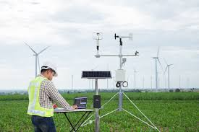
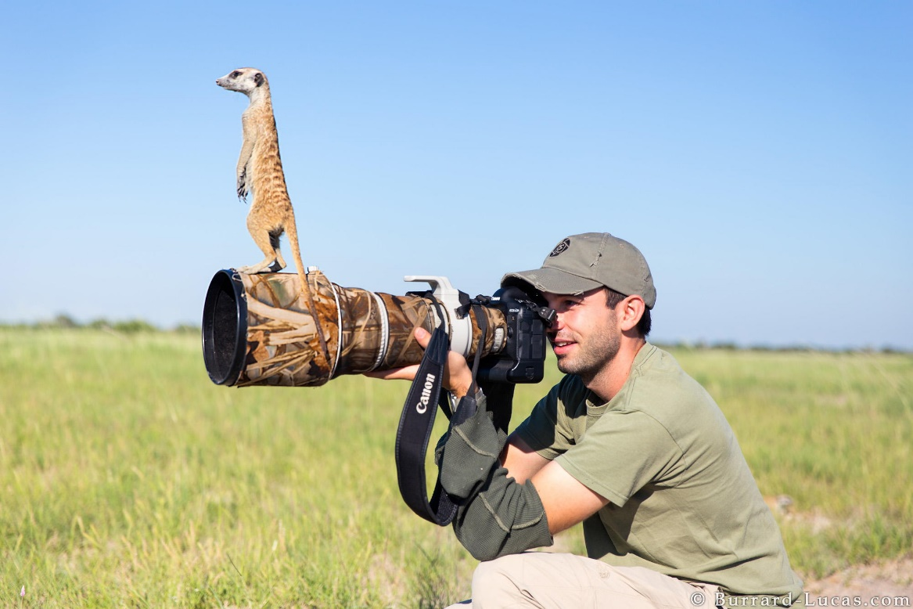

Career Options?
Climatology
International Relations
Hazard & Disaster Management
Meteorology
Geography
Travel & Tourism
Climate Change Scientist
Urban and Regional Planning
Marine Biology
Architect
Geology
Cartography
Resource Management

Slide 21
How is Geography linked to other subjects?
Key
Link to other subjects
Tourism & Inequalities
Economics/Law
Geography topics
Urbanisation
Ecosystem
Hot deserts, Rivers Coasts
Globalisation and Development
Art/
Architecture
Biology
Environmental Sciences
Business Studies
Political Science
History
The Sciences; physics, chemistry, geology

Slide 22
What our student think
“I like geography because of all the geography teachers who help us to get the highest possible grades. When I was in your position in year 8 I was torn between geography and other subjects, but now I am 100% sure I made the right choice with geography.”. MC, 2019
“Geography is great to study about the world and what's happening in the world around us. You can learn about different case studies and how people try to survive in different conditions”. AD, 2019
“Geography lets you study all parts of the world and gives you an awareness of current issues in certain areas”. CC, 2019
“ Geography lessons are actually enjoyable to go to. Due to my larger interest in the subject I am working towards a high expected grade of a 7 or even higher! I would not change my decision on taking geography. I would now like to progress further with geography”. LZ, 2019

Slide 23
Still unsure?
Read the following quotations from famous people about how important they think Geography is……….and then make up your own mind!
“Geographic Information is critical to promote economic development, improve our stewartship of natural resources and protect the environment.”
(Bill Clinton
Former President of the USA)
“If geography itself has any significance it is that we are made to lift our eyes from our small provincial selves to the whole complex and magnificent world.”
(Richard Burton,Explorer)
“As a young man my fondest dream was to become a geographer. However while working in the custom house office I concluded it was too difficult of a subject.”
(Albert Einstein, Physicist)
“Geographers are often in the front line of the world’s war zones and disaster areas and enabling people to update their views of the earth and its inhabitants.”
(Secretary General of UN)
“Geography is a subject which holds the key to our future!”
(Michael Palin
Writer / TV Presenter)
“Of all subjects, it is geography that best draws together the techniques of research, planning, communications and presentation that employers demand to day”
(Director of Transport Research)

Slide 24
Any questions please see:
Your Geography teacher or a member of the geography team!
AND
Read the additional information on skills for the future here! Royal Geographical Society - Why you should study geography (rgs.org)

