Slide 1

What is GCSE History?

Slide 2
Why study History?
History is the interpretation of the significance that the past has for us. – Johan Huizinga
If you want to understand today, you have to search yesterday. – Pearl Buck
It is important to have an understanding of history so we can put modern society in the correct context. That context gives us a deeper appreciation of modern life because we know the journey that led us here. Not only that but understanding the progression of history gives us insight to how the future will look like, as a society. And the skills we learn in doing this help us make the right choices in our personal lives.
Year 11 EPA Student

Slide 3



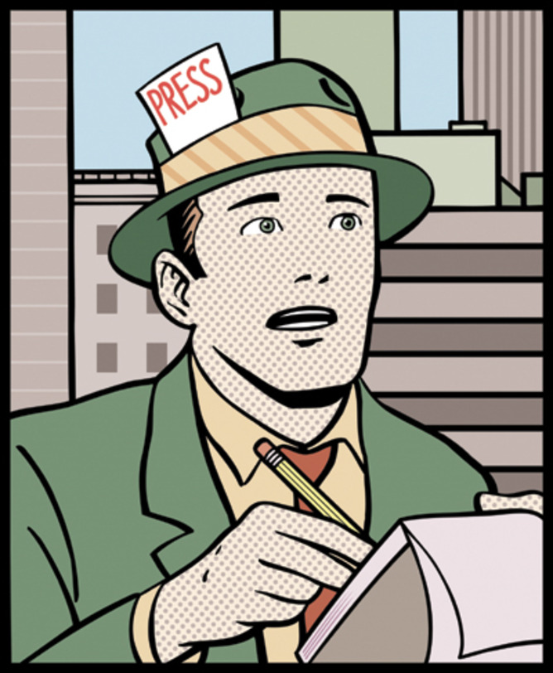
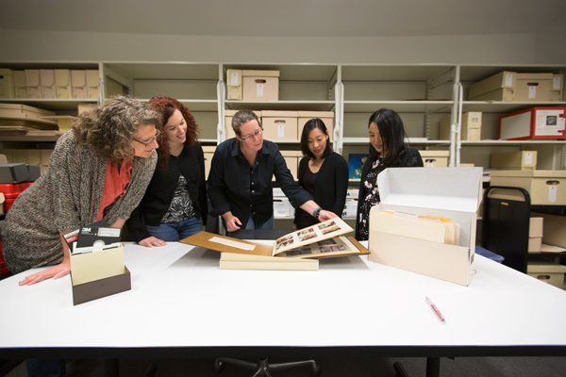
What are the job opportunities?
Teacher
Journalist
Solicitor
Researcher
Archivist
Politician
Civil Service
Business
This Photo by Unknown Author is licensed under CC BY
This Photo by Unknown Author is licensed under CC BY-ND

Slide 4
What skills will I develop?
The skills I have learnt in History are skills that I apply to all my subjects – it has really helped my essay writing across all my subjects.
Year 11 EPA Student
Communication and writing skills
How to construct an argument
Research and problem skills
Investigation and problem solving skills
Analytical and interpretation skills
You learn many handy skills needed later on in life such as problem-solving and general knowledge.
Year 10 EPA Student
History is a great subject, It develops your interpretation and writing skills, which can be very useful later on.
Year 11 EPA Student
You learn to question the reliability of sources, which makes it good for developing critical thinking skills that will be so helpful in your everyday life.
Year 11 EPA Student

Slide 5

What will I study?
Edexcel exam specification
Crime and Punishment, c.1000-present and Whitechapel, c.1870-c.1900: crime, policing and the inner city.
Early Elizabethan England, 1558-1588.
Superpower relations and the Cold War, 1941-1991.
Weimar and Nazi Germany, 1918-1939.
I have enjoyed History because of the range of topics that I have studied, from the Cold War to crime in the Middle Ages.
Year 11 EPA Student

Slide 6
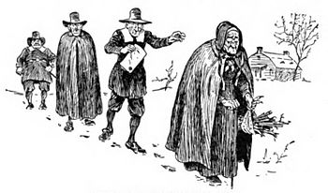
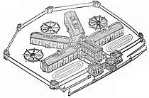
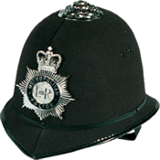

What will I study? – Crime and Punishment
The nature and changing definitions of criminal activity – Middle Ages, Early Modern, 18th and 19th centuries, Modern day
The nature of law enforcement and punishment – Middle Ages, Early Modern, 18th and 19th centuries, Modern day
Case study – Role of the Church, Gunpowder Plot, Matthew Hopkins and the witch hunts, Pentonville prison, Robert Peel, conscientious objectors, Derek Bentley Case
Whitechapel, c.1870-1900: crime, policing and the inner city – local context, housing and living conditions, policing
Use of historical sources for historical enquiries
This Photo by Unknown Author is licensed under CC BY-SA
This Photo by Unknown Author is licensed under CC BY-SA

Slide 7
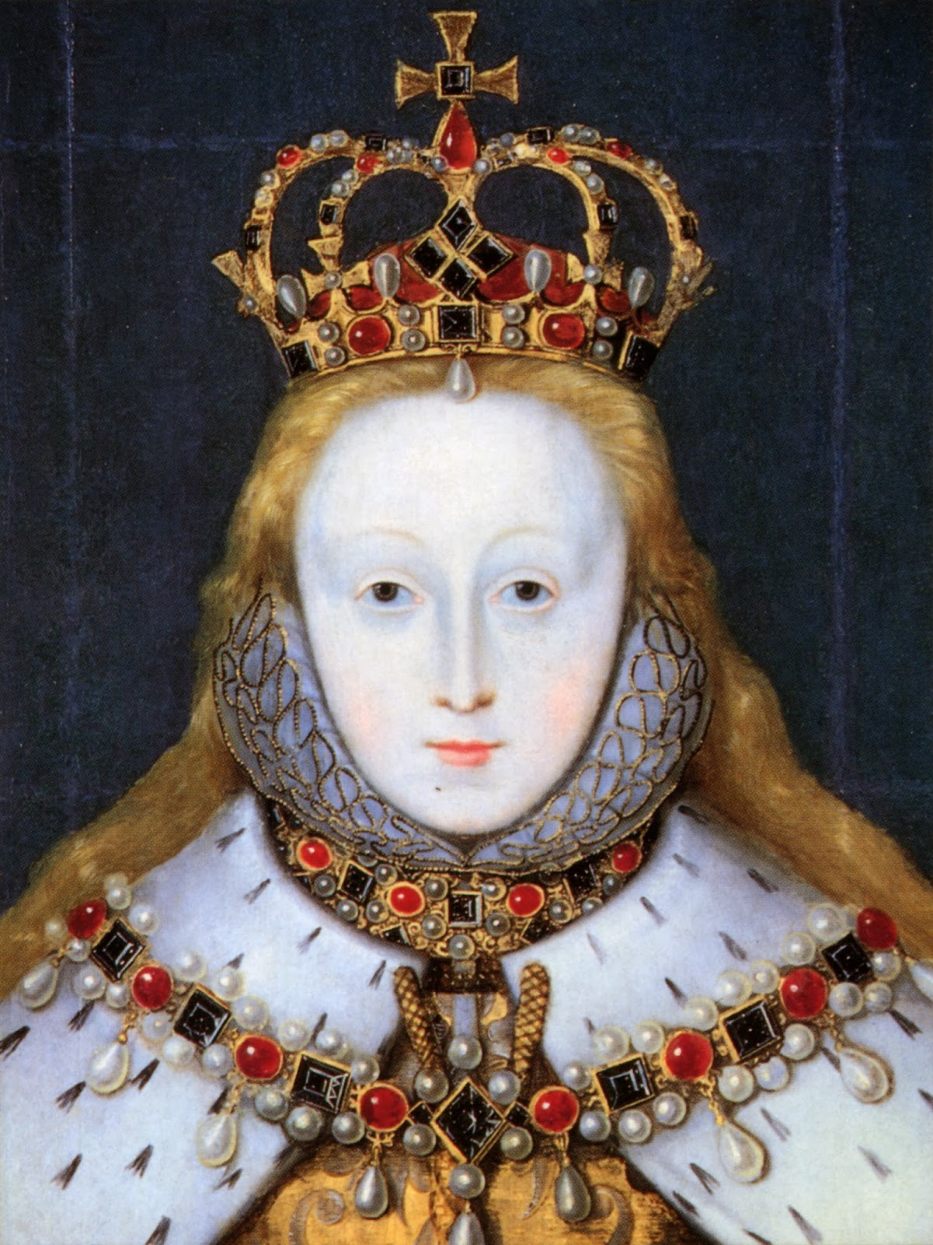
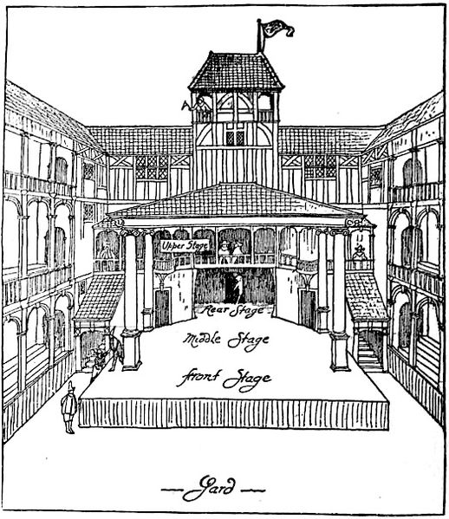
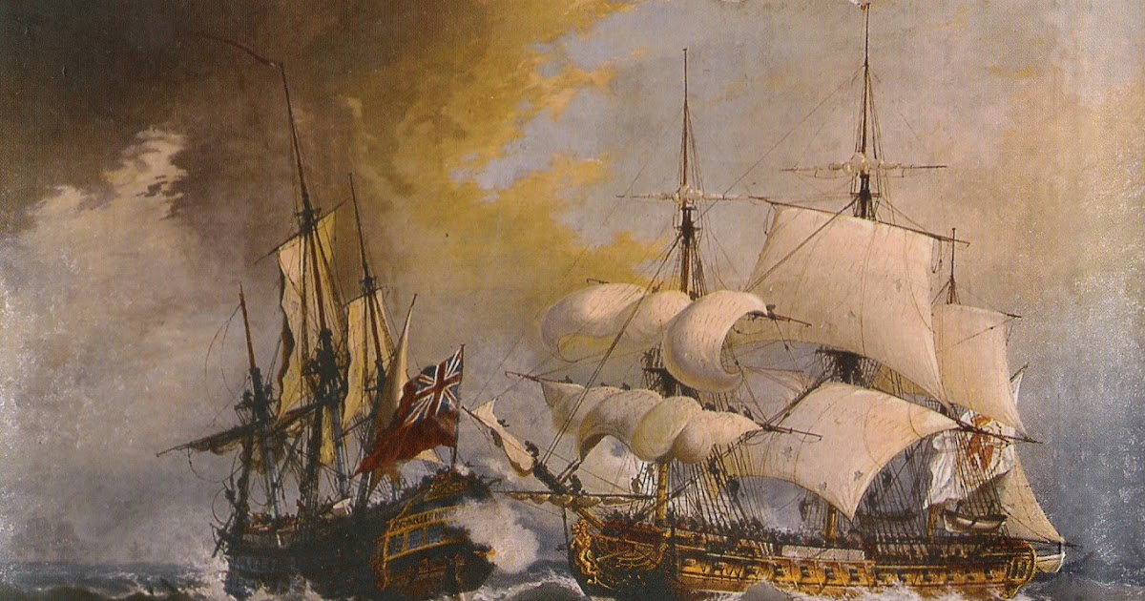
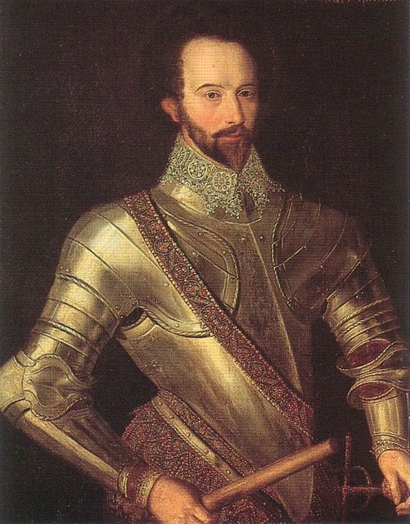
What will I study? – Early Elizabethan England
Queen, government and religion – Elizabeth’s accession, ‘settlement’ of religion, Mary, Queen of Scots
Challenges to Elizabeth at home and abroad, 1569-88 – plots and revolts at home, relations with Spain, Spanish Armada
Elizabethan society in the Age of Exploration, 1558-1588 – education and leisure, the problem of the poor, exploration and voyages of discovery, Raleigh and Virginia
This Photo by Unknown Author is licensed under CC BY-NC-ND
This Photo by Unknown Author is licensed under CC BY-SA
This Photo by Unknown Author is licensed under CC BY-NC-ND

Slide 8
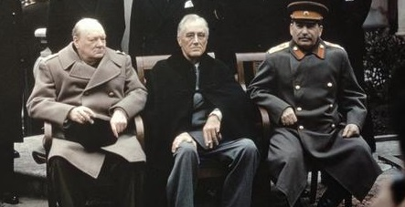
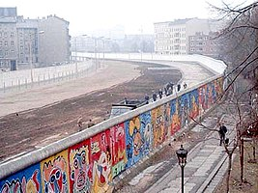
What will I Study? – Cold War
Origins of the Cold War, 1941-1958 – early tension between East and West, the development of the Cold War, the Cold War intensifies
Cold War crises, 1958-1970 – increased tension between East and West, Cold War crises, reaction to crises
The end of the Cold War, 1970-1991 – attempts to reduce tension between East and West, flashpoints, the collapse of Soviet control of Eastern Europe
This Photo by Unknown Author is licensed under CC BY-SA
This Photo by Unknown Author is licensed under CC BY-SA
The Cold War is a topic that I really enjoyed learning about as it was something I didn’t know much about. The fact that the events were so close to our lifetime makes it all the more interesting.
Year 11 EPA Student

Slide 9
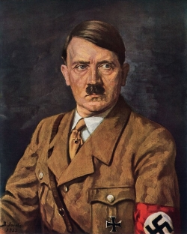
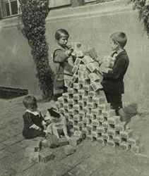
What will I study? – Weimar and Nazi Germany
The Weimar Republic, 1918-1929 – origins of the Republic, early challenges to the Weimar Republic, recovery of the Republic, changes in society
Hitler’s rise to power, 1919-1933 – early development of the Nazi Party, Munich Putsch and the lean years, the growth in support of the Nazi Party, how Hitler became Chancellor
Nazi control and dictatorship, 1933-1939 – creation of a dictatorship, the police state, controlling and influencing attitudes, opposition, resistance and conformity
Life in Nazi Germany, 1933-1939 – Nazi policies towards women, Nazi policies towards the young, employment and living standards, persecution of minorities
This Photo by Unknown Author is licensed under CC BY
This Photo by Unknown Author is licensed under CC BY-SA
I enjoy History because I get to learn about big figures like Hitler, a smart but evil man so it’s fascinating to go through his time
Year 11 EPA Student

Slide 10
How will I be assessed?
3 exams in the summer term of Year 11.
Paper 1: Crime and Punishment – 1 hour and 15 minutes – 30% of the overall grade.
Paper 2: Early Elizabethan England and the Cold War – 1 hour and 45 minutes – 40% of the overall grade.
Paper 3: Weimar and Nazi Germany – 1 hour and 20 minutes – 30% of the overall grade.
Although History is quite hard and you have to work hard it's honestly my favourite subject. It's so interesting and rewarding especially when you know you've worked hard and it begins to show in your grades, I always look forward to my lessons.
Year 11 EPA Student

Slide 11
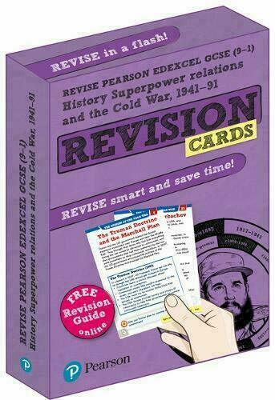
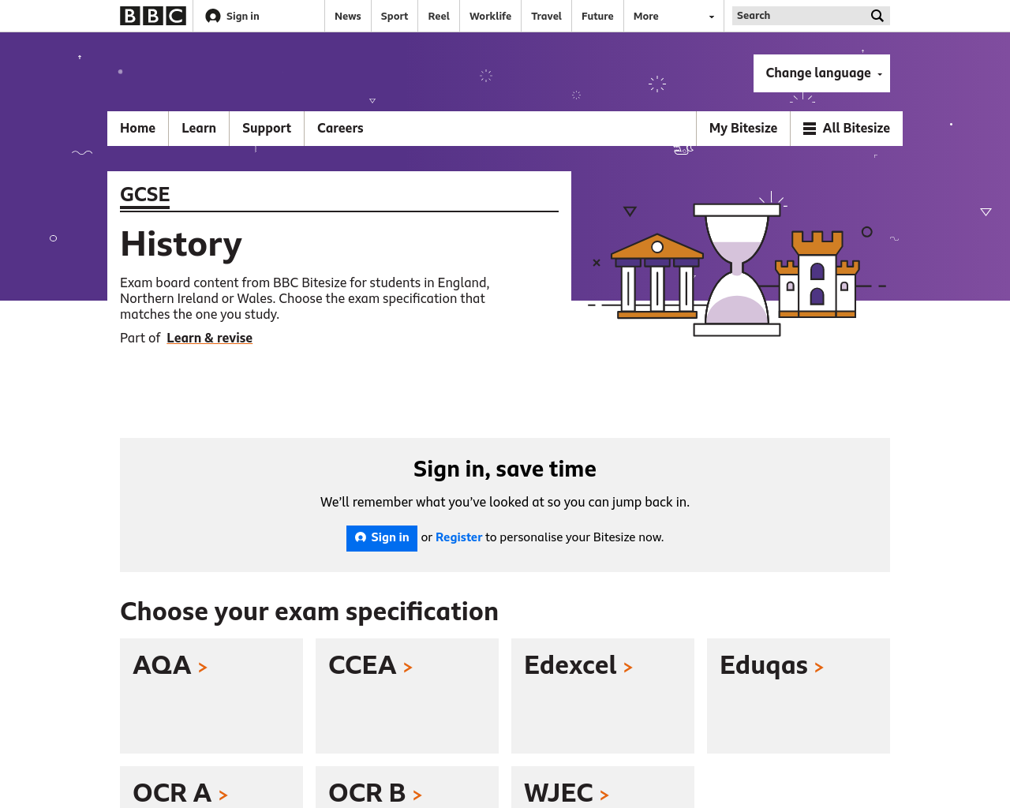
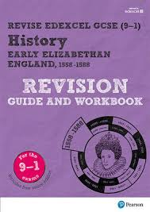
What resources are available to help me?

Slide 12
What do the Year 10s think?
Not only does History give you a boost in developing skills used within GCSE English language, it also covers 4 fun filled topics with plenty of mind-blowing facts along the way. History is a subject like no other.
Through year 10 I've loved GCSE history. it's fun, interesting and you learn a lot of subjects which you may not have learnt before and may help you learn many handy skills needed later on in life such as problem-solving and general knowledge.
I picked history because I think it’s interesting to learn about the past and how we got to where we are today.
I enjoy taking History because it is so interesting to be able to see how the world has changed and developed and become the society we live in today.
History is a great option choice I would definitely recommend it, it’s very enjoyable!

Slide 13
What do the Year 11s think?
I have really enjoyed GCSE History. I have found all the topics we study very interesting and fun to learn about. Because of how much I have enjoyed GCSE History, I have chosen to study History at A-Level.
History has been one of the best subjects to study at a GCSE level. It has shaped up understanding of the events that led to the world we live in today. The studying of history has given light to the interesting story of society to this point. History has also helped to develop my critical thinking and allowed me to apply this to more than just history.
History is a broad and exciting subjects full of interesting topics ranging throughout history showing how we have evolved and how society has expanded.
I love learning in history because you get to see why the world we live in today is the way it is. Especially the more modern topics like Nazi Germany and the Cold war.
The subject is highly enjoyable as you get to study a range of time periods with many interesting topics. The teachers are all really good and have made learning history far easier.
It’s very interesting to see how life has changed throughout time for others.

Slide 14
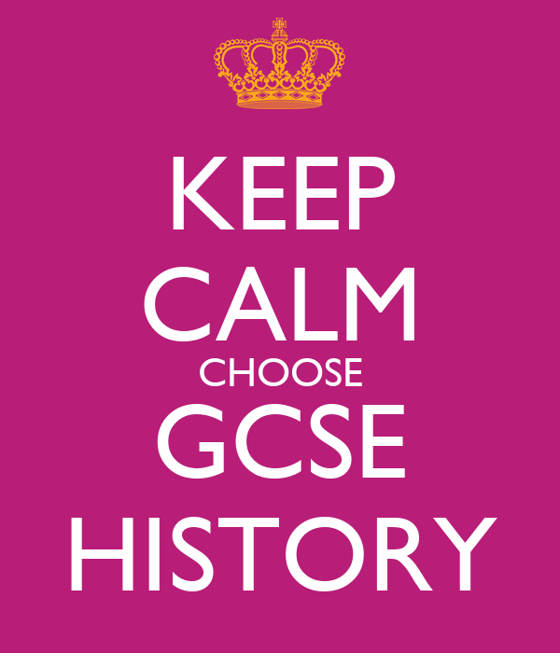
What if I have more questions?
If you still have questions about GCSE History, you can speak to your current History teacher.
Alternatively, you can speak to Mrs Caffull, Mrs Goodyear or Mrs Ragbir for more information.

