Slide 1
Business
Studying Business at GCSE

Slide 2
What you will learn …
You will start by exploring the world of small businesses through the eyes of entrepreneurs
Then you will move on to investigating business growth. How does a business develop beyond the start-up phase?
Much of the qualification investigates how large businesses operate, looking in detail at specific functional areas (Marketing, Human Resources, Operations, and Finance).

Slide 3
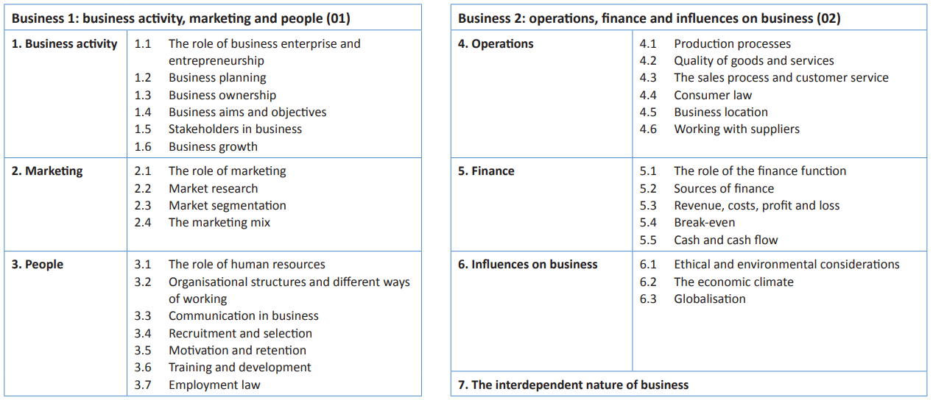

Slide 4
How you will be assessed …
Two written papers: 1 hour 30 minute exam each and both have 50% weighting.
Each paper is split into two sections:
  Section A contains multiple choice questions
  Section B includes short, medium and extended response style questions which use stimulus material that draws on real business contexts.

Slide 5
Do you need to be good at maths to study business?
Around 10% of marks from the two exam papers will consist of maths related questions in the context of business, so being confident in your mathematical ability is beneficial.
The business course requires the study of finance and therefore being comfortable with numbers is essential.

Slide 6
The key skills you will develop by taking business
An interest in business and entrepreneurial skills.
Connections between theory and practice so that you are able to apply your understanding of business to real-life organisations.
Making an informed approach that will help you to evaluate choices and decisions about your own future working lives.

Slide 7







