Slide 1

STATISTICS
MRS ELLIS

Slide 2

WELCOME
Hello pupils and parents and welcome to my Statistics Option PowerPoint.
I hope this gives you all the information that you need to decide whether or not you would like to take my subject as one of your options.
My subject is one that many just think is Maths, hard and boring but please let me remove these misconceptions by guiding you through what Statistics is and its benefits.
You will surprised just how much you use it.

Slide 3
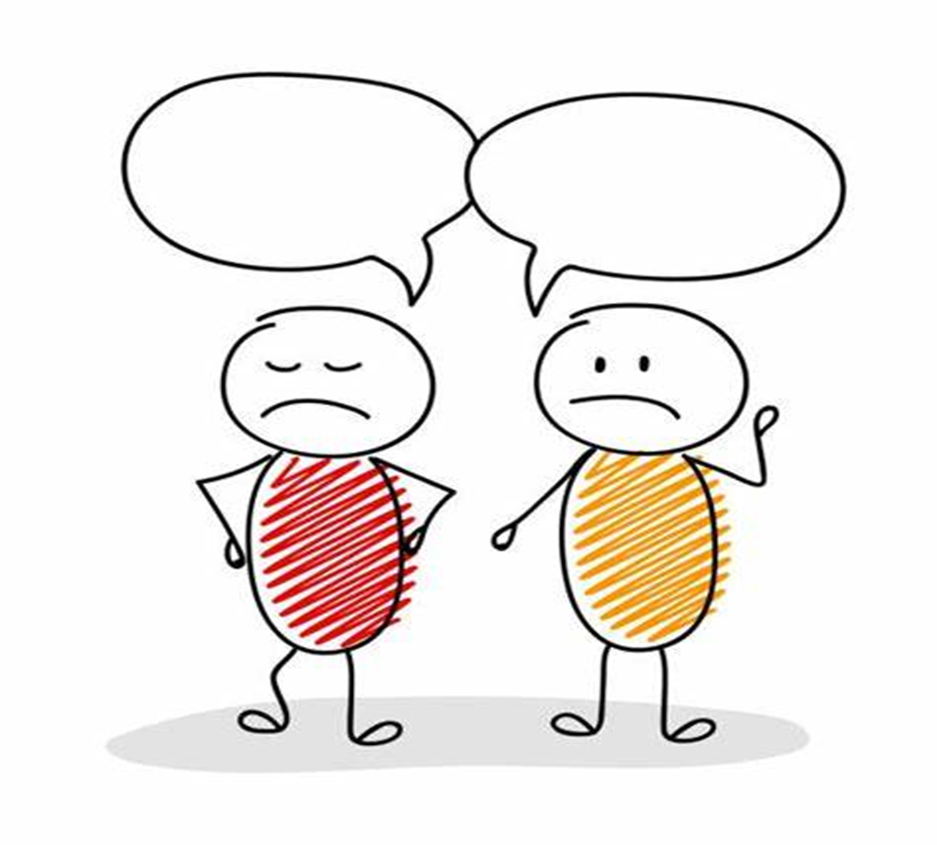
STATISTICS
What do you do when you see a lot of numbers, charts and the word, statistics? You very well may ignore them. But not today!
Well rest assured by taking Statistics these questions will not be spoken anymore as everything you will learn is related to the real life applications.
By taking Statistics as an option you will see how it is used to make decisions that affect our daily lives and the knowledge of statistical methods will give you a better understanding of how they affect you.
No matter what line of work you select you will find yourself faced with decisions where an understanding of data is helpful.
How many times do you here yourself say
Why do I have to learn this?
When am I ever going to use or need this?

Slide 4
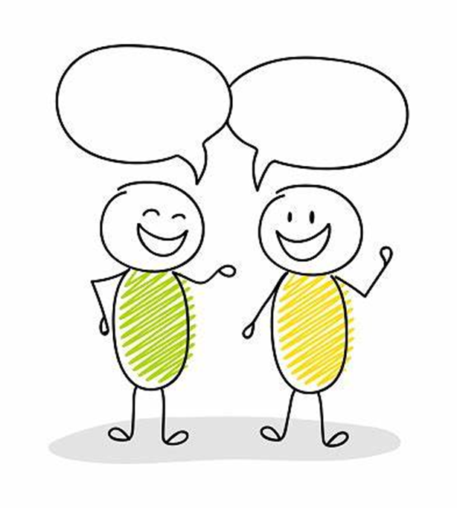
STATISTICS
The majority of pupils think what are the uses of statistics in our daily life.
They also want to know the importance of statistics in our daily life.
Today, I am going to tell you what the uses of statistics in our daily life and about the education and job scope of statistics.
What job can I do with this?
Will this help with other subjects?

Slide 5
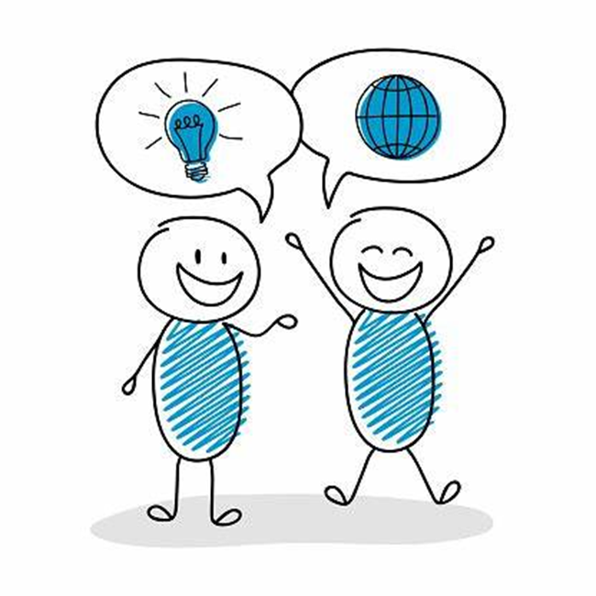
UNDERSTANDING STATISTICS
You've heard that today we live in the Information Age where we understand a great deal about the world around us. Much of this information was determined by using statistics.
When used correctly, statistics tell us any trends in what happened in the past and can be useful in predicting what may happen in the future.
Studies show human mind tend to understand things easily when it is presented with the help of data and visual aids.
In this information world, the role of statistics is undeniable and it is increasing day by day.

Slide 6
WHAT WILL I DO IN STATISTIC LESSONS?
Learning Statistics involves collecting, organising, presenting, analysing and interpreting data to assist in making more effective decisions.
Teaching happens by individual and group work activities, we look at using data and investigating in a wide variety of fields, by applying statistical and mathematical knowledge to social, economic, medical, political, and environmental problems.
You will be taught about the concepts of logic, reasoning, evaluating and research methods by practical, as well as a strategic approach to work and a accuracy to detail. It allows you to join the dots of a problem and give a solution, which is notable based on intuition but backed up by real logical reasons from the data.
Taking Statistics will give you effective oral and written communication skills, the ability to influence others and strengthen your employability skills.

Slide 7
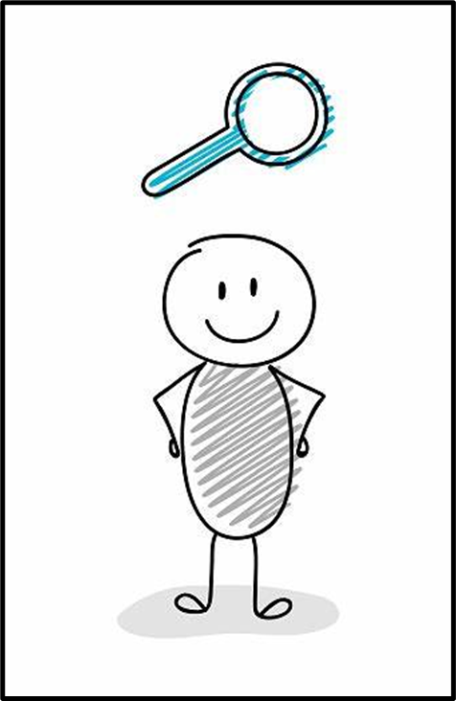
WHAT WILL I DO IN STATISTIC LESSONS?
The way I teach statistics is by focusing on real life events to make it much more enjoyable and interesting.
By doing this pupils are engaged and can see what and why they are doing the tasks.
We look at actual data and topics that everyone uses or comes across at some point in their life through social, education or careers, of which we discuss whilst working on each one to enhance knowledge.
It makes learning more accessible for all and easy to grasp.

Slide 8

SOME OF THE THEMES WE INVESTIGATE
Housing
Advertising
Nutrition
Olympics
Weather
Crime
Employment
Travel & Tourism
Recycling
Grades & UCAS
Music
Movies

Slide 9
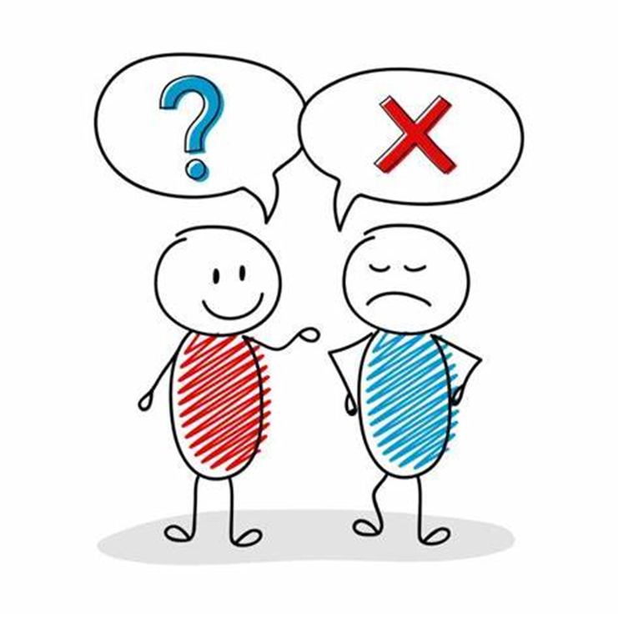
IS STATISTICS RIGHT FOR YOU?
If you think you need to be in top sets Maths, it’s not the case, although maths is involved because numerical information is everywhere and formulas are used it isn’t just all about the maths, its more fun than that!
If you appreciate problem solving and decision making
If you enjoy subjects that have a clear relevance to the working world you will find statistics very rewarding
If you want to develop varied Employability skills this is the subject for you

Slide 10
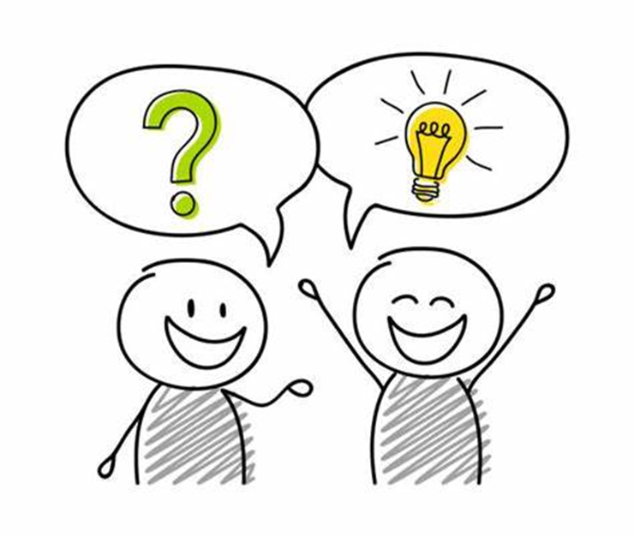
IS STATISTICS RIGHT FOR YOU?
Statistics is useful for pupils who are planning on taking GCSE in Geography or Business Studies because these subjects also require you to handle and interpret statistics.
Pupils going on to study subjects including Science, Geography, Social sciences, Psychology, Business, Sociology, Sports and Economics at sixth form will find knowledge of statistics extremely useful.
Having a GCSE in this subject will greatly benefit those pupils considering a variety of career options, roles include finance, marketing, business, medicine, politics, and many more.

Slide 11
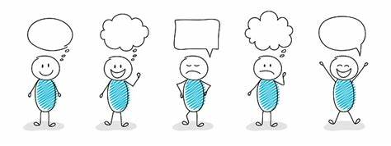
HOW DOES IT HELP MY EDUCATION AND CAREER?
In recent years, “Statistics” has become one of the best choices among pupils to choose, as Statistics are used in each and every career nowadays. It is a basic skill that can give you a competitive edge in any job and can prove invaluable.
The major driver of this growth is that our global society is becoming increasingly data-rich and data-dependent. And, there appears to be no apparent end to this growing need making it a solid and rewarding subject choice.
Recognised GCSE in further education and careers
More choices for education and jobs

Slide 12

FINALLY
So, that is the basis of Statistics and I hope your first impression of the subject has been changed for the better.
You can see how Statistics is beneficial for further education and many careers, due to its uses of everyday life and appeals to both male and female.
Statistics is classed as a higher level subject and many gain high level grades due to the broad components the subject offers, so works on all pupils teaching styles and strengths, all this will be an advantage on your CV
Lets hope I’ve encouraged you to get involved in and please feel free to contact me for anymore information.

Slide 13
Statistics in government is utilized by making judgments about health, populations, education, and much more.
2. Statistical concepts are used in quality testing. Companies make many products on a daily basis and every company should make sure that they sold the best quality items. But companies cannot test all the products, so they use statistics sample.
1. Statistics mostly used by the researcher. They use their statistical skills to collect the relevant data. Otherwise, it results in a loss of money, time and data.
4. Statistics is also helpful in emergency preparedness. With the help of statistics, we can predict any natural disaster that may happen shortly. It will help us to get prepared for an emergency.
3. Everybody watches weather forecasting, computer models compare prior weather with the current weather and predict future weather.
6. News reporter makes a prediction of winner for elections based on political campaigns. Here statistics play a strong part in who will be your governments.
5. Statistics play a big role in the medical field. Before any drugs prescribed, scientist must show a statistically valid rate of effectiveness. Statistics are behind all the study of medical.
7. Everybody has some kind of insurance, whether it is medical, home or any other insurance. Statistics calculate the risk of giving insurance.
8. Statistics are widely used in consumer goods products. The business use statistics to calculate which consumer goods are available in the store or not and when to ship the products.
10. Every sports require statistics to make the sport more effective. Statistics help the sport person to get the idea about his/her performance in the particular sports.
9. In financial market. Statistics are the key of how traders and businessmen invest and make money.

Slide 14
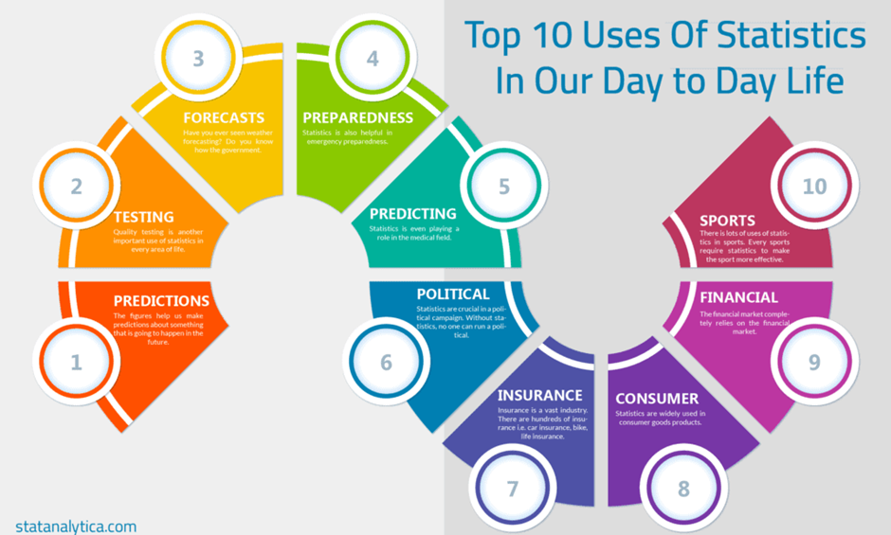

Slide 15
THANK YOU
MRS ELLIS

