Slide 1
GCSE Option Subject
Design & Technology
Food Preparation and Nutrition
Mr Allon

Slide 2
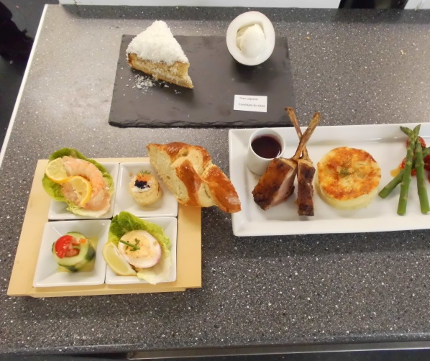
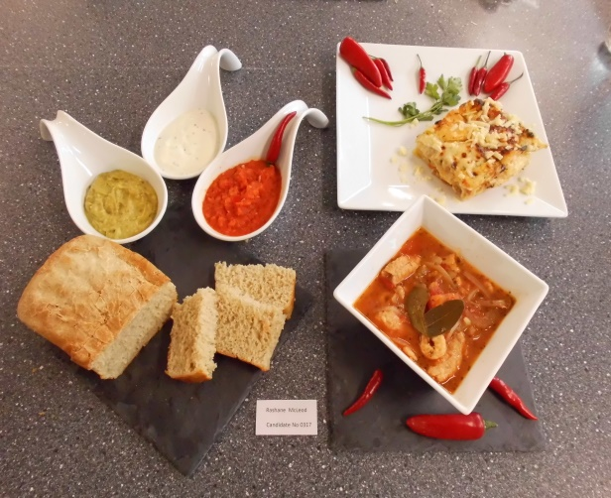
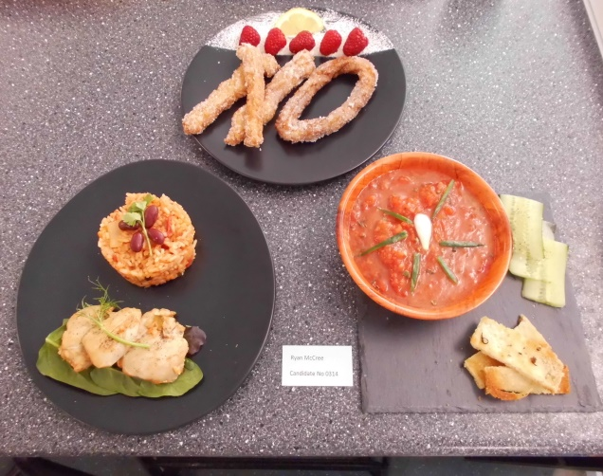
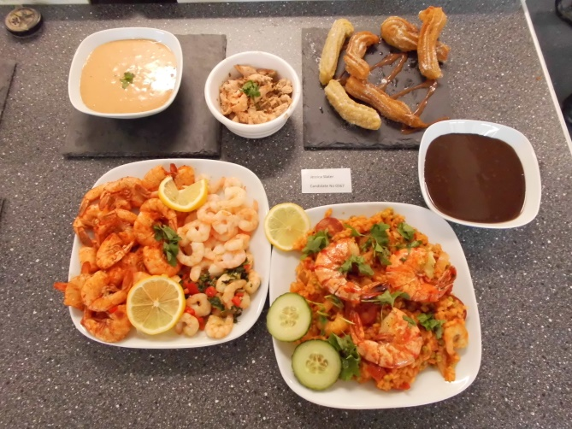
What is DT Food Tech ?
The Food Preparation and Nutrition GCSE is designed to develop cooking skills and learn about ingredients and cooking techniques. Subject areas include; diet and Nutrition, Food Science, Food safety, Food Choice and Food Provenance. You will have the opportunity to make dishes from around the world as well as gain an understanding of the main issues surrounding food preparation.
Images of student work – Mediterranean Cuisine

Slide 3
Every year the theme of our Food Preparation task changes. This makes it very exciting as students need to research a specific culture and cuisine. They plan and make three dishes that show an understanding of ingredients as well as demonstrating a variety of cooking skills. The Images show student outcomes on the year that required dishes from a Mediterranean cuisine
Images of student work – Mediterranean Cuisine

Slide 4
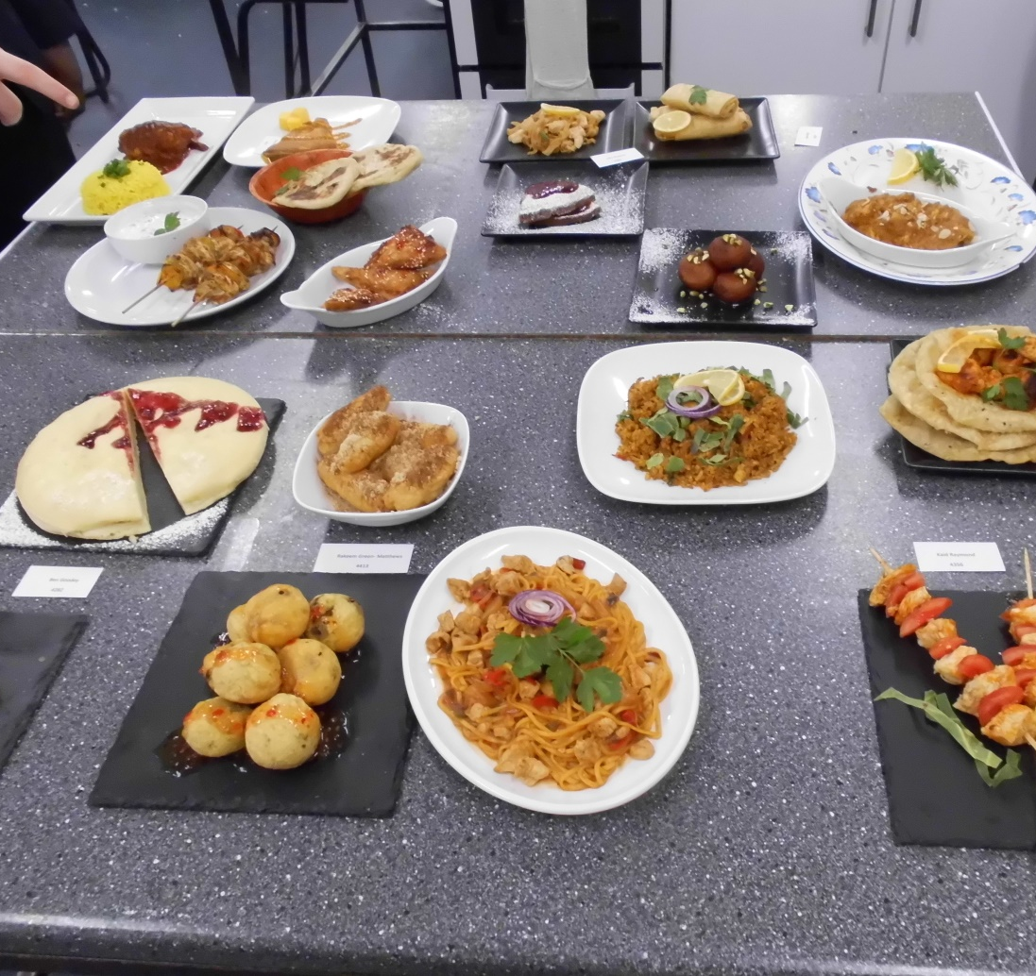
Photos of GCSE Work
In recent years the theme has included Asian cuisine, allowing students to make Chinese or Indian or Thai food. We had students making Japanese and Indonesian food. Last year was British food.
Evaluating outcomes at the end of the three hours..

Slide 5
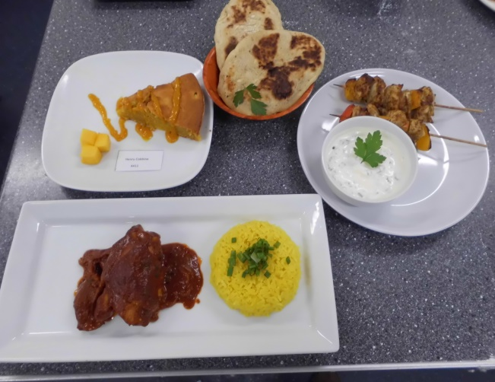
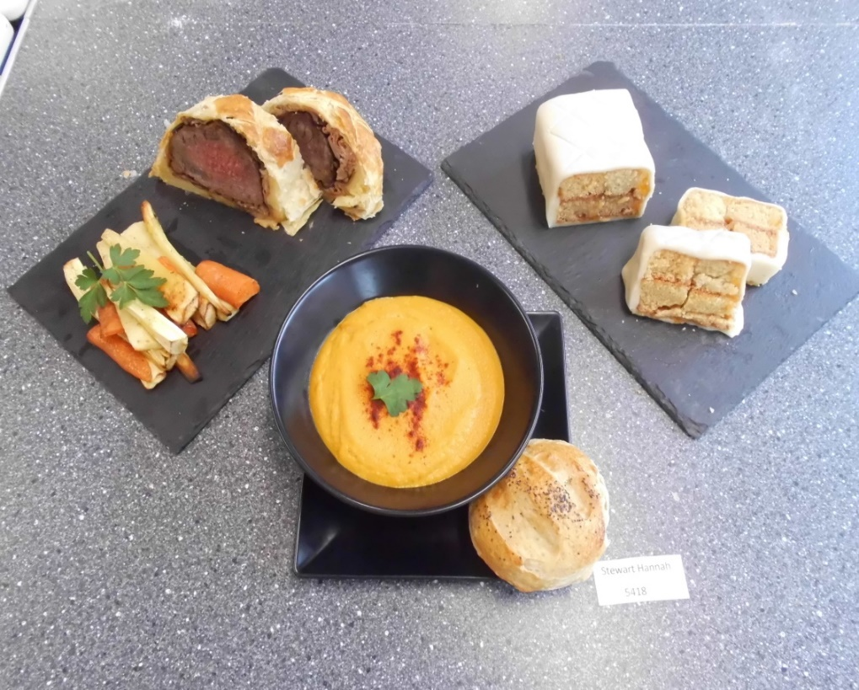
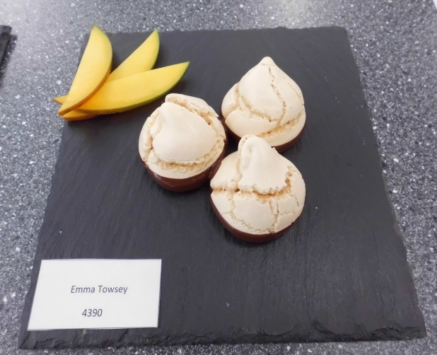
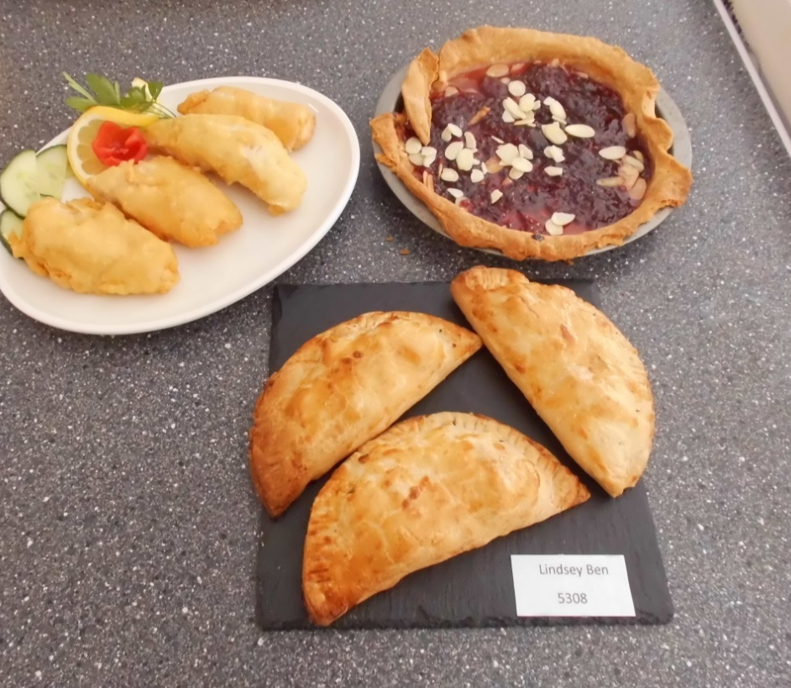
Students are encouraged to find recipes that interest them, whether they are savory or sweet, main course or desserts.
An example of British cuisine..

Slide 6
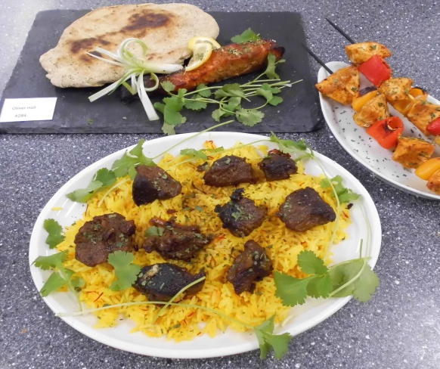
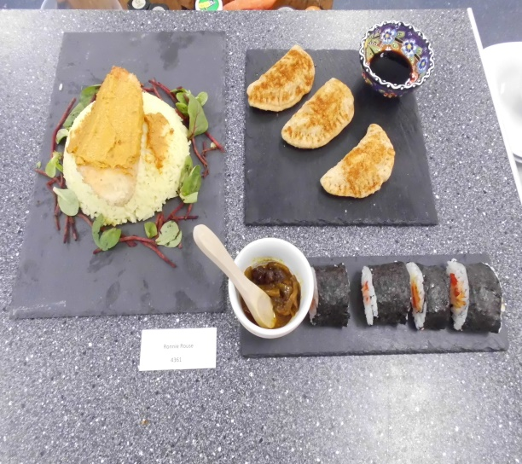
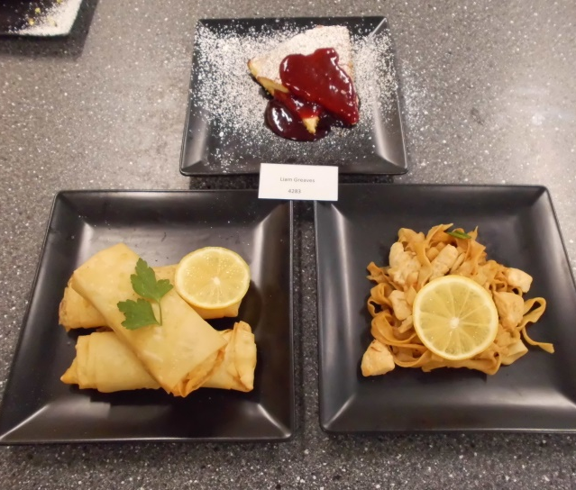
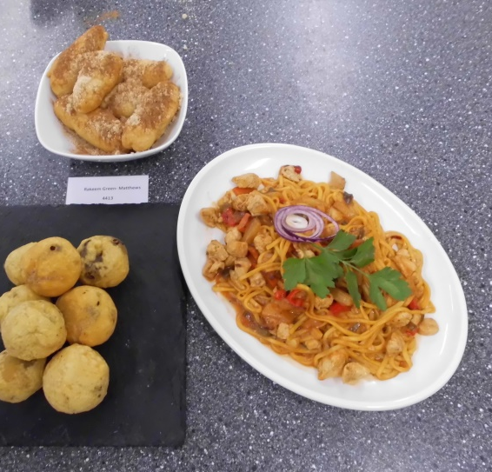
Examples of Asian cuisine

