Slide 1
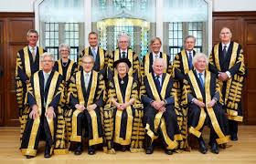
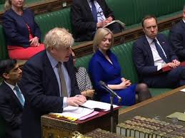
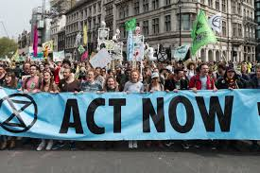
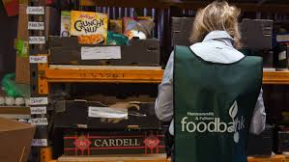
CITIZENSHIP STUDIES GCSE
What’s it all about?
Subject leader: Ms Hampton

Slide 2
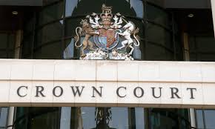

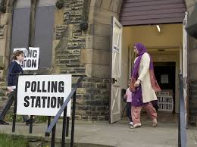
What is Citizenship about?
In a nutshell, Citizenship is about life in modern British Society. Pupils will learn about the main political and legal institutions that make up Britain, the fundamental principles and values that underpin Britain’s democracy, and what life is like for people living in Britain.

Slide 3
How is it assessed? The Citizenship Studies is 100% examination. The exam board is AQA.
Paper 1 | Paper 2
What’s assessed: Section A: Active Citizen Section B: Politics and Participation | What’s assessed: Section A: Life in modern Britain Section B: Rights and Responsibilities
1 hour 45 mins 80 marks 50% | 1 45 hour mins 80 marks 50%
Questions • Section A - Active citizen (40 marks) • Section B - Politics and participation (40 marks) • Question types: multiple-choice, short answer, source-based questions, extended answers. | Questions • Section A - Life in modern Britain (40 marks) • Section B - Rights and responsibilities questions (40 marks) • Question types: multiple-choice, short answer, source-based questions, extended answers.

Slide 4
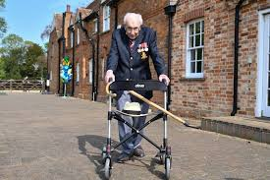
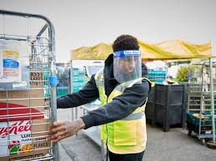
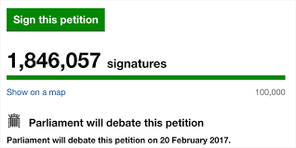
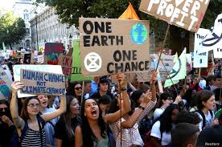
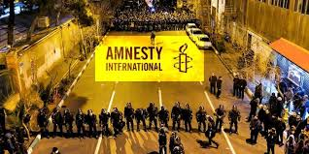
Paper 1, Section A: Active Citizen
In this section pupils will learn about the ways in which people can be active citizens in their communities. Pupils will learn about voluntary groups, pressure groups and other interest groups in society, and their role in providing services, being a voice for people, and challenging injustice. They will look at current and past examples of campaigns, and the methods people use to raise awareness of issues, and protest.
In year 11, the pupils will also undertake a Citizenship Investigation, which is their chance to research a citizenship issue of their choice and run a campaign to raise awareness, and influence a decision maker, such as an MP, to make a change. Examples of current campaigns are:
Increasing wages for Nurses
Ending trophy hunting
More funding for mental health services
Tougher sentences for carrying a knife
Protecting cancer treatment during lockdown
Introducing a living wage

Slide 5
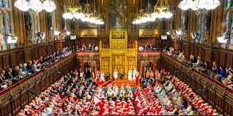
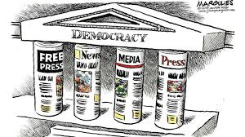
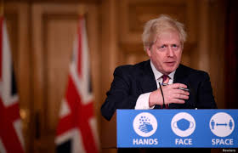
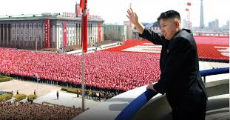

Paper 1, Section B: Politics and Participation
In this section pupils will be learning about the political institutions in Britain: Parliament, Central and Local Government, The Monarchy, The Civil Service, Elections and different voting systems and the regional governments in Scotland, Wales and Northern Ireland.
Pupils will Examine Britain’s Parliamentary democracy, and compare it to other democracies around the world, such as Switzerland’s direct democracy. They will also compare democracies to other forms of government, such as dictatorships.
Pupils will consider the role of citizens in Britain’s democracy, compared to citizens in non-democractic countries.
Examples of questions that we consider:
Should 16 year olds and prisoners get the vote?
What is the difference between a dictatorship and a democracy?
Should the monarchy be abolished?
Is there a problem with Britain’s democracy?

Slide 6

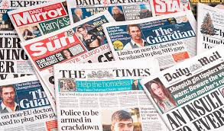
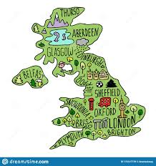

Paper 2, Section A: Life in Modern Britain
In this section pupils will learn about the different countries that make up Britain, and the different groups within them. They will explore issues of identity; individual, group and national identity. Pupils will also look at the role and influence of the media in modern British society, and how it’s used by citizens, and politicians.
Pupils will learn about Britain’s role in the wider world, through its membership of international organisations such as the United Nations, Commonwealth, and NATO. This includes Britain’s involvement in conflict resolution, through negotiations to military intervention.
Pupils will look at the fundamental principles and values that underpin British society such as equality, democracy, rule of law, individual liberty and tolerance and mutual understanding.
Examples of questions we consider:
When is conflict justified?
Why are some people radicalised?
What is Britain’s identity?
Is NATO relevant?

Slide 7
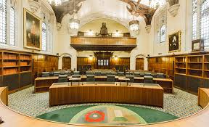
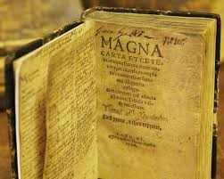
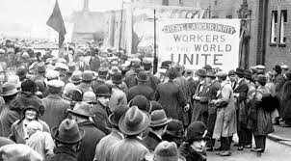

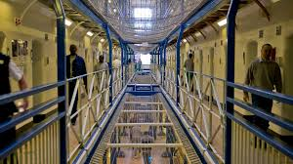
Paper 2, Section B: Rights and Responsibilities
In this section pupils will learn about the different rights and freedoms that people living within Britain are entitled to, and the role of the courts in protecting these rights.
The pupils will explore the purpose of the law, and the operation of the legal systems in the U.K., the role of which it is to enforce the law. They will also be looking at the different roles that people play in the legal system.
The pupils will also examine crime in the U.K. They will look at the usefulness and limitations of crime statistics, crime types, impact of crime, causes of crime, and also look at the journey of defendants through the criminal justice system. Pupils will consider the effectiveness of different punishments used in the criminal justice system in the U.K.
Examples of questions we consider:
Does Prison work?
Are human rights protected effectively?
How can we reduce violent crime?
Is pre trial detention fair?

Slide 8
Some skills that pupils develop
Critical thinking - Gathering, understanding and interpreting data. Using data to consider different topics, and draw evidence based conclusions. Learning to evaluate sources in the media by looking at their reliability, validity and bias.
Opinion forming - Considering different viewpoints on topical and current issues, and using a range of sources to help develop their opinions; verbally and written.
Active Citizenship skills - Research, enquiry, lobbying, campaigning, report writing, and working in a team.
Essay Writing skills - Writing balanced essays, which require pupils to construct reasoned evidence based arguments, and draw sound conclusions in their work.

Slide 9
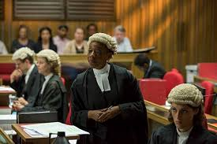
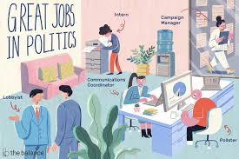
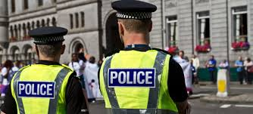
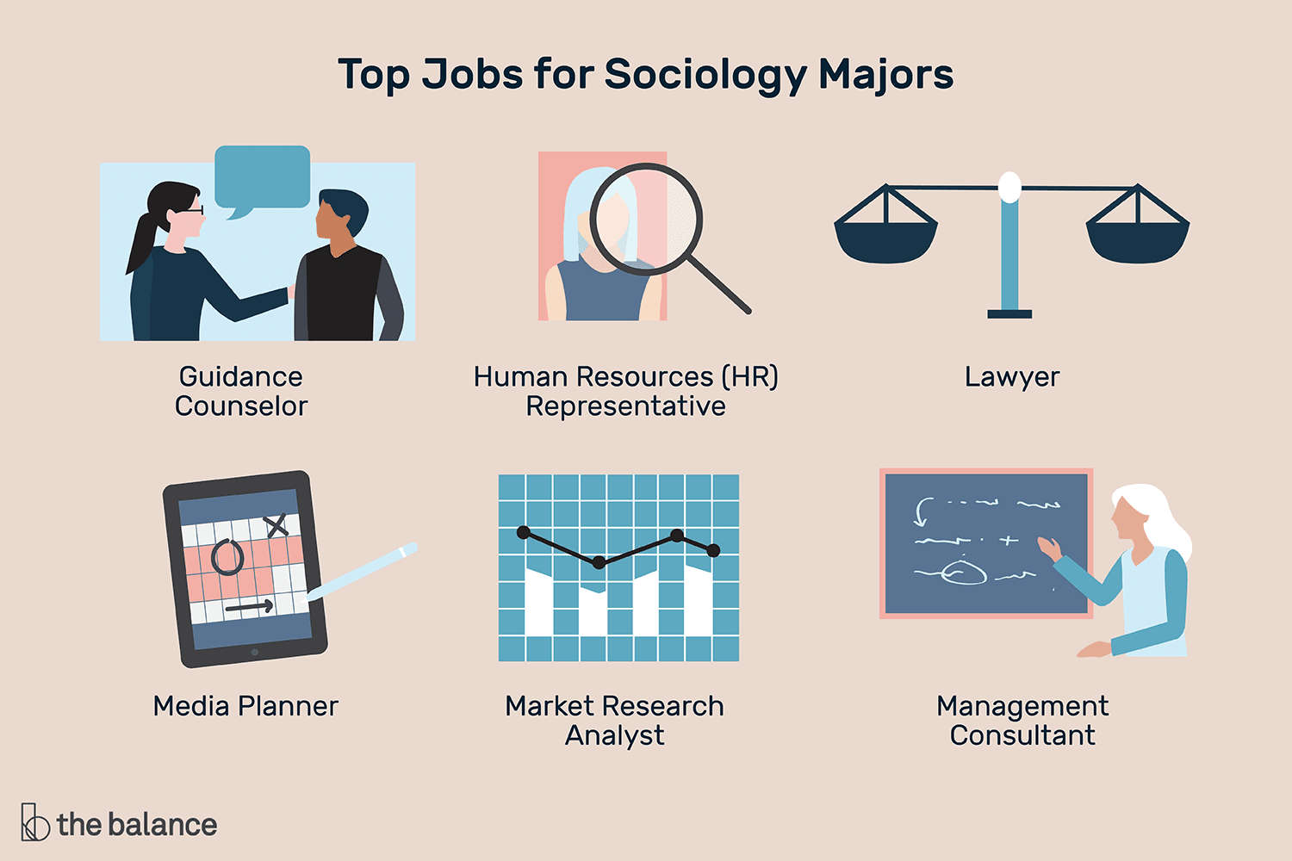
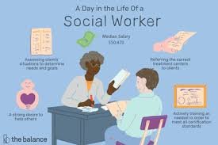
What about progression?
Many pupils who take Citizenship are interested in studying law or politics and entering jobs in those fields. Some pupils may have an interest in working in public sector roles, such as in social work, health and social care, and child care. Taking Citizenship may be part of a package of subjects which allows them to learn about society.
Citizenship Studies GCSE will most closely relate to the following A level subjects:
Politics and Government
Sociology
Law
Some former pupils went on to study the Level 3 BTEC National in Public Services, as they were interested in joining the police.

Slide 10
Questions to ask yourself...
Am I interested in society/law/politics/current affairs?
Am I interested in taking related subjects in College/Sixth form?
Am I interested in campaigning and active citizenship?
Will I enjoy the topics being covered?
If you answered yes to any of the above, Citizenship may be a good fit for you.
If you want to know more, find me to talk about the course, or take a look at the specification, that you can find here, AQA GCSE Citizenship Studies
Ms Hampton

