Slide 1

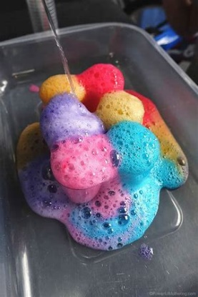
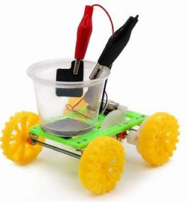
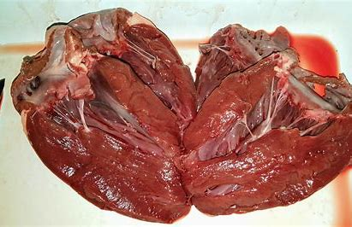
Separate Sciences

Slide 2
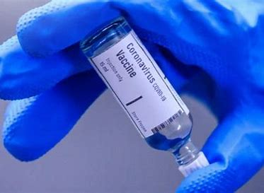



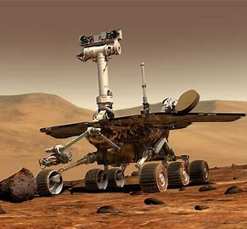
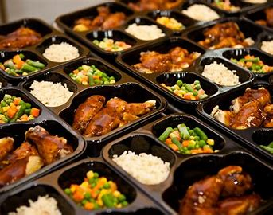
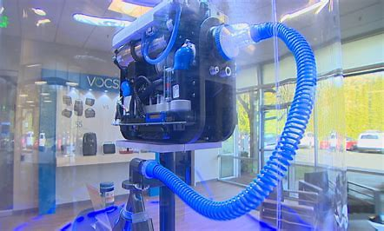




Slide 3
What is Separate Science?
You will achieve three separate science GCSEs:
Biology
Chemistry
Physics
These are all independent of each other.
If you do not opt for Separate Science you will achieve two GCSEs in Combined Science.

Slide 4
How is Separate Science different?
The work you cover is in greater depth and detail than in the Combined Science course.
You will also cover a wider range of topics.
Space
More chemical analysis
More about genetics and evolution.
In both courses you will do Required Practicals – but you will do more in Separate Science

Slide 5

Reasons for choosing Separate Science:
If you want to study A levels in any of the sciences you need Separate Sciences.
Learning transferrable skills required for other jobs and life activities.
Separate Sciences are highly regarded – whatever career you choose to follow.
If you enjoy science – it’s a fun and challenging subject!

Slide 6

But ……….
It is a lot of work!
You will spend seven hours a week
studying science.
It is very academic and demanding.
You will have extra physics formulae to learn.
You will have extra practical tasks to complete and learn.
You will have a lot of content to learn and revise.

Slide 7
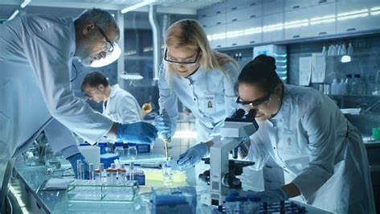
What do we expect of Separate Scientists?
Curiosity about the world around you.
Determination.
Commitment.
A genuine interest in science!
Enquiring mind.
Good manipulative skills.
Be able to work independently and as part of a team.

Slide 8
What opportunities will you have?
Trips:
Science Live
Medical Day
Science Ambassadors:
Help out or teach classes practicals in Science Week.
Teach primary school pupils (Langtons, Ardleigh Green).

Slide 9
Our success rate:
100%
Last year’s results:
Biology grade 4 +
100%
Chemistry grade 4+
100%
Physics grade 4+

Slide 10
What are previous Separate Science students doing now ……
Research physicist at CERN.
RAF – learning to be a pilot.
Vet
Midwife
Doctor
Dentist
Engineer
Computer games designer
Physiotherapist
Chemical engineer
Science teacher!

Slide 11
Any questions ……
You can gmail me any questions you may have.
You can contact your science teacher.

