Slide 1
Year 9 Options Presentation
March 2021
GCSE Photography
“Photography is a language more universal than words”
Minor White

Slide 2
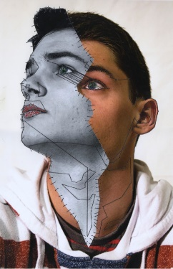
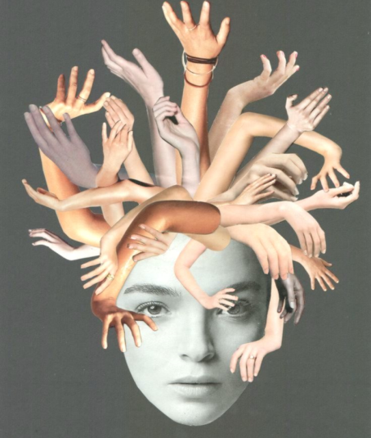
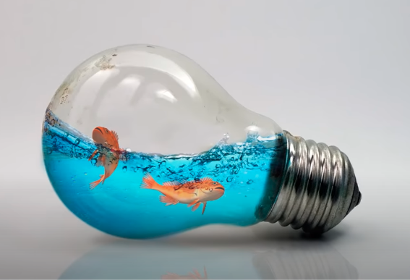
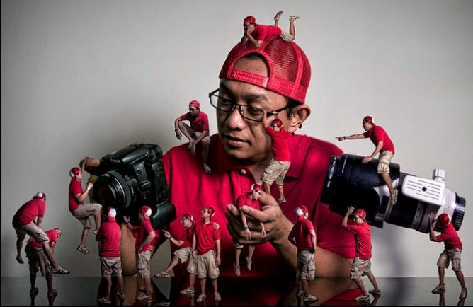
Some sample photography and Photoshop techniques you could be learning…

Slide 3
Why Study GCSE Photography
Photography is about looking, learning, thinking and communicating ideas.
It inspires creative thinkers. Photography means ‘drawing with
light’ and that is what photographers do when they take a picture.
Many photographers have explored various techniques to create images that make a personal statement about things that have interested or concerned them.
The most exciting aspect of photography is that you are capturing the world as you see it.

Slide 4
AQA GCSE Photography at EPA -1
Photography is a fun but technical subject.
You will gain numerous soft skills such as planning, analysing, researching and evaluating as well as verbal and visual communication skills.
You will master how to use your camera in manual mode.
You will learn compositional techniques so you can take great images.
You will be taught how to use the industry standard image manipulation software - Adobe Photoshop.
Student will have an Adobe Photoshop subscription to use both at home and in school.

Slide 5
AQA GCSE Photography at EPA -2
The department has cameras, soft and strobe lights, tripods etc for you to use.
As a photography student, you will be expected to purchase your own camera however this is not a necessity.
If you need to purchase a camera, speak to your teacher for the best advise.
Your photography teachers are required to supervise your coursework to confirm that it’s you who did it.
Your Photography grade will normally begin to evolve towards the end of year 10.
So, plan to put in as much effort as possible during year 10 before all the pressures and anxieties kick in at the start year 11.

Slide 6
GCSE Photography – course outline…
Photography like Art is amongst the few remaining coursework only subject. So if you keep up with your coursework and complete it to a good standard, you should be able to pass it with flying colours.
Coursework projects – account for 60% of the overall grade.
Externally Set Task - account for 40% of the overall grade.
It is important for you to keep up with your Photography coursework; which will include homework, class teacher set tasks, as these will ultimately make up your coursework.
Photography has no written exam; however, you do get a project Set Task from AQA which will normally starts in January of your year 11 to complete by end of March.

Slide 7
GCSE Photography – assessment objectives…
There are 4 assessment objectives:
A01 – Research and Develop
A02– Experiment and Refine
A03 – Recording Ideas and Observations(with your camera)
A04- Making Connections with artists and showing understanding
You will be required to meet these assessment objectives in all of your coursework projects and Externally Set tasks.
You will normally be expected to complete 2 Coursework projects and 1 Externally Set Task.

Slide 8
Externally Set Assignment – 10- hour exam
Externally Set Assignment will account for 40% of the overall course grade.
This is the exam and it's set by the exam body; in our case AQA.
Here you will be responding to a starting theme set by AQA. You will have 7 choices to chose from and must choose only one theme.
The exam preparation normally starts on the 4th January after your year 11 Christmas break and the 10 hour exam will take place around March.
You have about 10 weeks to prepare for this exam by completing a project folder and final edit.
You will be required to do a 10-hour final edit in exam conditions spread over two days. i.e. 5 hours on each day.

Slide 9
GCSE Photography projects we currently do…
The Assembled project – this project is normally accompanied by a trip to Colchester zoo.
The Creative Landscape project – this project is normally supported by a trip to Central London to photograph the London cityscape.
The Out of Place Surreal project - this project is normally supported by a trip to the Tate Modern gallery.
We also have a wide array of starting themes from past AQA Photography exam papers that we can tailor to match your unique skills as individual students.

Slide 10
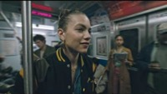
Photography and Photoshop techniques you might learn to use … Thanks for watching and good luck with your choices. Mr Sunday.

