Slide 1
Year 9 Options Presentation
March 2021
GCSE Art and Design
“Art is the oxygen that makes all other subjects breathe”
Alan Parker Filmmaker

Slide 2
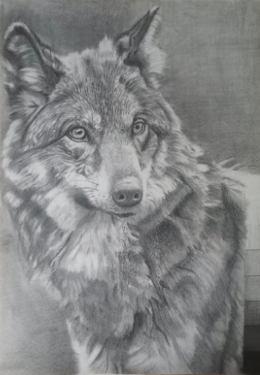
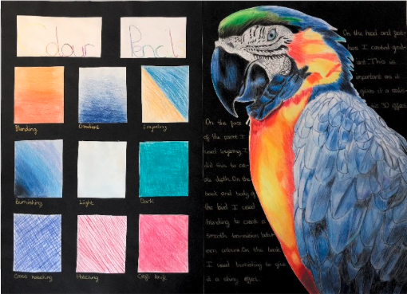
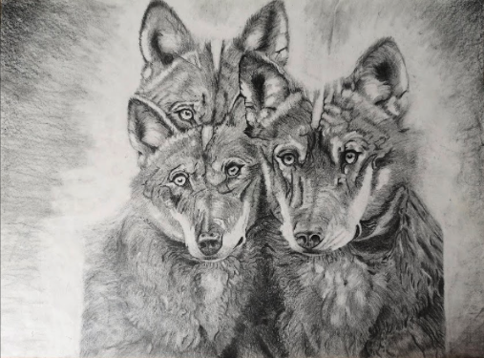
Some sample student GCSE artwork

Slide 3
GCSE Art and Design
Is amongst the few remaining coursework only subject. So if you keep up with your coursework and complete it to a good standard, you should be able to pass it with flying colours.
Coursework projects – account for 60% of the overall grade.
Externally Set Task accounts for 40% of the overall grade.
It is important for you to keep up with your Art Coursework; which will include homework, class teacher set tasks, as these will ultimately make up your Coursework.
Art has no written exam; however, you do get a project Set Task from AQA which normally starts in January of your year 11 to complete by end of March/ April.
Notes:
Is amongst the few remaining coursework only subject. So if you keep up your coursework and do it to a good standard, you can not fail.

Slide 4
How is Art assessed?
There are 4 assessment objectives:
A01 – Research and Develop
A02– Experiment and Refine
A03 – Recording Ideas and Observations
A04- Making Connections with artists and showing understanding
You will be required to meet these assessment objectives in all your Coursework projects and Externally Set tasks. You will normally be expected to complete 2 Coursework projects and 1 Externally Set Task.

Slide 5
GCSE Art Coursework
Coursework account for 60% of the overall course grade.
You will be expected to complete 2 projects over the duration of the two-year period, i.e., in year 10 and 11.
You will be taught a wide variety of media – which will give you grater confidence using any medium going forward in the course.
The course could be adapted to your current skills but must address the assessment objectives.

Slide 6
Externally Set Assignment – 10- hour exam
Externally Set Assignment will account for 40% of the overall course grade.
This is the exam and it's set by the exam body; in our case AQA.
Here you will be responding to a starting theme set by AQA. You will have 7 choices to chose from and must choose only one theme.
The exam preparation will normally starts on the 4th January after your year 11 Christmas break and the 10 hour exam will take place around March.
You have about 10 weeks to prepare for this exam by completing a project folder and final artwork.
You will be required to do a 10-hour final artwork in exam conditions spread over two days. i.e. 5 hours on each day.

Slide 7
GCSE Projects we currently do…
The very popular Animal project – normally
accompanied by a trip to Colchester zoo.
The Architecture project – again also supported by a trip to Central London.
We also have a wide array of starting themes from past AQA exam papers such as human form etc that we can use tailor to match your unique skills as individual students.

Slide 8
To Conclude…
Art is a fun subject but you must be prepared to work at home on your own and meet set deadlines.
You will be able to purchase an art kit with most materials that you will need to use while working at home for around £30.
Your art teachers are required to supervise your coursework so as to confirm that it’s you who did it.
Art rooms are normally open most evenings to all GCSE students.
Your art grade will normally begin to evolve towards the end of year 10 during the first year of your 2-year course.
So, plan to put in as much effort as possible during the first year before all the pressures and anxieties start to kick in year 11.

Slide 9
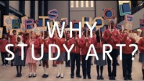
Find out why Art education is important from artists, young people and major cultural figures. Thanks for watching and good luck with your choices. Mr Sunday.
Notes:
https://www.youtube.com/watch?v=vKjkx6PzajE&feature=emb_logo

