Slide 1


BTEC Tech Award Level 2
Introduction

Slide 2

Component 1
Human
Lifespan
Development
30% of the total course
Internally assessed

Slide 3

Component 2
Health and Social Care Services and Values
30% of the total course
Internally assessed

Slide 4

Component 3
Health and Wellbeing
40% of the total course
Externally assessed

Slide 5

Component 1
Human
Lifespan
Development
30% of the total course
Internally assessed

Slide 6
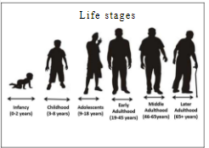
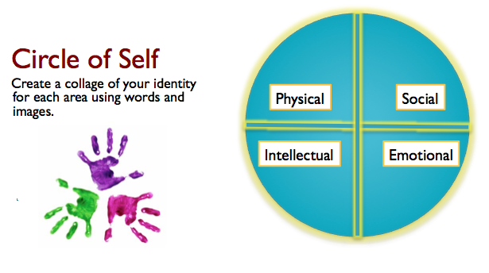
How
How people grow and develop throughout life.
Life Stages and PIES

Slide 7

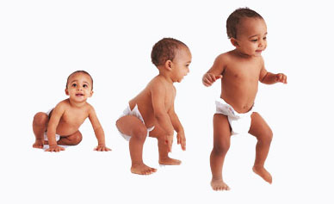
Factors that affect growth and development.
Physical, Social, Cultural, Economic

Slide 8

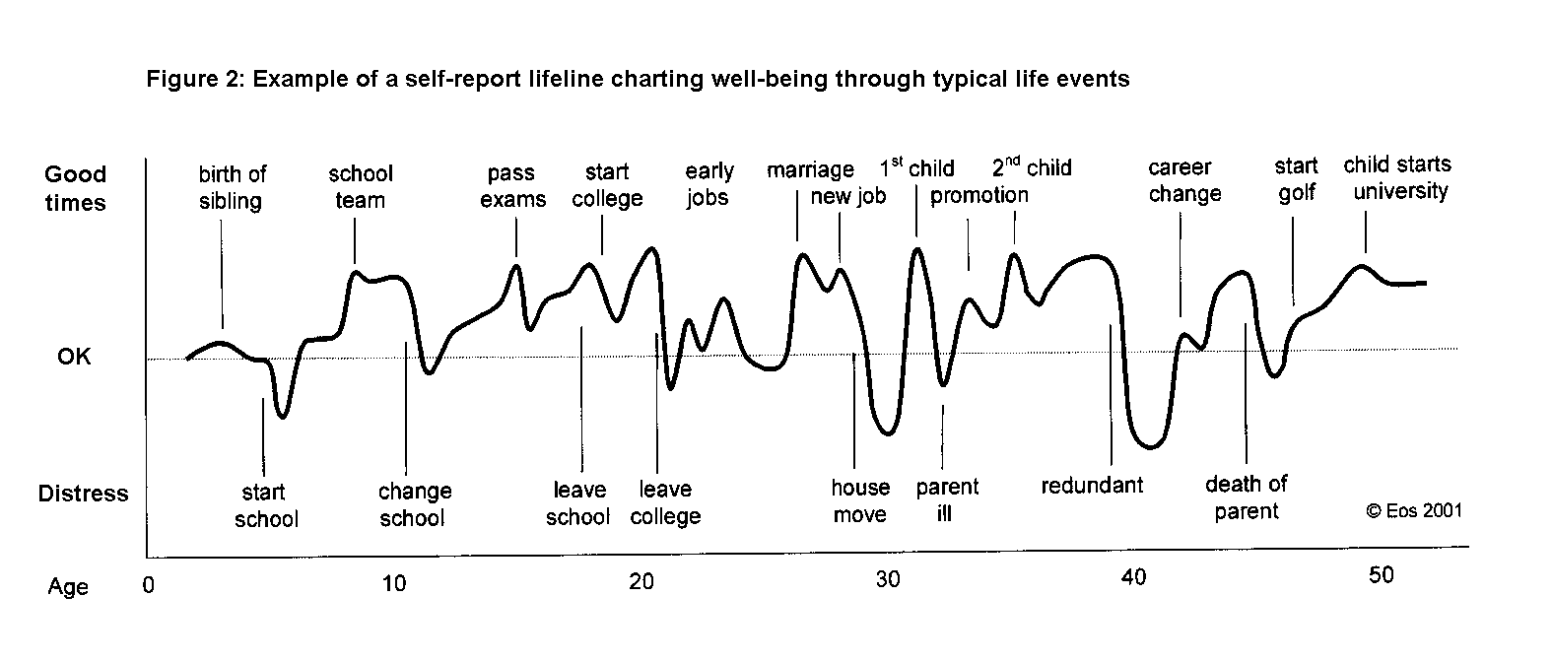
Different types of life event.
Physical events, Relationships, Life circumstances

Slide 9

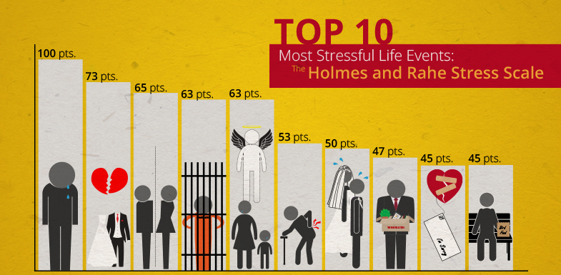
Coping with change caused by life events.
Sources of support and types of support

Slide 10



Component 1
Human Lifespan Development
Write a report about a person of your choice explaining how they have changed over the course of three life stages.
(Can be a celebrity.)
Choose two people who have experienced the same event and investigate how it affected them. (You will need to interview them).

Slide 11
Component 2
Health and Social Care Services and Values
30% of the total course
Internally assessed

Slide 12

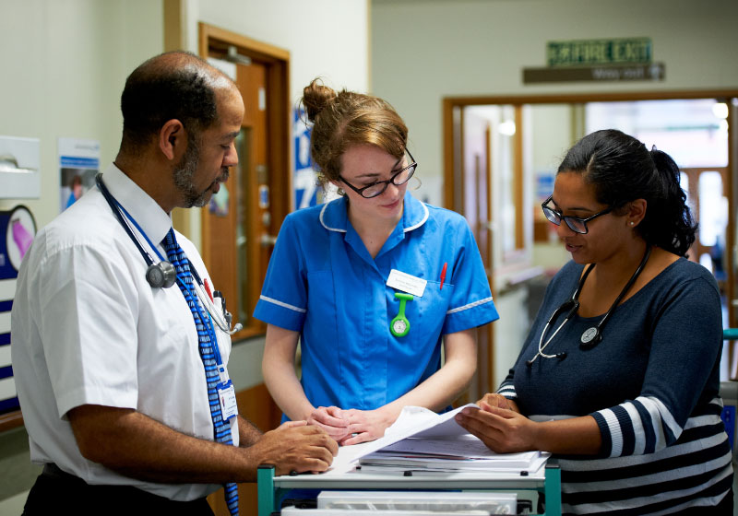
Health and Social Care Services
How services meet users’ needs

Slide 13
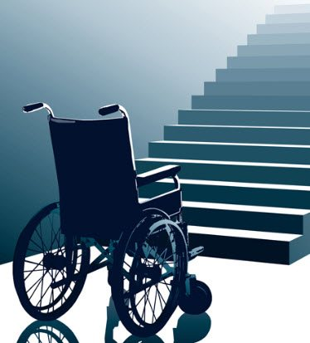

Barriers to accessing services

Slide 14
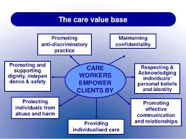
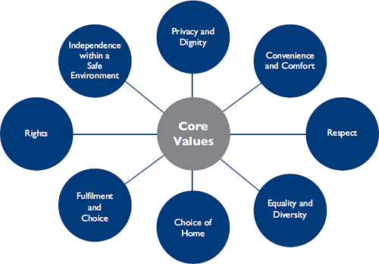
Care Values
Treating people with respect and ensuring they receive the correct care.

Slide 15
Component 2
Health and Social Care Services and Values
Review health and social care services in the local area and how they meet the needs of two people.
You must demonstrate your knowledge of the care values in two situations and review your performance.

Slide 16
Component 3
Health and Well-Being
40% of the total course
Externally assessed

Slide 17
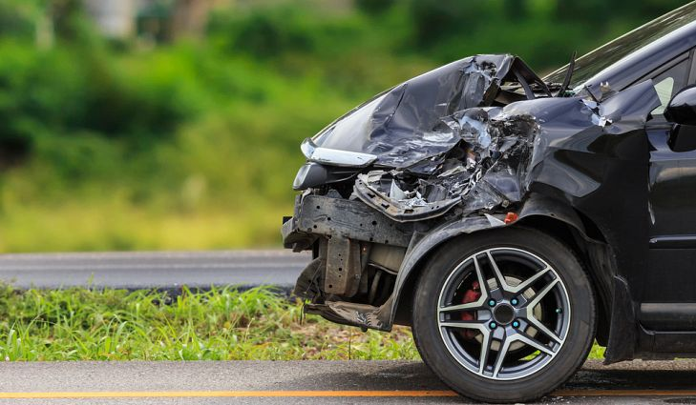
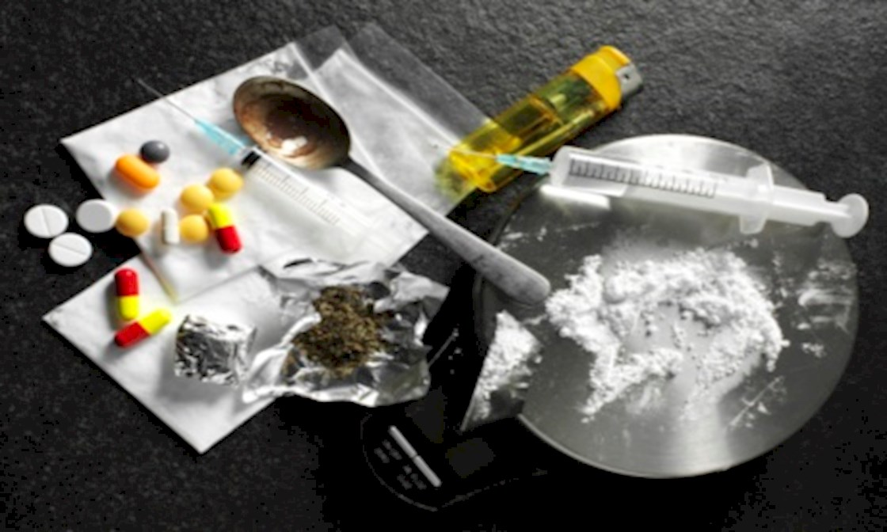
Factors that affect health and well-being

Slide 18
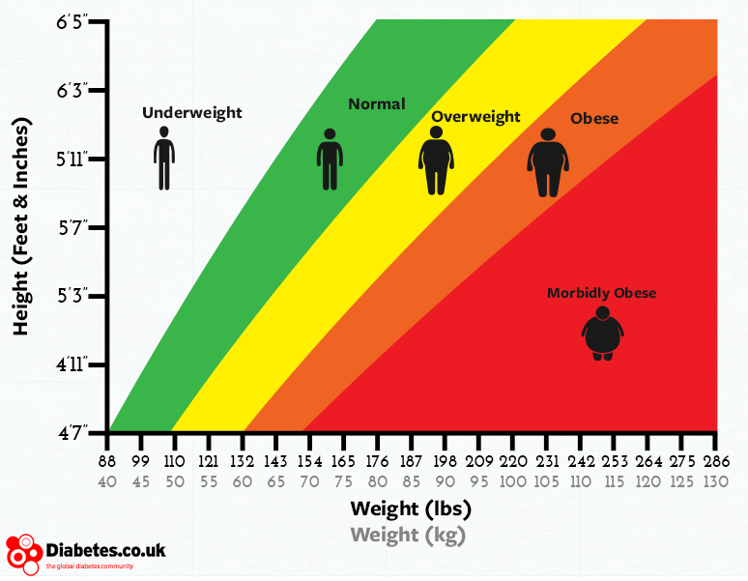
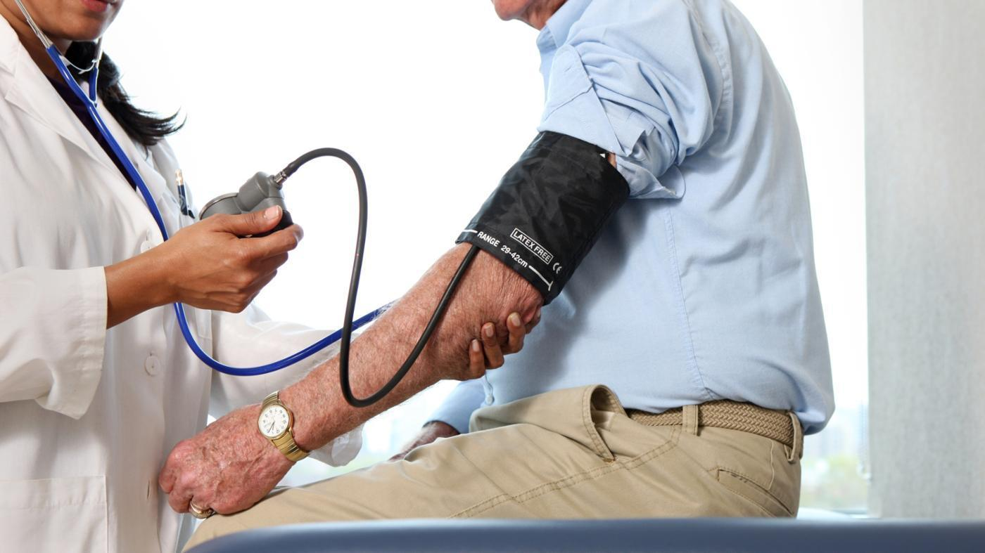
Health Indicators

Slide 19
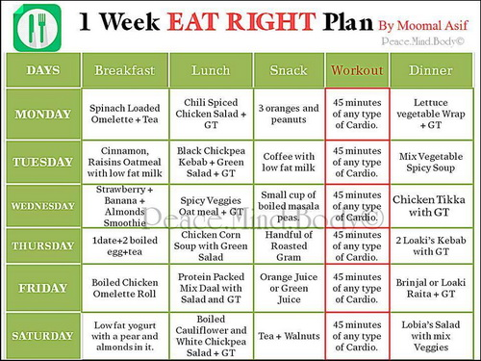
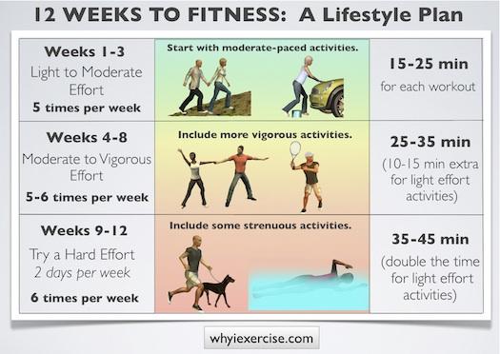
Health Improvement Plans

Slide 20


Component 3
Health and Well-Being
You will be set a case study whereby you have to assess an individual’s health and design an health improvement plan for them.

