Slide 1


GCSE Music at
Emerson Park Academy

Slide 2
Course Structure
Composition 30%
Free composition (15%)
Composition to a set brief (15%)
Your performances for both components must be a minimum of four minutes with at least one minute as part of an ensemble.
Your compositions for both components must be a minimum of three minutes long.
Performance 30%
Solo performance (15%)
Ensemble performance (15%)
Component 3: Listening and Appraising
Written exam 1hr 30 mins (40%)

Slide 3
Assessment Objectives:
Assessment Objectives
AO1
Perform with technical control, expression and interpretation.
AO2
Compose and develop musical ideas with technical control and coherence.
AO3
Demonstrate and apply knowledge.
AO4
Use appraising skills to make evaluative and critical judgements about music.

Slide 4
GCSE MUSIC IS 60% COURSEWORK
Coursework Part 1 - Integrated Portfolio.
Performance on
chosen instrument (15%)
Composition to a brief
set by you! (15%)
AO1: to be completed during
Year 11.
AO2: this can be completed at any
time during the course.
Submission:
A recording of both your performance and your composition
either live or computer generated
AND
A score or annotation FOR EACH ONE.
Component 1: Integrated Portfolio
Non-examined Assessment (30%)

Slide 5
GCSE MUSIC IS 60% COURSEWORK
Coursework Part 2 - Practical Component.
Ensemble Performance (15%)
marked out of 30
Board Set Composition (15%)
marked out of 30
Your performances for both components must be a minimum of four minutes with at least one minute as part of an ensemble.
Your compositions for both components must be a minimum of three minutes long.
Guidelines
Any genre and with any
group of your choice
Your part must not be
Doubled by anyone else!
Music must be provided
There will be a choice of four briefs
from each Area Of Study
Then choose a stimulus for your
starting point
You need to play to your strengths
Submission:
A recording of both your performance and your composition
AND
A score or annotation FOR EACH ONE
Component 2: Practical Component
Non-exam Assessment (30%)

Slide 6
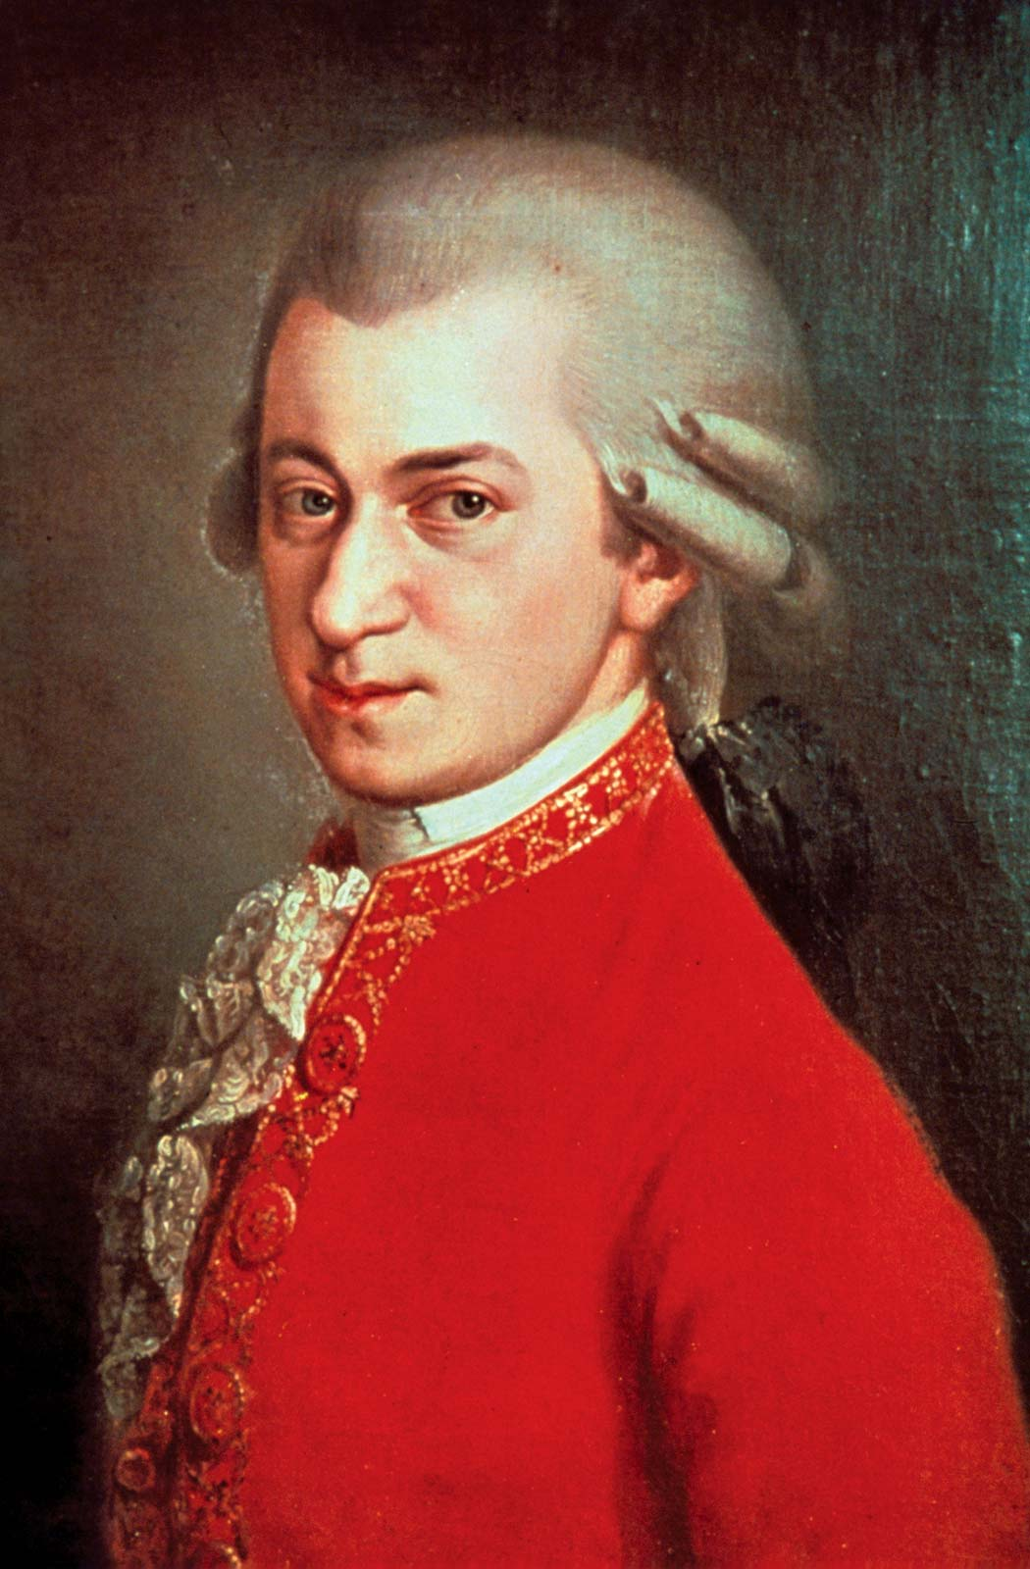
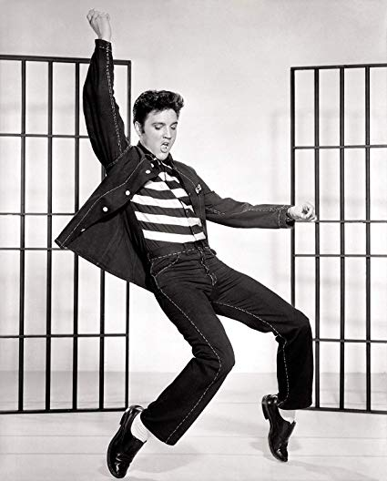

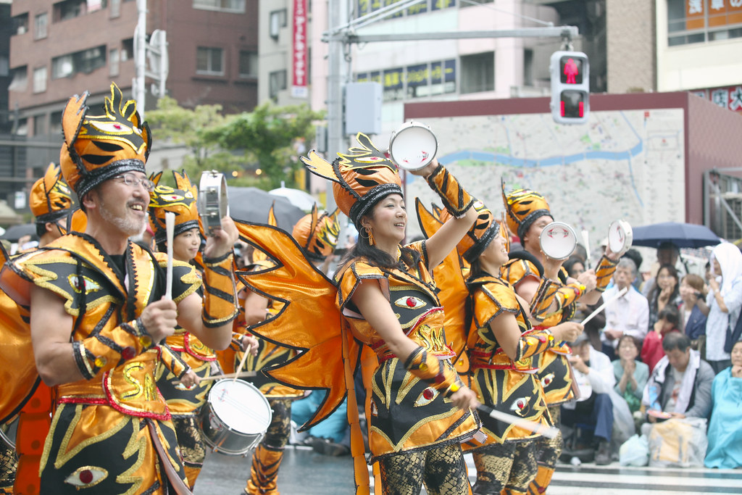
Listening & Appraising:
Areas of Study
1: My Music
5: Conventions of Pop
2: The Concerto Through Time
Areas of
Study
4: Film Music
3: Rhythms of the World
Component 3: Listening and Appraising
Written exam 1hr 30 mins (40%)

Slide 7
Which exam board?
OCR. You can have a look at the contents of the course here:
https://www.ocr.org.uk/qualifications/gcse/music-j536-from-2016/

Slide 8
Additional Information
You will be given premium accounts for the following online resources:
Soundtrap – a cloud based Digital Audio Workstation including 1,000s of instruments and audio samples to aid composition.
Focus on Sound – a huge online resource for music lessons and audio excerpts. In depth study, musical analysis, musical dictionary, music quizzes and much more.
Noteflight – a cloud based notation package, used by professional composers and arrangers to aid composition.

Slide 9
Additional Information – Instrumental Tuition
You will be given the option of having instrumental tuition on your chosen instrument. The cost of this will be covered by the school.
You will receive one lesson each week during school term time, lasting 20 minutes.
These lessons will help prepare you for your performances.

Slide 10
Frequently asked questions.
Do I have to perform in front of everyone? No. you can do it alone in a practice room, with just you and the recording equipment.
What happens if I make a mistake when I’m performing? It doesn’t matter. You can re-do it as many times as you like.
I really enjoy Music lessons at KS3 but will Music at GCSE be too difficult? If you really enjoy Music and are willing to work hard then it’s always worth the challenge!
Is Music all practical? The majority of the lessons are practical-based but there is an increased emphasis on developing listening skills.

