Slide 1

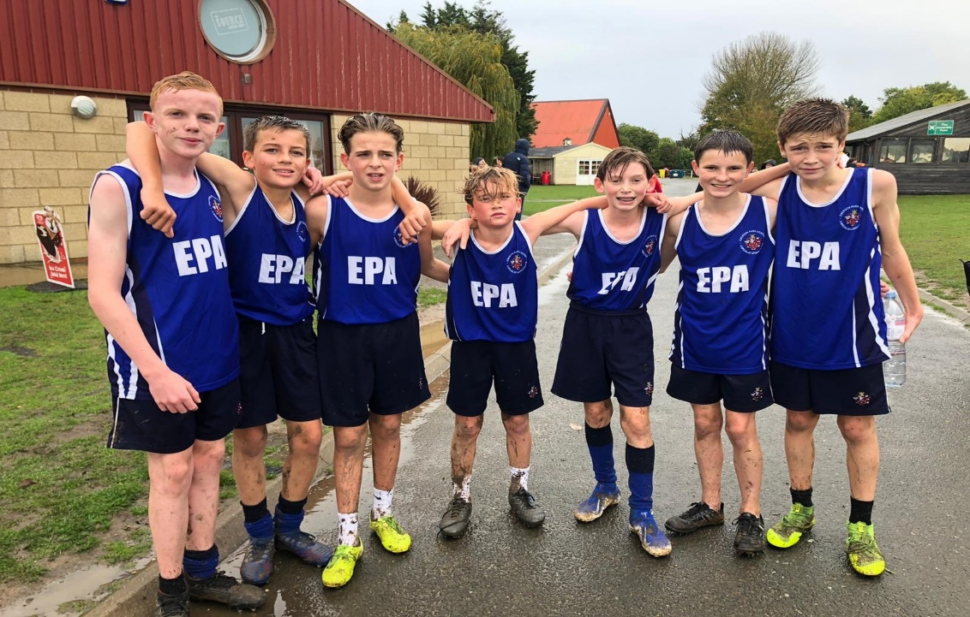
KS4 PE Options
Emerson Park Academy
Yr9 Options Process

Slide 2
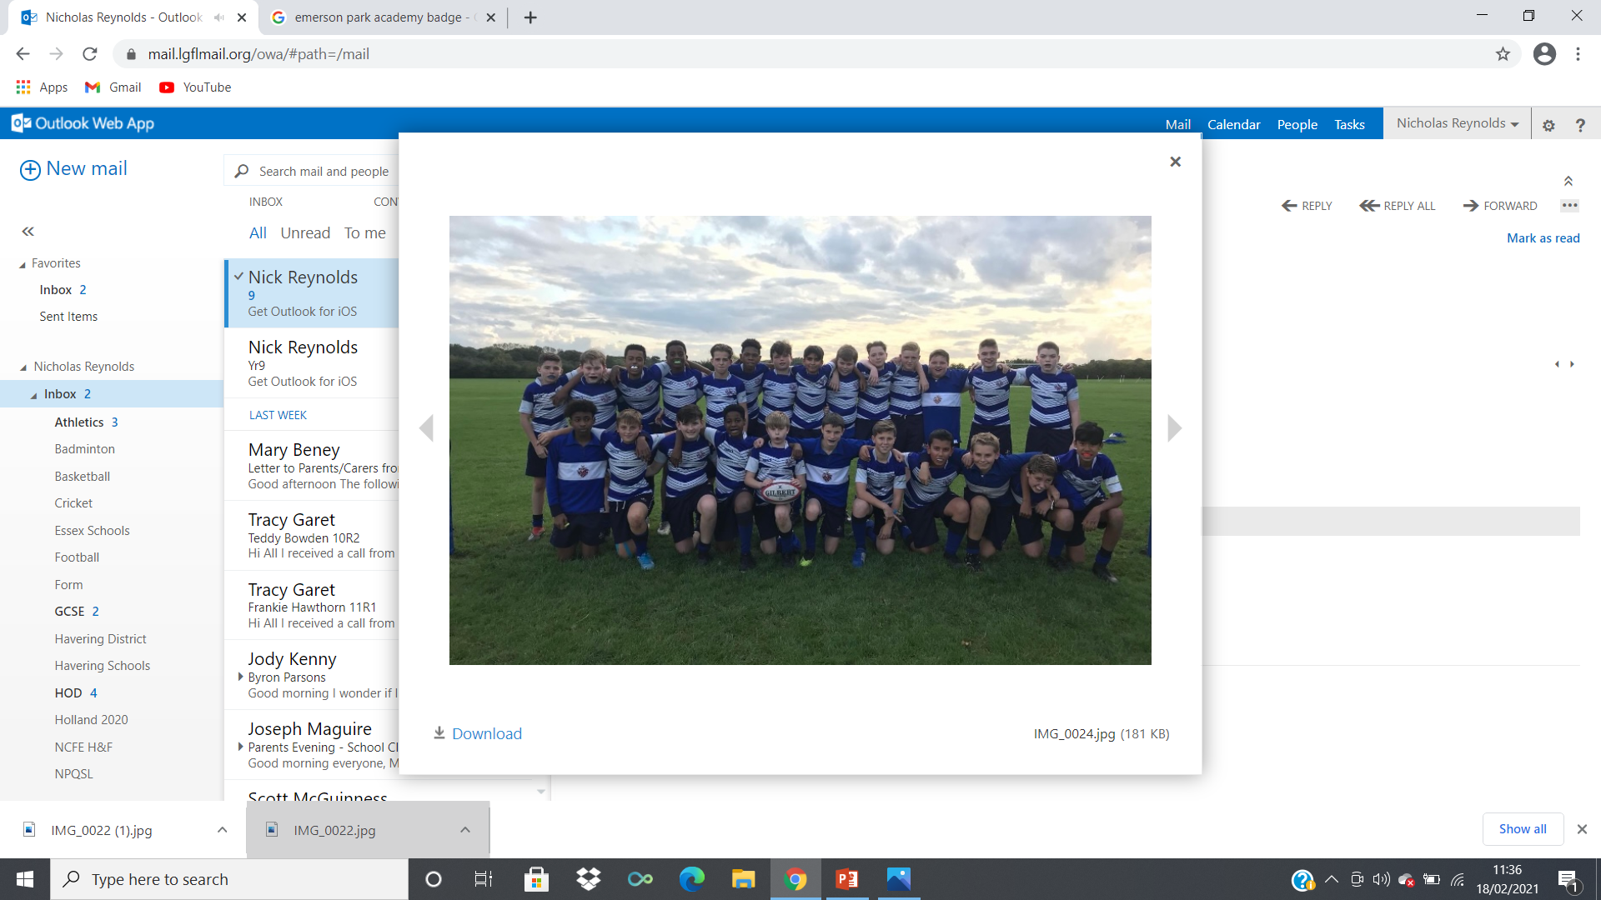
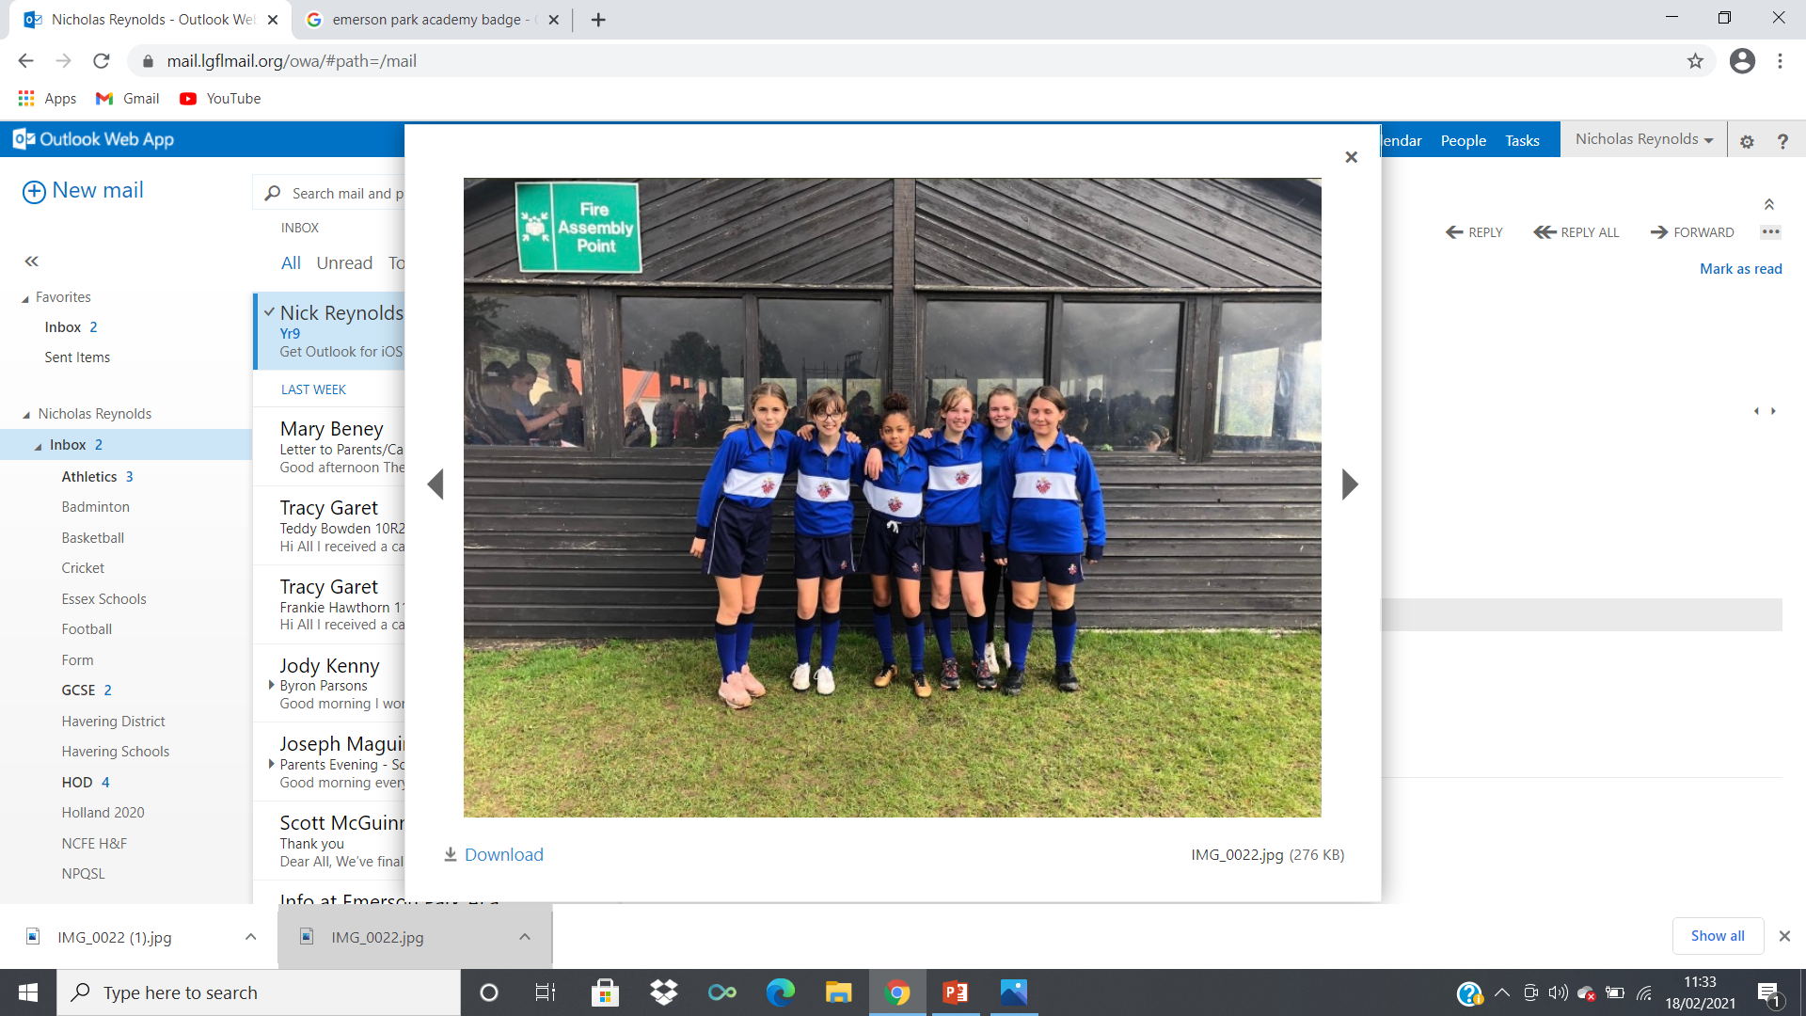
KS4 PE Options
Core PE
Health and Fitness
Sports Science

Slide 3
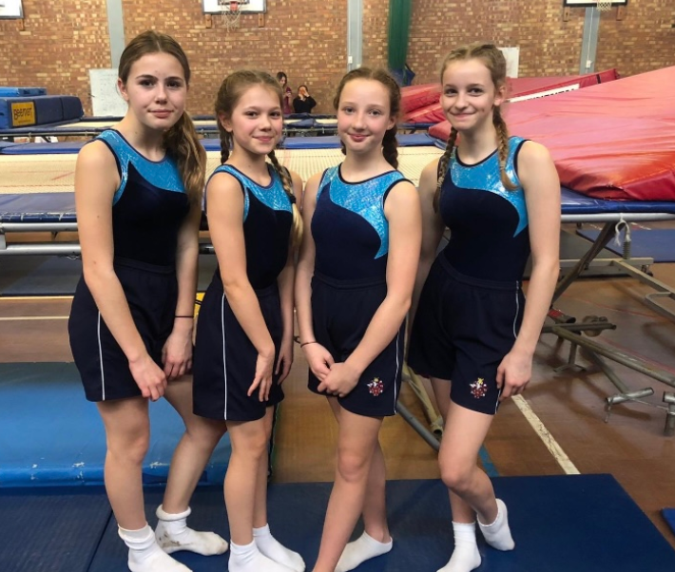
CORE PE
Everyone in Yr10 and Yr11 must do 1 hour of PE a week
Practical based, very similar to KS3
Inter House and other competitions
Only lesson you will not be getting graded in
Bring your kit and have fun!!!

Slide 4

Health and Fitness
VCert Level 1/2 - Graded Pass, Merit or Distinction
3 Hours per week: Mainly classroom based with some practical lessons based around fitness testing
Unit 1: Introduction to body systems and principals of training in health and fitness
1h30m Exam: 40% of final grade
Exam is in Yr10 – Opportunity to re-sit in Yr11
Unit 2: Understand how to test and develop components of fitness
Internal Synoptic Project: 60% of final grade
Exam board gives the title of the Project in December of Yr11
Learners must use knowledge gained from Unit 1 and 2 to complete project

Slide 5

Sport Science
GCSE with exam board OCR – Graded 9-1
3 Hours per week: 2 theory lessons in a classroom and 1 practical lesson
Exam Syllabus:
2 Exams: 60% of Final Grade
Exam 1: Physical Factors affecting Performance
Exam 2: Socio-cultural issues and Sport Psychology
Coursework: 10% of Final Grade
‘Action Plan’ based on how to improve fitness
3 Sports: 30% of Final Grade
Each sport is worth 10% of final grade

Slide 6
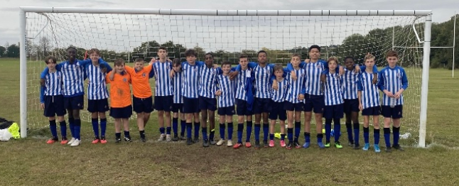
Any further information?
If anyone requires any further information regarding any of our PE options please don’t hesitate to get in touch
Parents – email info@emersonparkacademy.org
Students – See Mr Reynolds in PE office / Email on google apps

