Slide 1

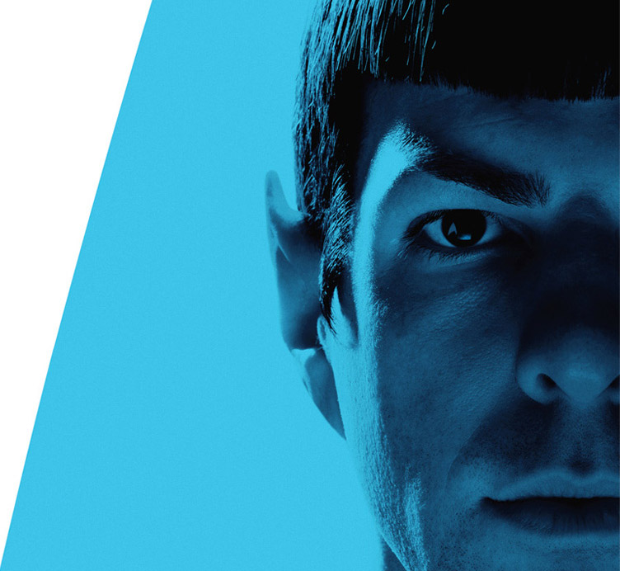
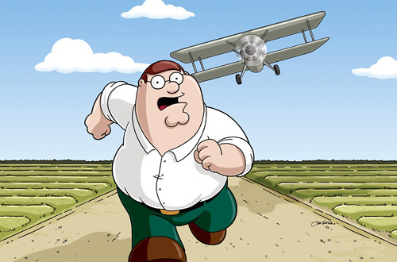
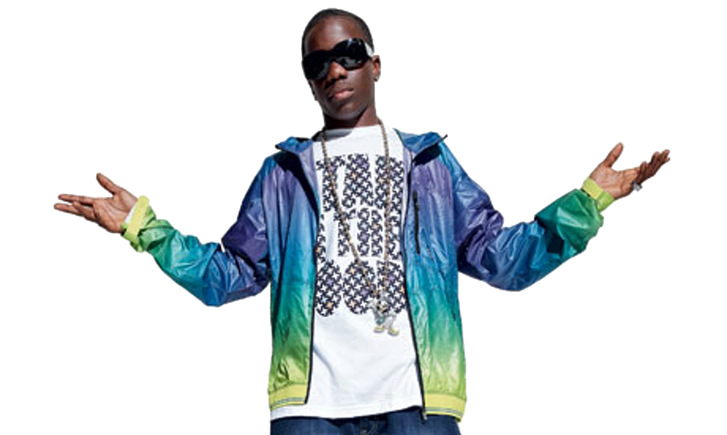
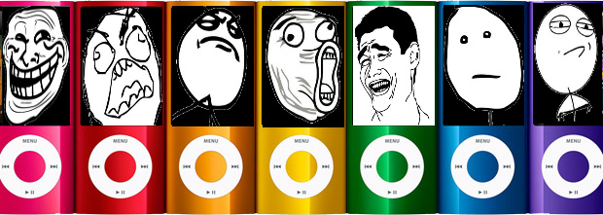
Studies
Media
at
Emerson Park

Slide 2



To start September 2021
We currently run the:
BTEC Technical Award
CREATIVE MEDIA PRODUCTION
THE COURSE
Coursework
(worth 60%)
Components
1 (year 10) &
2 (year 11)
Examination (worth 40%)
Component 3
(end of year 11)

Slide 3
Work from this year…
Year 11 music video
This is an example of a video created, during lockdown in 2021, by a current Year 11 student.
All her prep work was created in school before Christmas so she was in a position to attempt her video despite being at home!

Slide 4


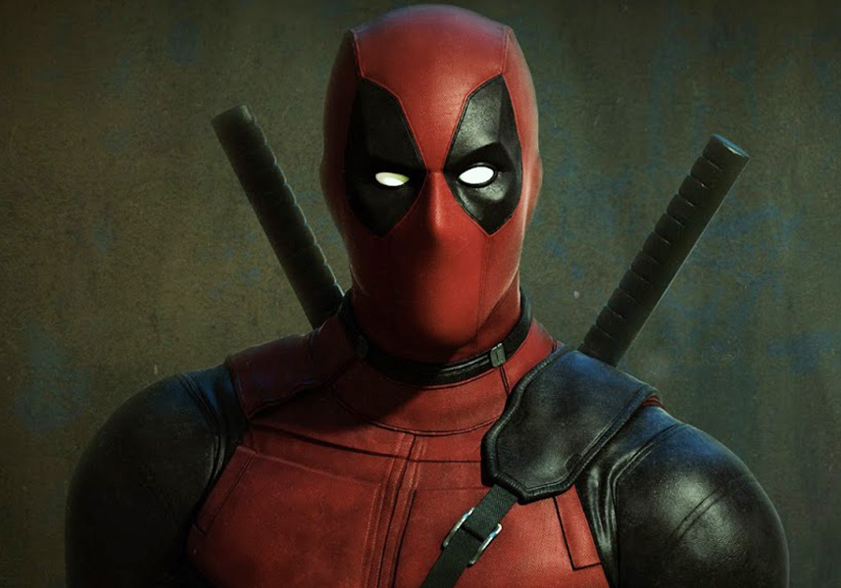





What is Media?
We typically focus on films, magazines, social media apps, computer games, and music videos
What is MEDIA?

Slide 5
To start September 2021
What Experience Do You Need?
0
Zip
Zilch
Nada
Nowt
None!
Everyone in Media Studies starts off at the same level

Slide 6
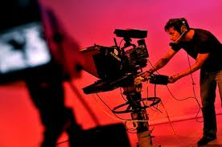
Careers in the Media
Journalist
Film-maker
Photographer
Publisher
Web Designer
App. Designer
Advertising
Software Developer
Games Developer
Computer Game Designer
Radio Broadcaster
Special Effects
Music Promoter
TV Production
Animator
Editor
Sound Engineer

Slide 7
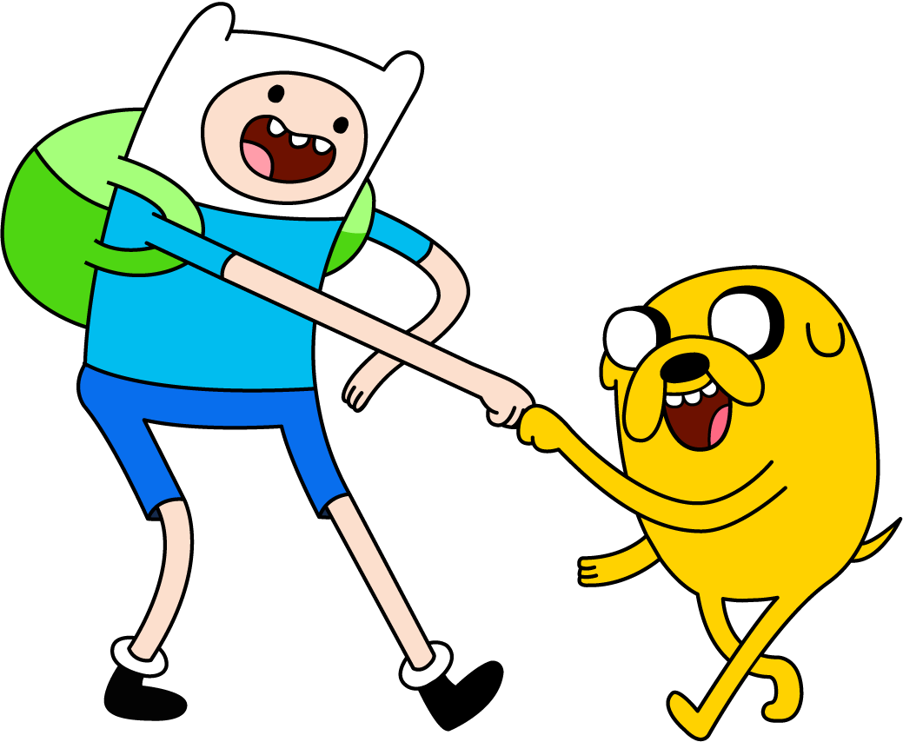
Other Subjects
Media Studies goes well with many other option subjects such as:
Graphic Design
Art
Music
Drama
Performing Arts
ICT
English
Or balances out ‘Heavier’ subjects like History!

Slide 8
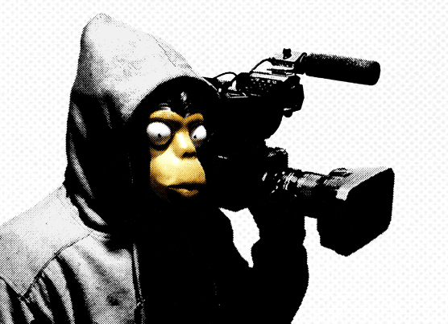

The Work
THEORY in year 10
We look at lots of different theories on areas such as audience, narrative, genre, characters and apply them to media texts we know well.
Year 10 has a LOT of writing

Slide 9
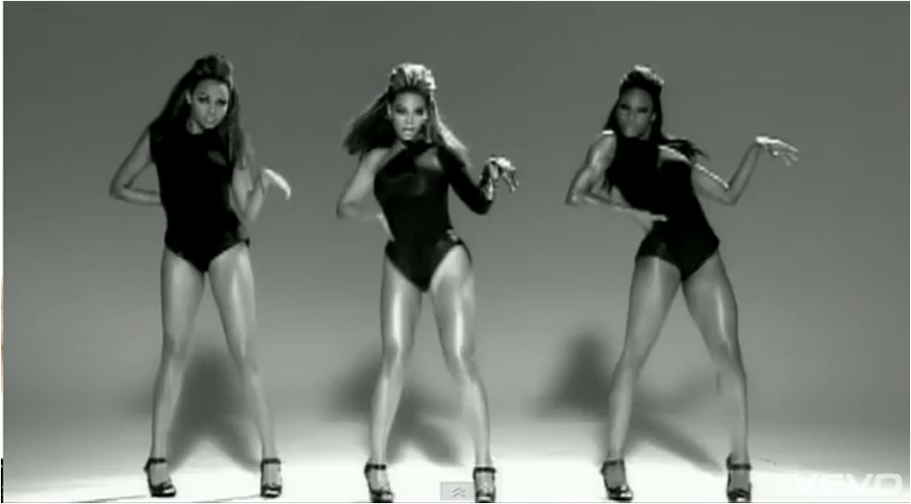
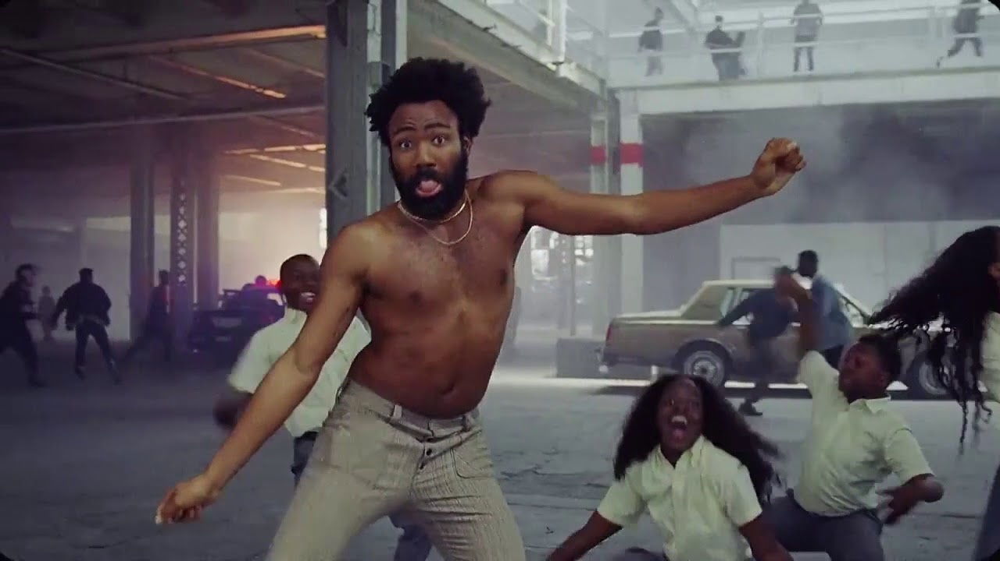
The Work
In year 11
Large practical element to this BTEC
HAS to be backed up by good research & written evaluation
(A LOT of Writing!!!!)
Planning and preparing
Filming and collecting footage
Editing
Understanding the concept of music videos
How are artists represented

Slide 10
In Year 11 at the moment
currently
We are working on music videos in Year 11 and at the moment is unlikely to change.
There is an exam component – themes have ranged from media jobs, media café and the environment.

Slide 11
BTEC Media
Make the right decision for you.
Media is a Fun, but Challenging subject
We do not spend our time watching films or making pretty pictures
The WHOLE of component 1 in year 10 is
largely written, essay writing and theory.
Come and talk to me in as much as you like before deciding
Email: kmorris@gapps.emersonparkacademy.org

