Slide 1



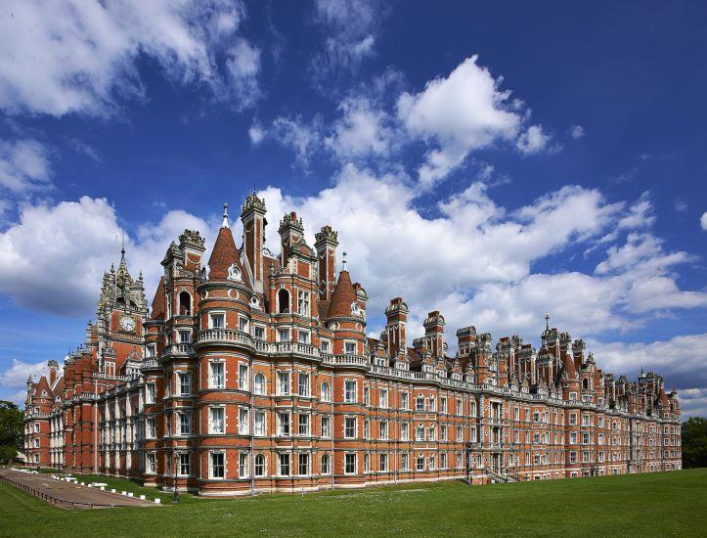
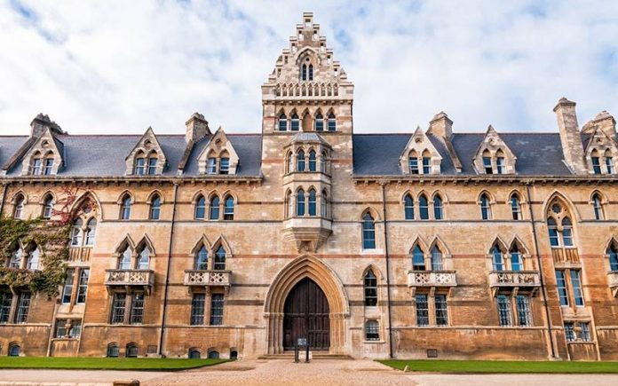




Preparing for University

Slide 2
Universities focus on two key elements:
Teaching
Research
How will learning at university be different from school/sixth form?
Lectures: up to 200 students
Seminars and classes: 5 to 20 students
Laboratory work and field work
Tutorials: usually 1-4 students and a tutor

Slide 3



Types of University
To consider: LOCATION
City universities
Departments and accommodation are spread across the city.
Collegiate universities
A key feature of the university is its’ college, small communities of university staff and students.
Campus Universities
Departments and accommodation are in one or more main areas.

Slide 4

Are looking for students with…

Slide 5
The Russell Group
The Russell Group’s members are world-class, research-intensive universities. They are unique institutions, each with their own history and ethos, but they share some distinguishing characteristics.
Through world-class research and education they are helping to create a dynamic economy, stronger communities and a better future for the UK. They maintain the very best research, outstanding teaching and learning experience and unrivalled links with local and national business and the public sector.
Russell Group universities have huge social, economic and cultural impacts locally, across the UK and around the globe:
They produce more than two-thirds of the world-leading research produced in UK universities and support more than 260,000 jobs across the country.
Russell Group members also have a strong role and influence within their regional and local communities, collaborate with businesses on joint research projects and supply highly-qualified and highly-motivated graduates to the local workforce.

Slide 6


Slide 7
Are Russell Group universities available in Clearing?
Yes, Russell Group universities have courses available through Clearing but they will be limited. It is unlikely that a Russell Group university will have any of its popular courses in Clearing, due to how quickly places are filled.
If you’re planning on applying to Russell Group universities in Clearing, ensure that you research your choices before you get your teacher assessed grades, so that your results day can be focussed on calling those universities and negotiating your place.

Slide 8
High academic achievement GCSE’s
Academic potential (predicted grades and evidence of key skills)
Interest (a clear interest in the subject they are applying for)
Question: How many courses are available to studying at university in the UK?
37, 000
What are Russell Group Universities looking for?

Slide 9
What A-Levels do I need?
Russell Group universities have high entry requirements for most courses. But, the entry requirements will vary depending on the course you're applying to.
For example, if you wish to study psychology at the University of Edinburgh, the standard entry requirements for A-Level students is AAA-ABB. However, if you are wanting to study psychology at University College London, you will require an A*AA.
Make sure to check the entry requirements on Whatuni before you apply. This will allow you to plan your A-Levels in advance, to ensure that you are taking the subjects necessary for you to be accepted.
Some subjects will require you to have taken particular A-Levels. For example, if you wish to study a BSc in biology from the University of York, not only will you need a minimum AAB but this will need to include two science-related subjects.
Do Russell Group universities accept BTECs?
Yes, BTECs are accepted by up to 95 percent of universities and colleges in the UK. Along with A-Levels, they are viewed as a valuable qualification. Gaining a Level Three BTEC Extended Diploma is the equivalent to 3 A-Levels.

Slide 10
What can you do now?
GCSE results matter!
A-Level choices: Facilitating subjects
If you don’t know what you want to study at university, then think about taking facilitating subjects. This will keep a wide range of degree courses open.
Facilitating subjects:
Biology
English Literature
History
Modern Languages
Chemistry
Physics
Maths and Further Maths
Geography

Slide 11

GCSE results matter!
A-Level prediction are also going to be important for any potential offers.
If you do decided to apply for UNIVERSITY, you will spend a lot of time with your tutors working through the UCAS application process.
You will submit your GCSE grades.
Your A-Level predictions will be uploaded to UCAS.
You will also have to write a personal statement.
Personal statement: You will need to outline why you wish to take your desired course. You will also have to outline how your extra curricular activities contribute to your desire to pursue a degree in….
THINK ABOUT: what are you doing now to help support your application? Voluntary work? Competitions outside of education/academic enrichment, sports, music, dance/drama etc.

Slide 12
Personal statements
Personal statement: You will need to outline why you wish to take your desired course. You will also have to outline how your extra curricular activities contribute to your desire to pursue a degree in….
THINK ABOUT: what are you doing now to help support your application? Voluntary work? Competitions outside of education/academic enrichment, sports, music, dance/drama etc.
Try and highlight the benefits of what you are doing and work it to your advantage. If you are taking a year out to work and earn money for university, this demonstrates that you are sensible and have a strong work ethic, while volunteering shows a passion for certain causes and a willingness to learn.
The importance of university research

Slide 13











Summer school
Twitter
University visits
Individual enrichment
Reading

Slide 14
What should I study at university?

Slide 15

It could be something you have studied before..
BA English

Slide 16

It could be something academically new..
BA War Studies

Slide 17

It could facilitate a specific career…
BEng Medical Engineering

Slide 18




Law at Oxford
Required subjects:
Any subjects combination
Required subjects
Chemistry,
AND Maths, Biology, Physics
Medicine at Oxford
Combined honours
Required subjects
Maths and Further Maths (9) or Computing
Computer Science at Oxford
History of Art at Oxford
Required subjects
A subject involving essay writing.

Slide 19
Tuition fees by region for courses starting in 2021
England | Up to £9,250 | Up to £9,250 | Up to £9,000 | Up to £9,250
Scotland | Up to £9,250 | No fee | Up to £9,000 | Up to £9,250
Wales | Up to £9,250 | Up to £9,250 | Up to £9,000 | Up to £9,250
Northern Ireland | Up to £9,250 | Up to £9,250 | Up to £9,000 | Up to £4,395

Slide 20
What financial help can you get?
Student loans can include a tuition fee loan and a maintenance loan to help with your living costs.
Tuition fee loans, to cover the full cost of your course, are paid directly to the course provider, and you won’t have to pay it back until after your course, when you’re earning above a certain level.
Maintenance loans can be applied for at the same time, lending you money at the start of each term (or monthly in Scotland). How much you get depends on your household income, where you study, where you live and how long for.

Slide 21





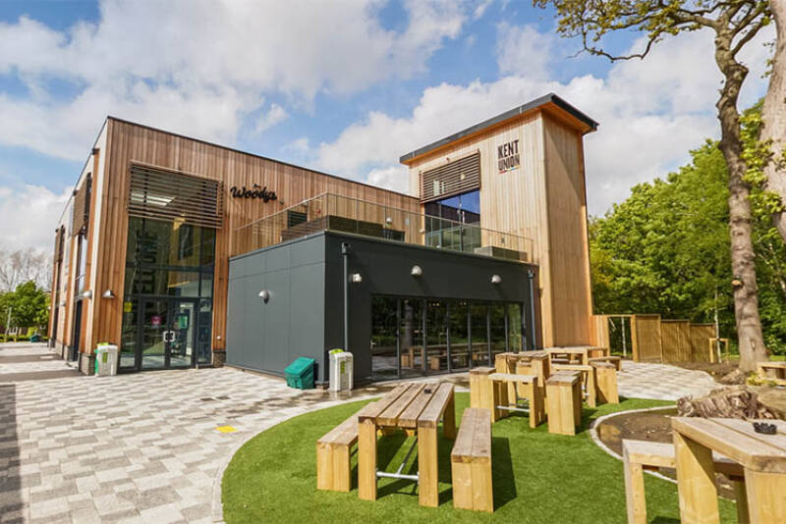



Student Life

Slide 22


