Slide 1
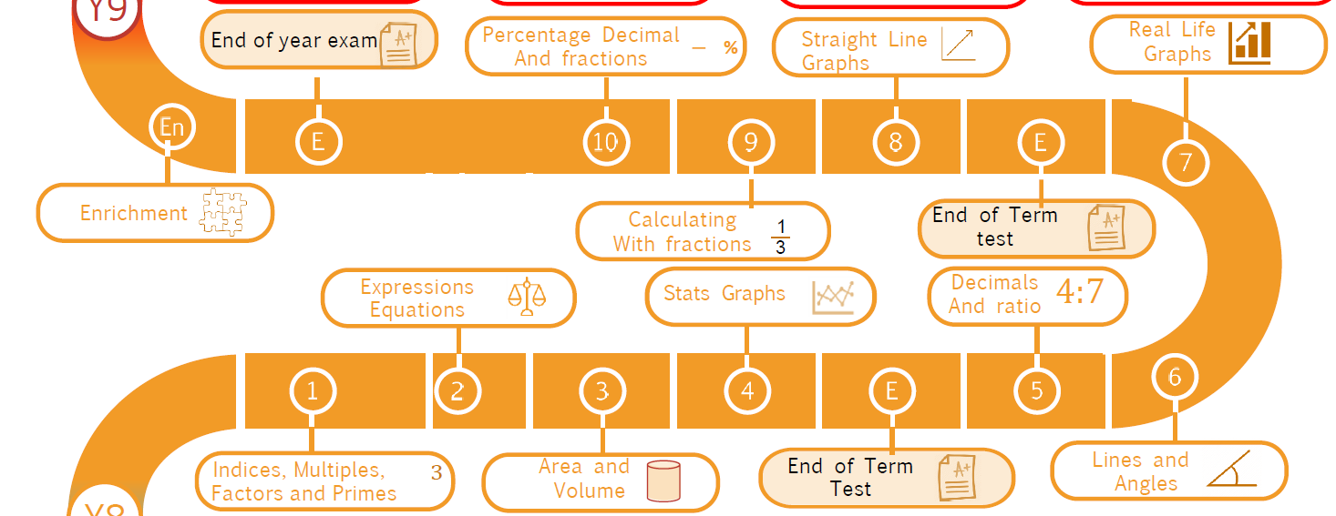

Slide 2
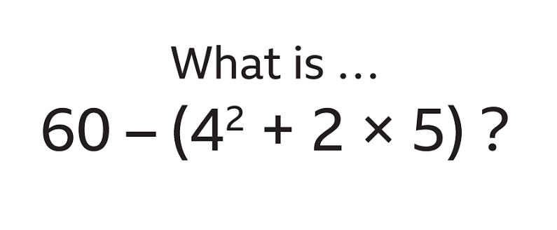

Number skills
Stick this on a new page then leave the rest of the page empty
Year 8 Unit 1
Negative number calculation
M106,M288
Divisibility and Division
M823, M354
Calculations
M187
3
3
3
☺ | 😐 | ☹
☺ | 😐 | ☹
☺ | 😐 | ☹
Powers, Roots and Brackets M521
Square, cubes, square roots
M135
Applications
Prime Factors M108
3
3
2
☺ | 😐 | ☹
☺ | 😐 | ☹
☺ | 😐 | ☹
☺ | 😐 | ☹
My favourite topic this unit was ________________________________________________________
I struggled most on __________________________________

Slide 3

Expressions, brackets and equations
Stick this on a new page then leave the rest of the page empty
Year 8 Unit 2
Factorising brackets
M100
Expanding Brackets
M792
Powers in Algebra
M120
3
2
3
☺ | 😐 | ☹
☺ | 😐 | ☹
☺ | 😐 | ☹
One step equations
M707
Balancing equations
M647
Two step equations
M634
Applications
2
1
3
☺ | 😐 | ☹
☺ | 😐 | ☹
☺ | 😐 | ☹
☺ | 😐 | ☹
My favourite topic this unit was ________________________________________________________
I struggled most on __________________________________

Slide 4

Statistics, charts and Graphs
Stick this on a new page then leave the rest of the page empty
Year 8 Unit 3
Stem and Leaf
M210, M648
Using Tables
M899, M127
Pie Charts
M574, M165
3
3
3
☺ | 😐 | ☹
☺ | 😐 | ☹
Comparing data
M450
☺ | 😐 | ☹
Applications
Scatter Graphs
M769,M596
4
4
☺ | 😐 | ☹
☺ | 😐 | ☹
☺ | 😐 | ☹
My favourite topic this unit was ________________________________________________________
I struggled most on __________________________________

Slide 5
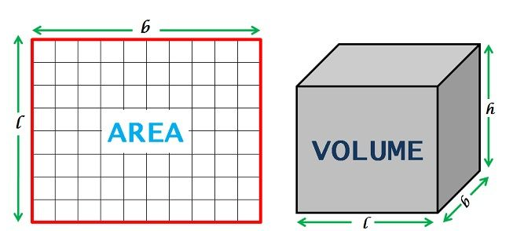
Area and Volume
Stick this on a new page then leave the rest of the page empty
Year 8 Unit 4
Volume cubes and cuboids
M765
Area quadrilaterals
M705, M291
Area of a triangles
M610
2
2
3
☺ | 😐 | ☹
☺ | 😐 | ☹
Nets, plans and elevations
M229, M518
☺ | 😐 | ☹
Applications
Measures
M865
Surface Area
M534
4
3
3
☺ | 😐 | ☹
☺ | 😐 | ☹
☺ | 😐 | ☹
☺ | 😐 | ☹
My favourite topic this unit was ________________________________________________________
I struggled most on __________________________________

Slide 6
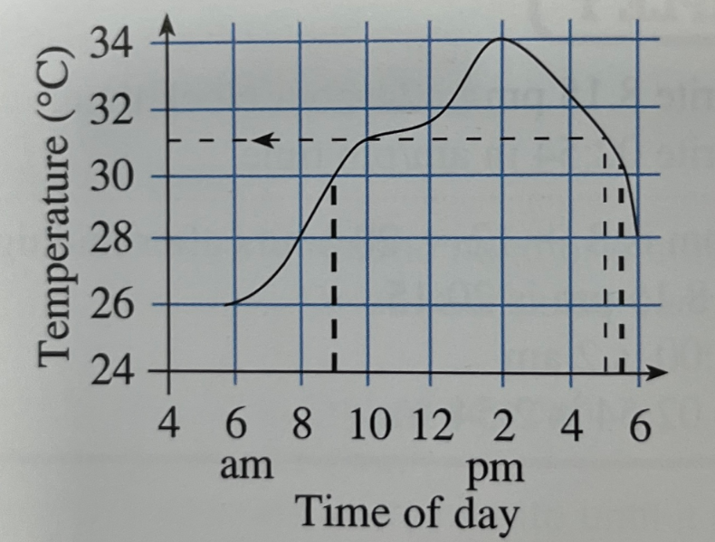
Real Life Graphs
Stick this on a new page then leave the rest of the page empty
Year 8 Unit 5
Line graphs
M140
Distance-Time graphs
M581,M551
Conversion Graphs
M771
3
4
3
☺ | 😐 | ☹
☺ | 😐 | ☹
Real life graphs
M843
☺ | 😐 | ☹
Curved Graphs
M751
Applications
4
3
☺ | 😐 | ☹
☺ | 😐 | ☹
☺ | 😐 | ☹
My favourite topic this unit was ________________________________________________________
I struggled most on __________________________________

Slide 7
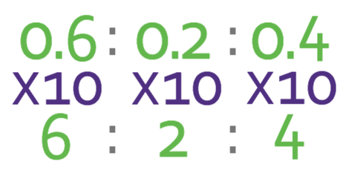
Decimals and ratio
Stick this on a new page then leave the rest of the page empty
Ordering decimals and rounding
M522, M431
Year 8 Unit 6
Calculations with decimals
M803, M491
Place value
M522
2
2
3/4
Ratio and proportion with decimals
M525, M113
☺ | 😐 | ☹
☺ | 😐 | ☹
☺ | 😐 | ☹
Applications
3
☺ | 😐 | ☹
☺ | 😐 | ☹
My favourite topic this unit was ________________________________________________________
I struggled most on __________________________________

Slide 8
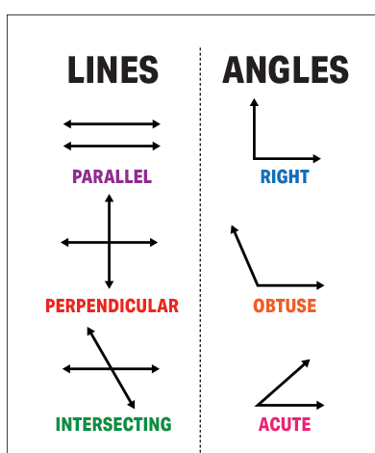
Lines and Angles
Stick this on a new page then leave the rest of the page empty
Year 8 Unit 7
Angles and Parallel lines
M606
Alternate Angles
M606
Quadrilaterals
M679,M393
2
3
3/4
Solving geometric problems
M653
Interior and exterior angles
M653
☺ | 😐 | ☹
☺ | 😐 | ☹
☺ | 😐 | ☹
5
5
☺ | 😐 | ☹
☺ | 😐 | ☹
My favourite topic this unit was ________________________________________________________
I struggled most on __________________________________

Slide 9
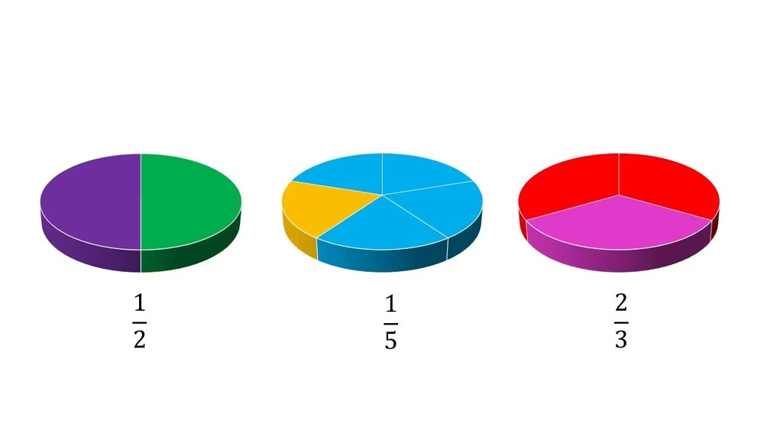
Calculating with Fractions
Year 8 Unit 8
Add and Subtract Fractions
M835
Ordering Fractions
M335
Multiply Fractions
M157
2
3
3
☺ | 😐 | ☹
☺ | 😐 | ☹
☺ | 😐 | ☹
Mixed Numbers
M931, M197, M265
Divide Fractions
M110
Applications
3/4
3
☺ | 😐 | ☹
☺ | 😐 | ☹
☺ | 😐 | ☹

Slide 10
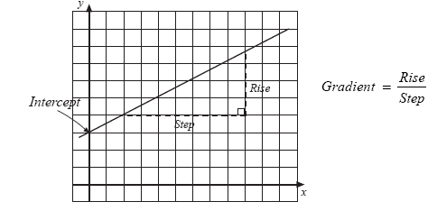
Straight Line Graphs
Stick this on a new page then leave the rest of the page empty
Year 8 Unit 9
Direct Proportion Graphs
M472, M448
Gradients
M888, M544
☺ | 😐 | ☹
Equations of lines
M932
☺ | 😐 | ☹
Applications
☺ | 😐 | ☹
☺ | 😐 | ☹
My favourite topic this unit was ________________________________________________________
I struggled most on __________________________________

Slide 11
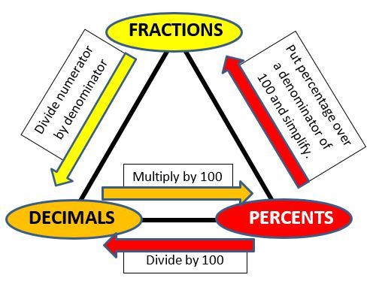
Percentages, decimals and fractions
Stick this on a new page then leave the rest of the page empty
Year 8 Unit 10
Writing percentages
M235, M476
Fractions & decimals
M958, M515
Equivalent proportions
M264
☺ | 😐 | ☹
☺ | 😐 | ☹
Percentages of amounts
M533, M528
☺ | 😐 | ☹
Applications
☺ | 😐 | ☹
☺ | 😐 | ☹
My favourite topic this unit was ________________________________________________________
I struggled most on __________________________________

Slide 12
Title
Stick this on a new page then leave the rest of the page empty
Year 8 Unit x
Powers in Algebra
M120
☺ | 😐 | ☹
☺ | 😐 | ☹
☺ | 😐 | ☹
☺ | 😐 | ☹
☺ | 😐 | ☹
☺ | 😐 | ☹
☺ | 😐 | ☹
My favourite topic this unit was ________________________________________________________
I struggled most on __________________________________

