Slide 1

Career highlight:
Electrician

Slide 2
What is?
From Go Construct:
Electricians provide buildings with energy to light rooms, heat water and power devices. They install, inspect and test electrical equipment, making sure it is working properly and safely. As an electrician, you could be maintaining traditional systems in homes, shops and offices. Some electricians work with renewable technology or fibre-optics. Others service motors, transformers, street lighting or traffic systems, or work on engineering projects.

Slide 3
What qualifications will you need?
Routes:
College
Level 2 Diploma in Access to Building Services Engineering (Electrical)
Level 2 and Level 3 Diploma in Electrical Installation
T Level in Building Services Engineering for Construction
GCSEs - Although the National Careers Service says you can get onto a Level 2 course with GCSEs under a grade 4, that’s not the case with Havering College or Barking and Dagenham College
Once you’ve completed the college courses, you will then need to train further on the job in an apprenticeship role to become fully qualified by completing the relevant NVQ at Level 3.
Apprenticeships with an electrical installation company are another way to qualify. You can start at 16 and work towards completing the installation and electrician maintenance advanced apprenticeship Level 3.

Slide 4
Duties of an Electrician
From the website goconstruct.org, the role of an electrician involves the following duties
Inspecting electrical systems, wiring and equipment to ensure they are safe and functioning properly
Fixing electrical faults or replacing parts
Connecting sockets, switches, light fittings and appliances
Laying cables to connect equipment to power and computer networks
Installing security or data network systems
Working with street lights and traffic managements systems
Fitting fibre-optic cables
Maintaining electrical motors, transformers and machinery
Making and installing electrical control panels
Programming computer-controlled ‘intelligent’ buildings
Following technical plans
Adhering to strict safety regulations
Learning about new electrical legislation
Responding to emergency call-outs such as power cuts
Working on a construction site, in domestic or commercial settings, offshore, locally or abroad.

Slide 5
Progression routes for a qualified electrician.
According to the Electrical Times, the top 10 Electrical companies in 2023 were:
Dakia Group Limited
NG Bailey Group Limited
TClarke Plc
Emcor Group (UK) Plc
Integral UK Limited
Enerveo Limited
Atlalian Servest AMK Limited
Skanska Rashleigh Weatherfoil LImited
SES (Engineering Services) Limited
Dodd Group Limited
Work for a contractor
Working for yourself
Contract yourself out
Become a master electrician
Setting up a business
Energy renewal specialist
Security systems
The employment of electricians is projected to grow until 2032

Slide 6
Salaries
According to GoConstruct and Electrical Careers, the salary range is as follows:
£18,000 to £44,000

Slide 7
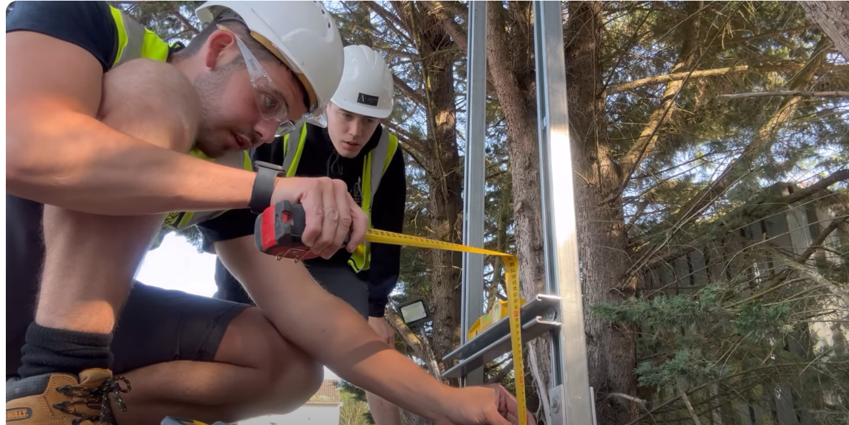
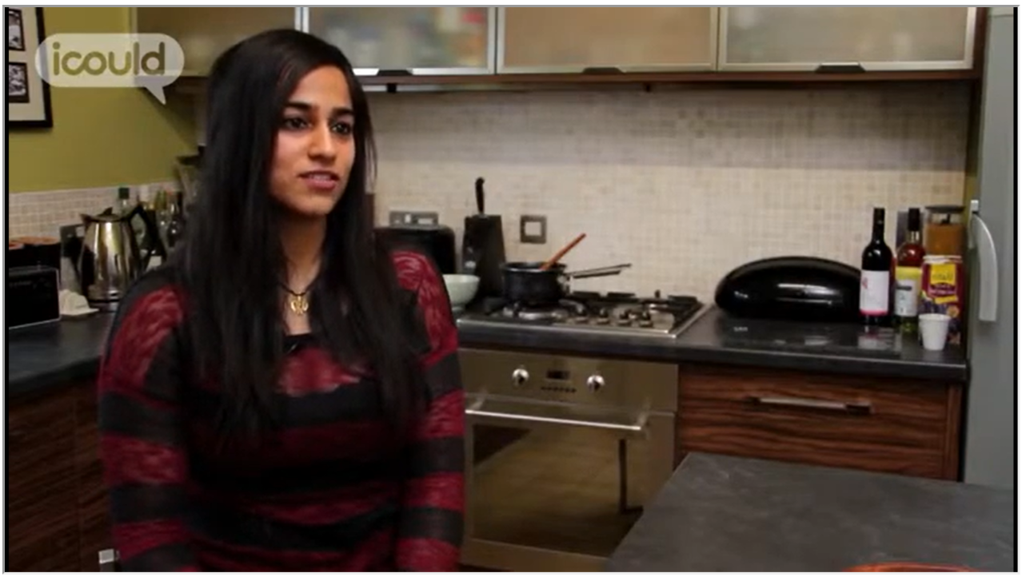
What’s the job like?
Day in the life of an Electrician
Start at 2.10mins.
Production Electrician
Electrician's favourite Job

Slide 8
To find out more…
https://www.goconstruct.org/
https://www.electricalcareers.co.uk/

