Slide 1
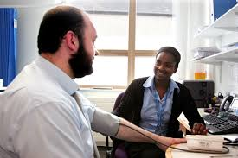
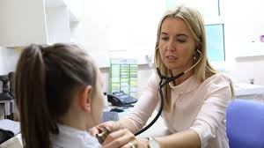
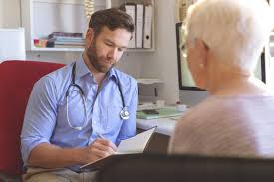

Career highlight: General Practitioner

Slide 2
What is?
A General Practitioner (GP) is a medical doctor who provides primary care to patients in the community. They are usually the first point of contact for individuals seeking medical advice or treatment and are responsible for a wide range of healthcare duties.

Slide 3
What qualifications will you need?
Traditional Route
A-levels (or equivalent): Typically including Biology and Chemistry.
Medical degree (MBBS or MBChB): 5 years at a university medical school.
2-year Foundation Programme (F1 and F2): Rotations in hospitals and sometimes GP practices.
GP Specialty Training: 3 years of specialised training in general practice, including hospital and GP placements.
Graduate Entry:
If you already hold a degree in another subject (especially a science), you can apply for a 4-year graduate-entry medicine programme.
After graduating, the steps are the same (Foundation + GP training).
Apprenticeship Route (New as of 2025):
The Medical Doctor Degree Apprenticeship is a new route allowing students to earn a salary while training. Apprentices work in NHS settings while completing academic studies over 5–6 years.
They still need to complete Foundation and GP specialty training afterwards.

Slide 4
Duties of a…
GPs are responsible for:
Diagnosing and treating a variety of health conditions and illnesses.
Prescribing medication and providing treatment plans.
Referring patients to hospital specialists or other healthcare professionals when needed.
Providing health education, advice, and preventative care (e.g. vaccinations, screenings).
Monitoring chronic conditions like asthma, diabetes, or heart disease.
Maintaining patient records and ensuring continuity of care.
GPs often work in GP surgeries, health centres, or group practices, and may also do home visits or work in out-of-hours services.

Slide 5




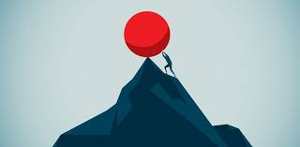

What skills do you need to become a doctor?
Good communication skills
Being Open-minded and Non-judgemental
The ability to deal with uncertainty
The ability to work independently
Resilience
A desire to continue learning for life
Notes:
Match the image to the skill and say why it’s important for doctors

Slide 6
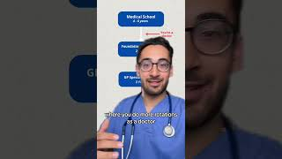
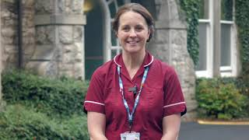
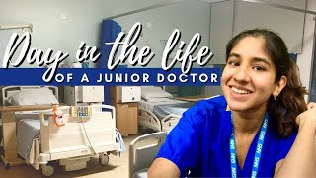

Slide 7
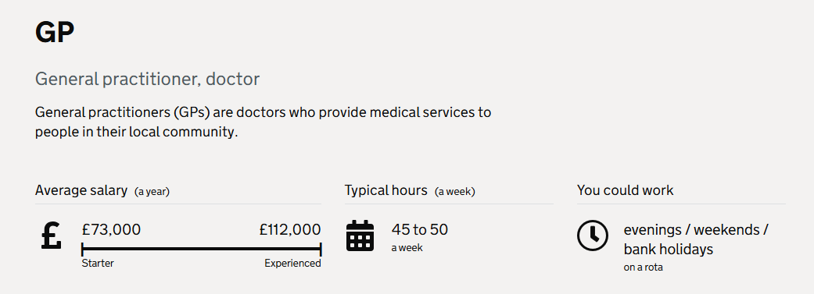
Salaries

