Slide 1
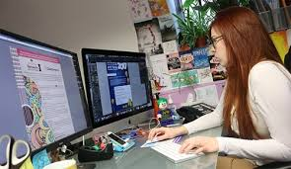
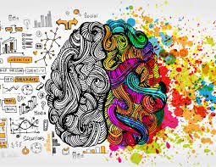

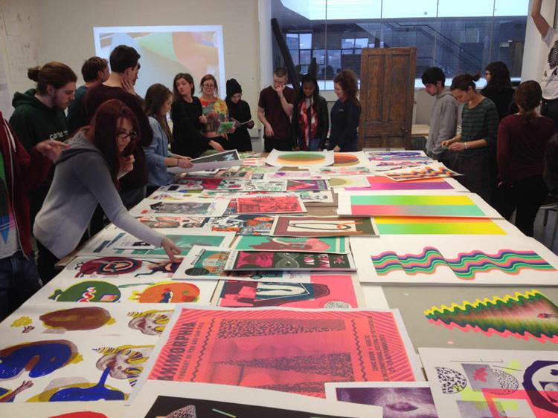

Career of the week: Graphic Designer

Slide 2
Quick facts!
Graphic Designer : Graphic designers create visual content to communicate messages through typography, imagery, colour, and layout, working across print, digital media, branding, advertising, and packaging. Creativity, attention to detail, and software skills (e.g., Adobe Creative Suite) are essential.
Routes into Graphic Design:
Common pathways include completing a degree or HND in graphic design or a related subject. Apprenticeships and college courses also offer hands-on experience and industry contacts.
Job Hotspots in the UK:
London is the main hub, followed by Manchester, Birmingham, Bristol, and Edinburgh, which all have thriving creative sectors.
Average Salary:
Entry-level designers earn around £18,000–£22,000 annually. With experience, this rises to £30,000–£40,000. Senior designers and art directors can earn over £50,000.
Job Outlook:
Graphic design remains a growth sector, particularly in digital design, UX/UI, and branding, as demand for creative content continues to rise across industries.

Slide 3

Average Salary:
Entry-level designers earn around £18,000–£22,000 annually. With experience, this rises to £30,000–£40,000. Senior designers and art directors can earn over £50,000.
Job Outlook:
Graphic design remains a growth sector, particularly in digital design, UX/UI, and branding, as demand for creative content continues to rise across industries

