Slide 1
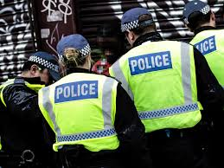
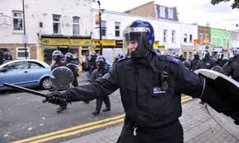
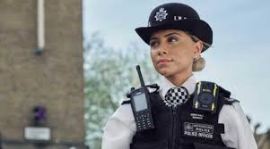

Career of the week: Police officer

Slide 2
Quick facts!
Police Officer – Career Information
Police officers work to keep the UK safe by preventing crime, responding to emergencies, investigating offences, and supporting communities. The role demands communication skills, resilience, and sound judgement.
Routes In:
You don’t need a degree to apply to become a police officer. You need a Level 3 qualifications, which means A levels, or Level 3 equivalent qualifications, such as a Level 3 course in public services. You can join through the Police Constable Degree Apprenticeship (PCDA), earn while you learn; or apply if you already have a degree via the Degree Holder Entry Programme (DHEP). A degree can be advantageous when applying for Detective constable roles.
Average Salary:
Starting salary is around £36,775 (including London weighting), rising with experience.
Job Outlook:
Policing is a stable, essential service with ongoing recruitment to reflect London's diverse needs. The sector is investing in technology and community engagement, making it a dynamic and evolving career choice.

Slide 3


Pay in the Met Police
The seven basic pay bands are:
Band A: £77,332 to £89,320
Band B: £56,911 to £69,342
Band C: £44,132 to £52,652
Band D: £35,998 to £38,523
Band E: £31,880 to £34,108
Band F: £28,851 to £31,011
Band G: £27,066 to £27,33
Annual leave:
Less than 5 years service: 28 days
More than 5 years service: 33 days

