Slide 1




Career highlight: Engineer

Slide 2
What is?
Engineers use maths, science, and creative thinking to help design and build important things we use every day – like roads, bridges, power stations, computers, and even medical machines.
They do lots of different jobs, such as planning and testing new ideas, building models, designing using computers, checking things are made properly, and fixing problems. Engineers often work together in teams, so it’s important they can communicate well and help organise big projects. They also have to make sure their work is safe and good for the environment.

Slide 3
Different branches:
Civil and Structural - roads, rail, water, buildings
Mechanical and manufacturing - machines, HVAC, Production lines
Electrical and electronic - power, control, embedded systems
Chemical and process - petrochem, pharma, food, nuclear fuel
Aerospace and defence - aircraft, spacecraft, weapons, avionics, (electronic equipment fitted into an aircraft)
Automotive and motorsport - ICE, (Instrumentation and control engineering), EV, (Electrical vehicles), battering and drivetrain R&D, (this is a branch of engineering involved in looking at how engine power is delivered to the wheels of vehicles).
Software, AI and Systems - renewables, drid-scale, storage, net-zero tech
Biomedical and medical devices - prosthetics,imaging, diagnostics

Slide 4
What qualifications will you need?
Academic route:
A level Maths and science, or equivalent, such a a T-Level.
BEng, (Bachelor's degree in engineering) or integrated MEng, (A qualification that includes a bachelor’s and Master’s degree in engineering).
Graduate scheme to become a chartered Engineer
Higher & degree apprenticeships, which allow you to Earn-while-you-learn. You will need Grade 5s or higher at GCSE, including maths, and A levels, (depending what level you begin). You will complete either a Level 4-6 HNC/HND, Foundation degree or BEng, while being paid by your employer.
Engineering is one of the UK’s fastest-expanding sectors.
In 2024, there was a shortfall of 124,000 engineers and technicians.
Green and digital engineers will be needed more and more in the future.

Slide 5
Biggest Uk engineering employers
BAE Systems - Defence and aerospace; UK workforce - 43,000, (6,500 trainees = 15% of staff)
Rolls-Royce - Aero engines, nuclear; UK workforce - 20,900
Network Rail - Rail infrastructure; UK workforce - 40,966
National Grid - Electricity and gas networks; UK workforce - 31,425
Jaguar Land Rover (JLR) - Automotive and EV, UK workforce - 38,000

Slide 6



Example video

Slide 7
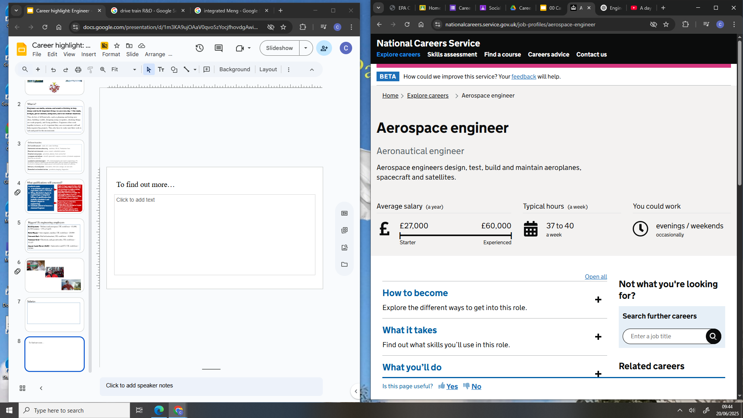
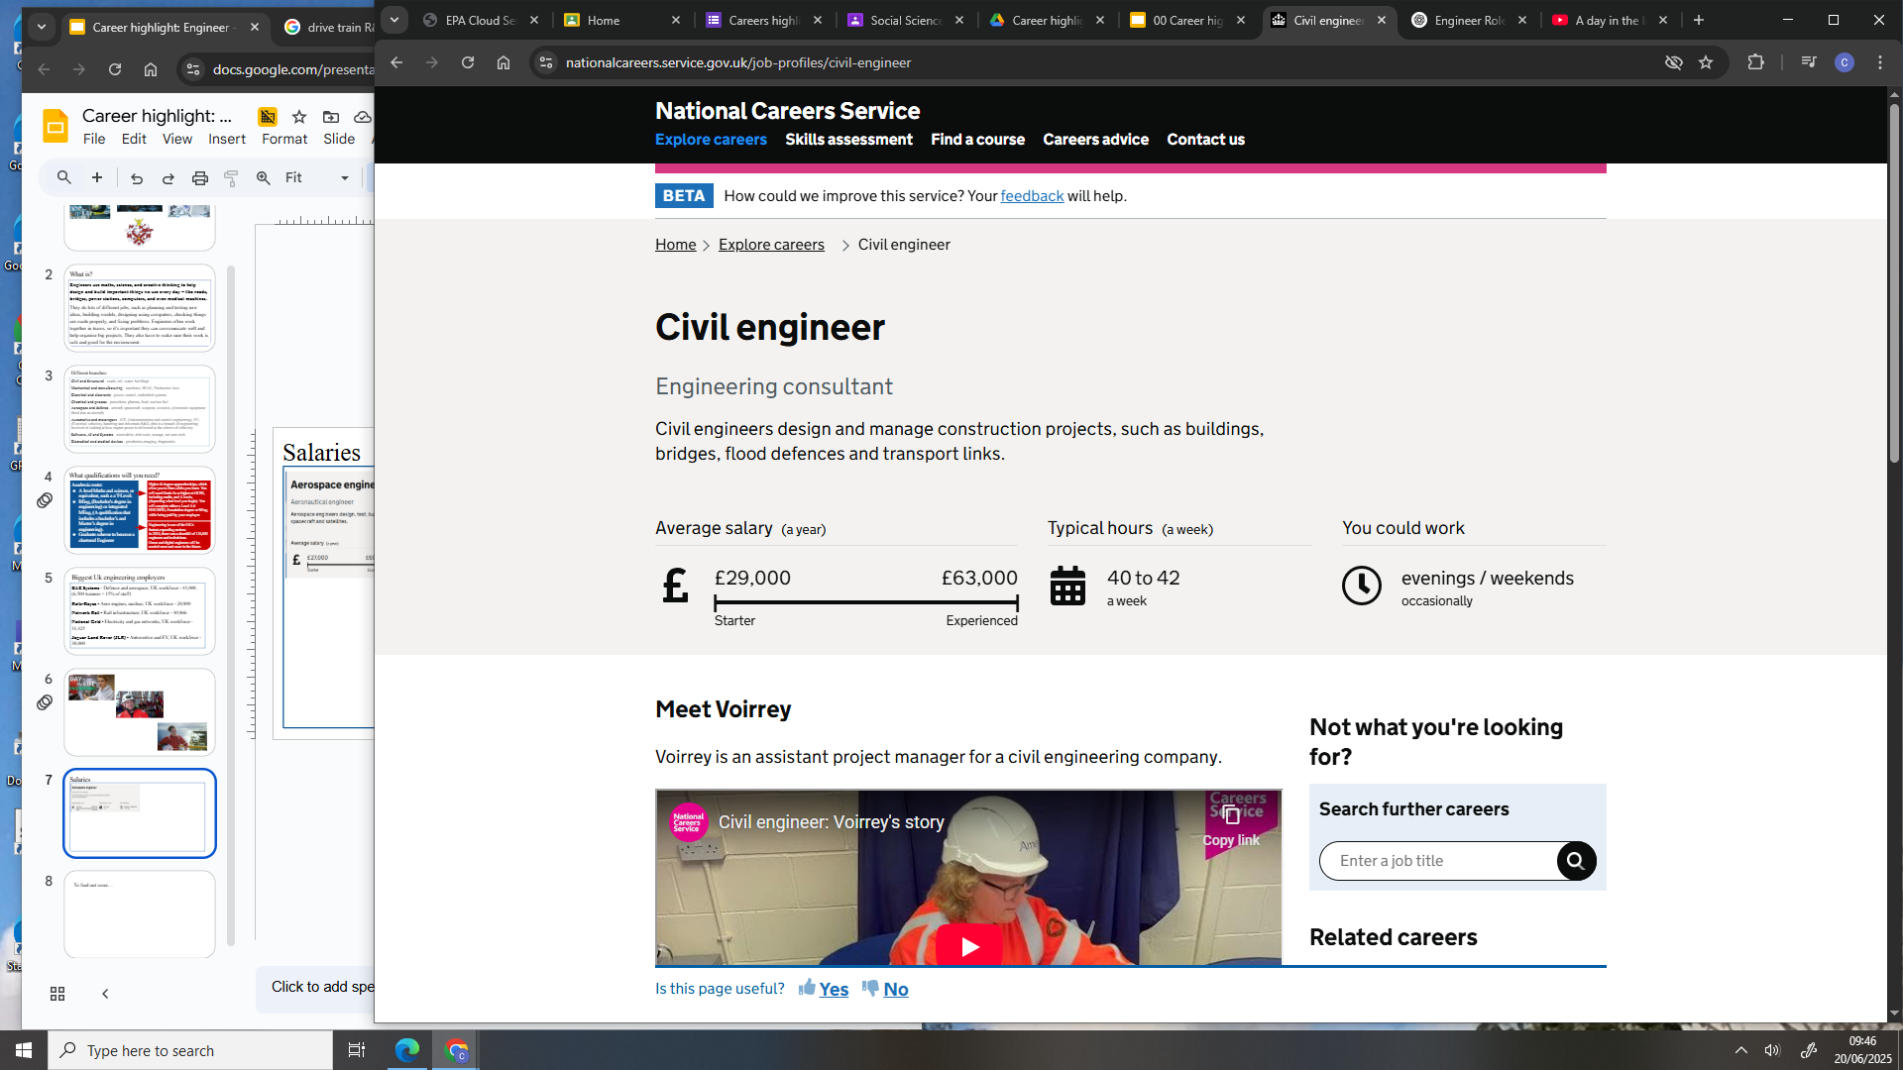
Salaries
To look at the different salaries for the different types of engineers, look at the National Careers Service or the Engineering Council

