Slide 1
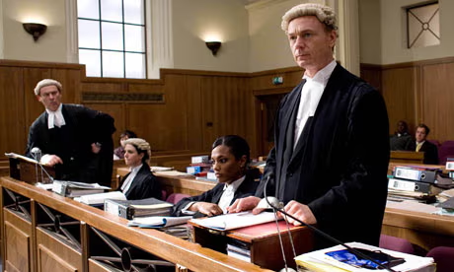


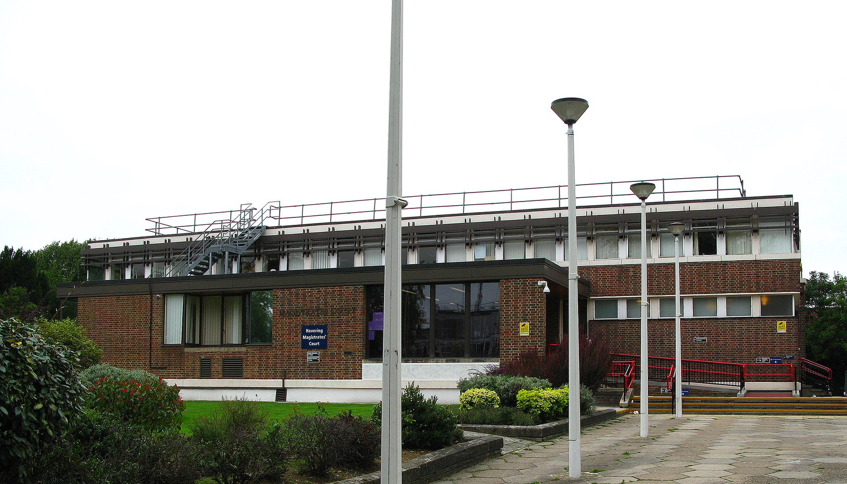

Career highlight: Lawyer

Slide 2
What is?
A lawyer in the UK is a person who is trained and qualified to give legal advice, represent people in legal matters, and help them understand the law. There are two main types of lawyers in the UK: solicitors and barristers.
Solicitors usually work directly with clients. They give advice, prepare legal documents, and may represent people in lower courts. They often work in law firms or for businesses, helping with things like buying a house, making a will, or dealing with family matters.
Barristers are experts in court work. They are usually hired by solicitors to speak in higher courts. They wear wigs and gowns in court and present cases to judges and juries.
There are also legal executives, who are qualified lawyers but specialise in a specific area of law, and paralegals, who assist lawyers but aren’t fully qualified.
All of them help people solve legal problems.

Slide 3
What qualifications will you need?
Routes into
Solicitor:
Take an undergraduate degree in any subject.
Pass parts 1 and 2 of the Solicitors Qualifying Exam (SQE)
Complete 2 year (or equivalent if part-time) qualifying work experience
Meet the character and suitability requirements of the Solicitors Regulation Authority.
You could apply to do a Solicitor Level 7 Degree Apprenticeship. This route includes the completion of a law degree and usually takes around 5 to 6 years. You’ll need to then complete the SQE and do 2 years work experience.
The Solicitors Regulation Authority will need to know about any criminal conduct, behaviour which has a bearing on your integrity and independence, Education assessment offences, such as plagiarism, your financial conduct, any disciplinaries and health conditions.

Slide 4
What qualifications will you need?
Routes into
Barrister:
Complete a law degree, or do a degree in any subject and complete a Graduate diploma in law afterwards.
Once graduated you complete the Bar Professional Training Course which takes a year
Undergo a year of practical training called a pupillage.
You could apply to do start your careers by working in a law firm or the law department of an organisation. You could, complete a qualification such as the Level 6 Professional Higher Diploma in Law.
You could join the Bar Council for professional development, training opportunities and to make industry contacts. The Bar Council

Slide 5
Duties of a…
Solicitors provide legal advice to clients on a wide range of issues, including family law, property, commercial matters, and criminal defence.
Solicitors prepare legal documents and contracts, such as wills, leases, and business agreements.
Solicitors handle legal paperwork and client communication, often acting as the first point of contact and managing the day-to-day running of a case.
Solicitors may represent clients in lower courts, such as magistrates’ courts or tribunals, and can apply for ‘rights of audience’ in higher courts.
Solicitors often work within law firms, corporations, or government bodies and may also manage client accounts and conduct negotiations.

Slide 6
Duties of a…
Barristers specialise in advocacy and represent clients in court, especially in higher courts like the Crown Court, High Court, and above.
Barristers provide expert legal opinions and advice, often referred to them by solicitors for more complex cases or specialist areas of law.
Barristers draft court documents and legal pleadings, especially in litigation and criminal cases.
Barristers are self-employed and typically work in sets of chambers, although they may work with other barristers on larger cases.
Barristers wear traditional court dress (wigs and gowns) in most courts and focus heavily on oral arguments, cross-examinations, and case strategy in trials.

Slide 7
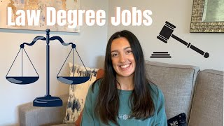
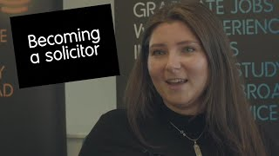
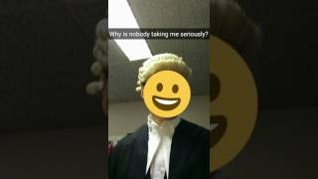

Slide 8
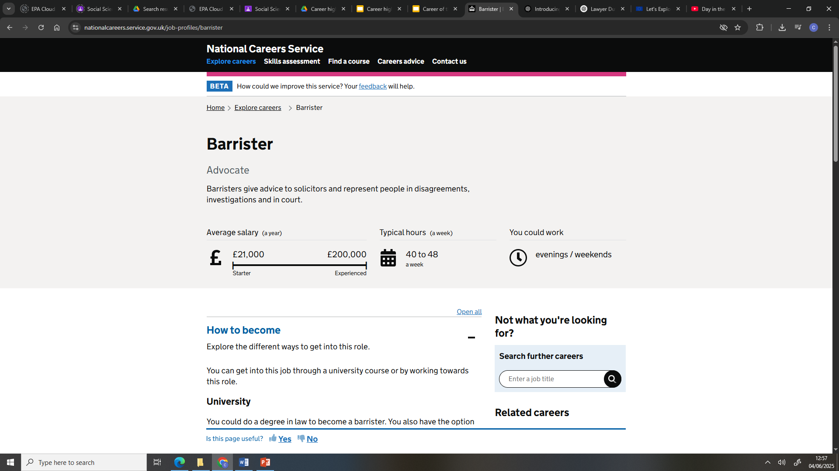
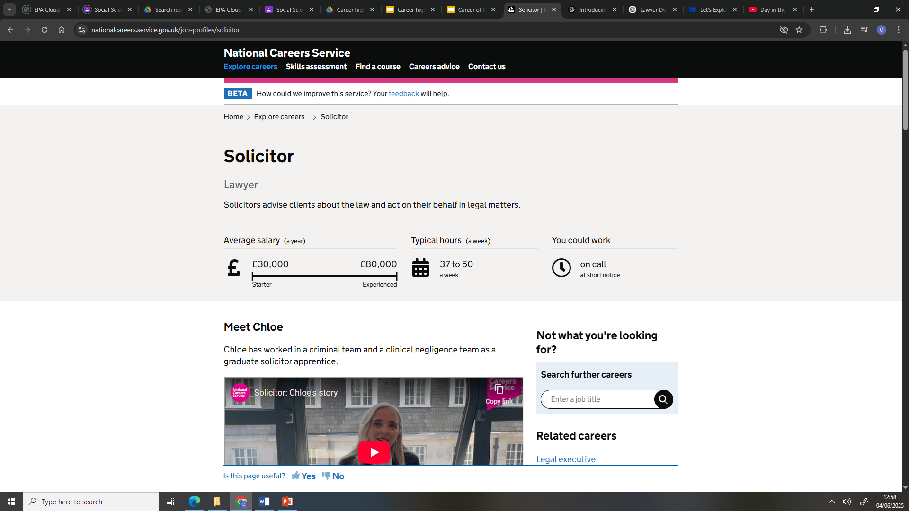
Salaries

