Slide 1

Career highlight:
Beauty Therapist

Slide 2
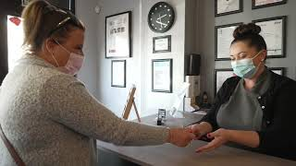
What is a Beauty Therapist?

Slide 3
What qualifications will you need?
Routes in Beauty Therapy
College:
Level 2 or Level 3 diploma in Beauty Therapy
T Level in Hairdressing, Barbering and Beauty Therapy
GCSEs:
Level 2 diploma - 2 GCSEs at grades 9 to 3
For Level 3 diploma - 4 or 5 GCSEs at grades 9 to 4
For T Level - 4 or 5 GCSEs at grades 4 or above, including English and Maths
Intermediate or Advanced apprenticeship:
Intermediate - GCSEs including English and Maths
Advanced - 5 GCSEs at grades 9 to 4 including English and Maths
Be aware that although the National Careers Service doesn’t specify that you need English and Maths for a a Level 2 course, this is usually what most colleges will require.

Slide 4
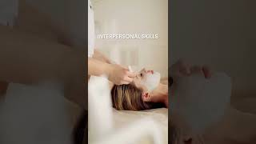
Duties of a…
What skills do I need to become a beauty Therapist?
Answer the telephone and welcome visitors to the salon
Book appointments
Carry out beauty treatments
Check and order supplies
Keep notes of clients’ medical histories and treatment programmes
The treatments you’d provide could include:
Facials, to cleanse, massage and tone the skin
Applying and advising about makeup
Shaping eyebrows and colouring eyelashes
Manicures, pedicures and other nail procedures like extensions and nail art
Removing unwanted facial and body hair
Electro-therapy treatments to improve body tone and shape
Non-surgical skin improvement
UV (ultraviolet) and spray tanning
You might offer other treatments such as massage, aromatherapy, hydrotherapy and reflexology. Occasionally you might need to refer clients to their doctor, for example, if they have a severe skin problem. You would earn a commission on any beauty products that your customers buy from you, so good sales skills would be valuable.

Slide 5
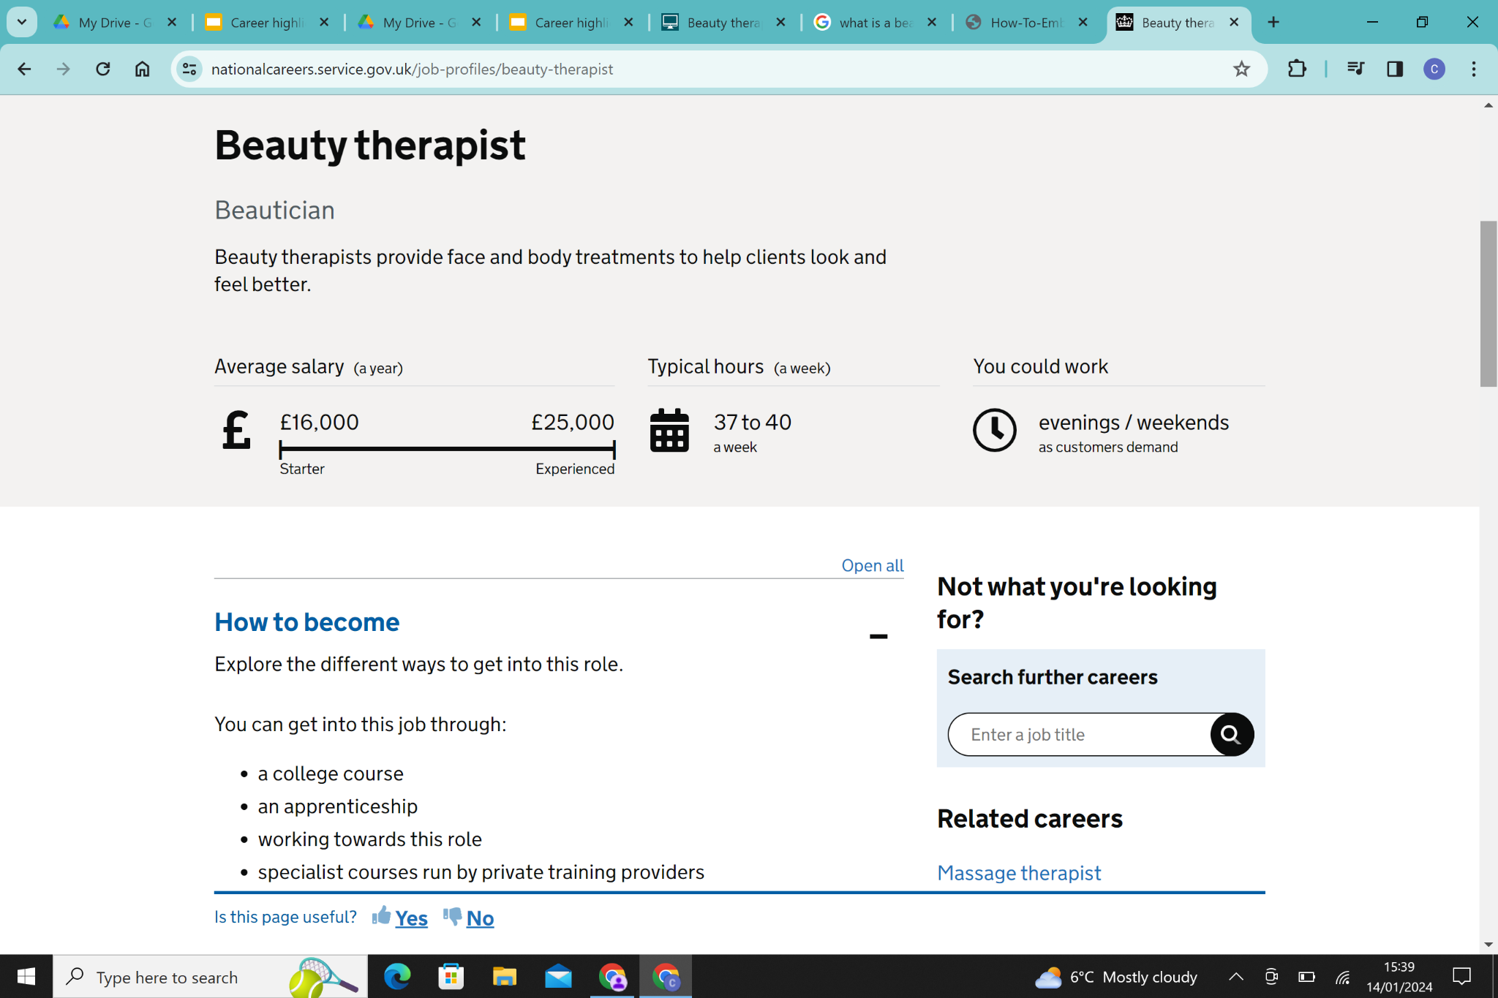
Salaries

Slide 6
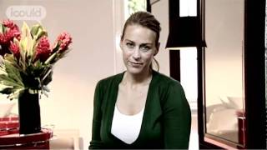
Example video

Slide 7
To find out more…
Guild of Beauty Therapists - https://www.beautyguild.com/
Hair and Beauty Industry Authority - https://habia.org/
British Association of Beauty Therapy and Cosmetology - https://www.babtac.com/

