Slide 1
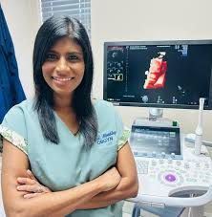
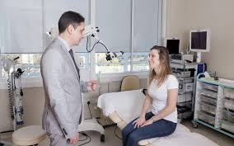
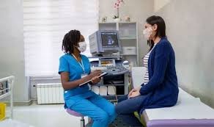

Career highlight: Gynecologist

Slide 2
What is?
A gynaecologist is a medical doctor who specialises in the health of the female reproductive system —Many also practise obstetrics, caring for women during pregnancy and childbirth. Together, this field is called Obstetrics and Gynaecology (O&G).

Slide 3
What qualifications will you need?
Complete a 5-year degree in medicine (MBBS, MBChB) at a university recognised by the General Medical Council (GMC).
Typical entry: 3 A-levels (including Biology and Chemistry).
Undertake a 2-year UK Foundation Programme (general medical training).
Apply for a 7-year Specialty Training programme in Obstetrics and Gynaecology.
If you already have a science degree, a 4-year graduate-entry medicine degree is available at many universities.
While there is no direct medical apprenticeship for gynaecology, the Medical Doctor Degree Apprenticeship (introduced by the NHS in England from 2024) allows students to train as doctors while earning a salary — potentially leading to O&G specialisation later.

Slide 4
Duties
Main Responsibilities
Conducting examinations, screenings, and diagnostic tests (e.g., cervical smears, ultrasounds).
Managing menstrual, fertility, and menopausal issues.
Performing surgical procedures such as hysterectomies, caesarean sections, or laparoscopies.
Supporting pregnancy, childbirth, and postnatal care.
Advising on contraception, sexual health, and reproductive wellbeing.
Working within multidisciplinary teams (midwives, nurses, anaesthetists).
Managing emergencies (e.g., ectopic pregnancies, complications during labour).

Slide 5
Salaries
Foundation Doctor - £32,400 to £43,00 - During initial two-year foundation training after medical school.
Specialty Registrar - £43,900 to £63,400 - Gynaecologists in training; salary increases with experience.
Consultant (NHS) - £93,700 to £126,300 - Core NHS salary scale
Consultant (Private sector) - £120,000 to £250,000 - Income varies. Many consultants combine private and NHS work.
Locum Consultant - £100 to £160 per hour - Short-term contracts to fill NHS gaps; flexible positions but less job security.

Slide 6
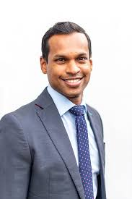
Last facts to know…
Volunteering at Women’s Health Charities can be useful, or you could also work as a health assistant, or volunteer in a ward in order to get to know how hospitals work.
Is it a Growth Sector?
The RCOG 2022 Workforce Report identified a shortage of O&G doctors, with around 20% of posts unfilled in some NHS Trusts
Factors include rising birth rates, later pregnancies, and growing demand for fertility and menopause services.
Workforce expansion is a government priority, with NHS Long Term Workforce Plan (2023) pledging to increase medical training places by 50% by 2031.
So — this is a secure and growing sector, though competitive at higher grades.

Slide 7

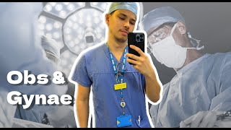
What’s the job like?

