Slide 1

Career highlight:
Accounting

Slide 2

What is an Accountant?
Taken from Investopedia:
Accountants ensure that work goes on efficiently by reviewing financial statements and reports, analysing data, budgets, tax filings and accounting records. They proffer financial services, and the recipient of these services are individual clients or businesses and organisations. Often, people think a bookkeeper performs similar roles as an accountant. A bookkeeper's major duties are gathering and recording financial information, while an accountant typically analyses information and usually has a minimum of a degree in accounting.

Slide 3
What qualifications will you need?
Routes into accounting:
Degree - Accounting degree, or related degrees such as business, maths, economics, finance or management.
A levels - Will depend on the above degrees. Some degrees and universities may require maths for an accounting degree, but not all.
GCSEs - GCSEs at 9-4, including maths and English. Note that if you study Maths at A level, it’s usually recommended you achieve a grade 7 at GCSE.
You could also start an apprenticeship at advanced, higher or degree level.
It’s also possible to start in a junior role and work towards professional status.
You can also do a BTEC at Level 3, before going on to do your degree. Check that the University you’re interested in accepts BTECs.

Slide 4

What is a chartered Accountant?
How to become a Chartered Accountant
The difference between an accountant and a chartered accountant is that the latter has taken extensive professional qualifications, is more highly qualified and may be able to offer specialist financial advice and services. Chartered accountants will also be part of a professional body. In order to use the title ‘chartered accountant’ you will need to pass several exams and also have many years experience in the industry. You will then join a body such as the ICAEW, (The Institute of Chartered Accountants in England and Wales).

Slide 5

Jobs you can achieve with an accountancy qualification

Slide 6
Salaries
The average salary for an accountant is around £40,000, but there are so many roles in accounting that the salary range is between £22,000 whilst training and £90,000. There are occupations within accounting that can lead to salaries over £100,000.
Eagle Education - how much does an accountant earn?.

Slide 7
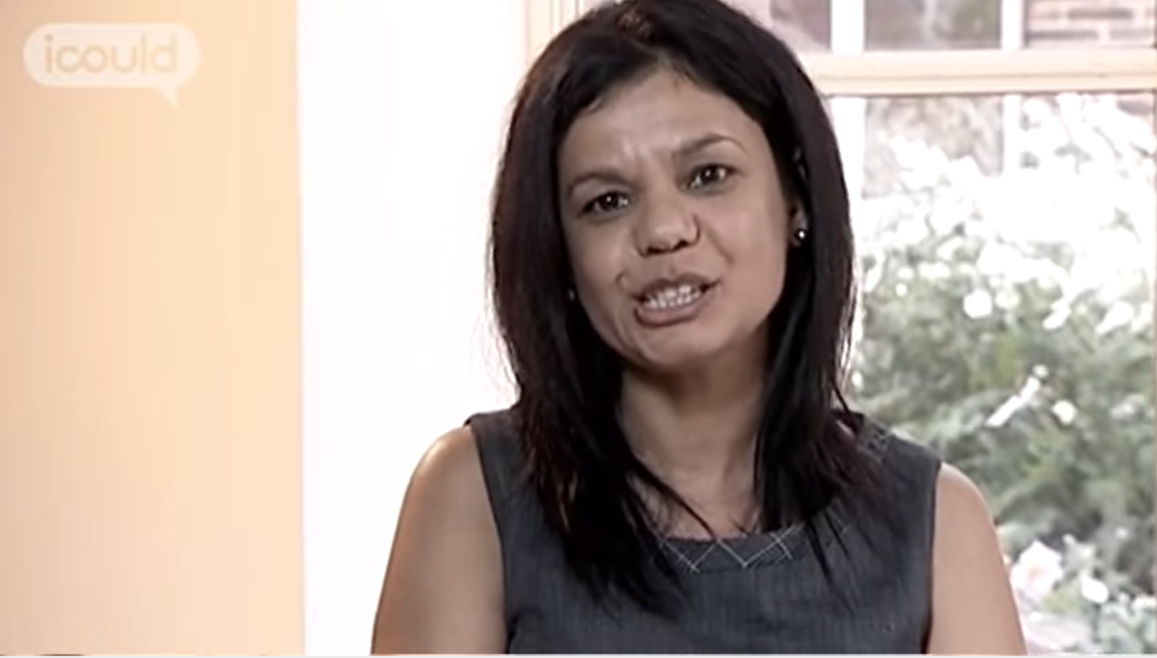
Fund Accountant at Fidelity

Slide 8
To find out more…
https://www.icaew.com/ - The institute of Chartered Accountants in England and Wales
https://www.aicpa-cima.com/home - The Chartered Institute of Management Accountants.

