Slide 1
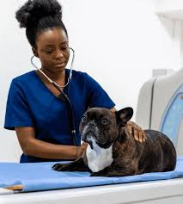
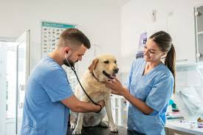

Career highlight: Veterinarian

Slide 2
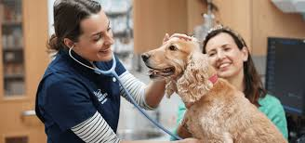
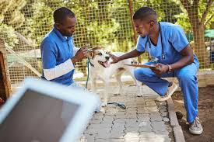
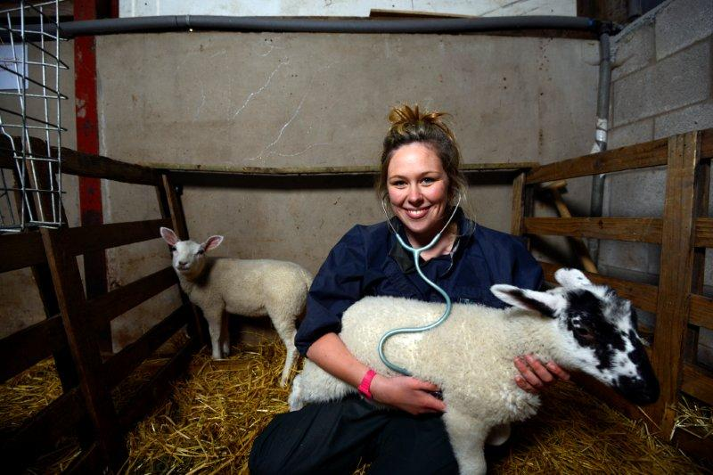
What is?
Veterinarians in the UK are medical professionals for animals, working across companion animals, farm livestock, equine practice, wildlife, research, and public health. Their work combines clinical care, surgery, diagnostics, disease prevention, and advisory roles in animal welfare and food safety.

Slide 3
What qualifications will you need?
Veterinary Medicine Degree (BVetMed, BVSc, or equivalent)
Accredited by the Royal College of Veterinary Surgeons (RCVS).
Typically a 5–6 year course at universities such as Cambridge, Edinburgh, Glasgow, Bristol, Liverpool, Surrey, Nottingham.
A levels: You will need biology, another science subject, sometimes chemistry is specified, and another academic A level of your choice.
For those with prior bioscience degrees; some universities offer a 4-year accelerated course.
Related apprenticeships:
Veterinary Nurse Apprenticeship (Level 3) – a key entry point into animal care.
Animal Care and Welfare Assistant Apprenticeships (Level 2/3) – often a feeder route.

Slide 4
Duties
Day-to-Day Responsibilities
Conducting consultations, diagnosing illness, and performing surgery.
Advising on nutrition, preventive healthcare, and welfare.
Working with farmers on herd/flock health management.
Public health work in food safety, zoonotic disease control.
Administration, record-keeping, and continuous professional development (CPD).

Slide 5
Salaries
New Graduates: From £32,000 to £37,000
Experienced Vets: £40,000 to £70,000
Highly Experienced/Senior Vets: From £70,000 to £100,000
Factors such as location and size of the practice, or the company, can impact salary. Note: There are workforce shortages in this sector, especially in rural and food-animal practices.

Slide 6
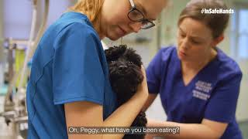
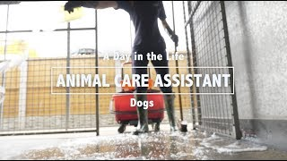
What’s the job like?

Slide 7
To find out more…
Key Professional Organisations
Royal College of Veterinary Surgeons (RCVS) – statutory regulator, sets education standards, maintains register.
British Veterinary Association (BVA) – represents vets, provides lobbying, CPD, and professional support.
Specialist Divisions:
  British Small Animal Veterinary Association (BSAVA)
  British Cattle Veterinary Association (BCVA)
  Equine Veterinary Association (BEVA)

