Slide 1
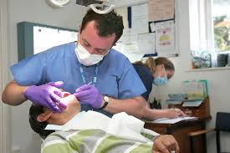
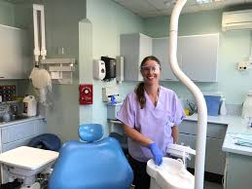


Career highlight:Dentistry

Slide 2
What is?
Dentists in the UK are responsible for diagnosing, preventing, and treating oral health conditions. Key tasks include:
Conducting oral examinations and X-rays.
Preventive care (cleaning, fluoride application, sealants).
Performing restorations (fillings, crowns, bridges).
Surgical procedures (extractions, implants, root canal treatments).
Educating patients about oral hygiene.
Supervising dental hygienists, nurses, and technicians.
(NHS England, 2022; Gallagher & Wilson, 2019)

Slide 3
What qualifications will you need?
Undergraduate route – A 5-year Bachelor of Dental Surgery (BDS) degree at a General Dental Council (GDC) approved university.
Dental foundation training – One year of supervised practice after graduation.
Specialist training – Additional postgraduate training in areas such as orthodontics, oral surgery, prosthodontics.
Graduate-entry route – For those with a prior degree (often in biomedical sciences), usually a 4-year accelerated BDS.

Slide 4
Salaries
Average Salary of Dentists
NHS dentists: Foundation dentists start at ~£34,000. Associates earn between £50,000–£110,000, depending on NHS/ private mix.
Private practice dentists: Can exceed £120,000 annually.
Consultants and specialists: Often earn £80,000–£120,000+.
(British Dental Association, 2021; NHS Digital, 2022)

Slide 5


Example video - the second video is not for a UK dentist practice.

Slide 6
Some other information…
Dentists in the UK must be registered with the General Dental Council (GDC) to practice. Many also join:
British Dental Association (BDA) – professional body and trade union.
Faculty of Dental Surgery (Royal Colleges) – postgraduate development.
Biggest Employers
National Health Service (NHS) – the single largest employer of dentists in the UK.
Corporate dental chains – Bupa Dental Care, and Portman Dental Care.
Private practices – significant proportion of dentists are self-employed associates.

