Slide 1
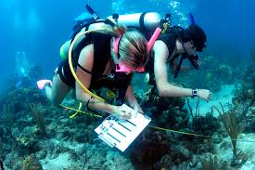
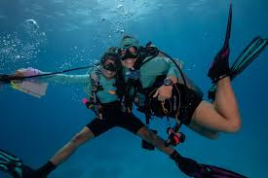
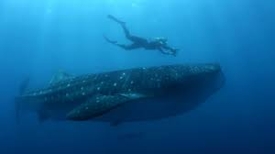
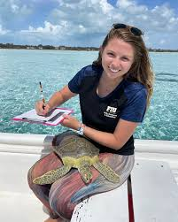

Career highlight: Marine Biologist

Slide 2
What is?
What they do: Study marine life—from plankton to whales—using fieldwork, diving, lab work, ecological modelling, genetics, toxicology, fishery management, and pollution assessment.
Typical tasks:
  Collecting samples at sea or along the coast (often diving)
  Analysing specimens in labs and writing scientific reports
  Monitoring marine health and informing policy or conservation
  Public outreach, teaching, consultancy, or policy work .

Slide 3
What qualifications will you need?
Education:
BSc, (Bachelor of Science), in Marine Biology, Oceanography, or biology, often followed by an MSc, (Master of science) degree, and frequently a PhD for research roles.
You will need an A level in biology, and frequently another science subject. Maths A level is also advised.
Early roles: Internships, unpaid/low-pay fieldwork, research assistant roles, (£18-£24k).
These roles are essential to gain diving/field/lab experience.
Mid-career: MSC-qualified roles, senior researchers, consultants, or lecturers, (£25-£35k)
Senior positions: Lead scientists, policy advisors, professors, and senior consultants, (£50-£80k)

Slide 4
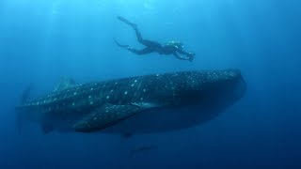
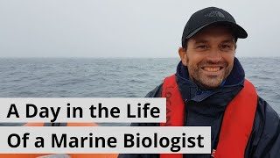
Example video

Slide 5
Salaries
Overall average:
  £31–32k typical, per Indeed and Glassdoor.
  Starting salary: as low as £13.7k for entry-level/assistant roles..
  MSc level: £25–35k; Senior: £36–50k; Professor/policy lead: £55–80k+
Geographic/sector variation:
  Higher pay near Plymouth (£46k), Aberdeen, Liverpool.
  Academic and government research roles may command higher pay than NGO or field roles.
Job satisfaction: High, despite wage challenges—people actively choose this for passion and purpose.

Slide 6
To find out more…
https://www.mba.ac.uk/
https://noc.ac.uk/
https://noc.ac.uk/

