Slide 1
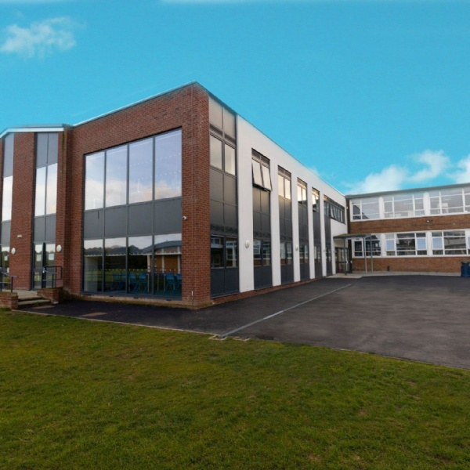

Emerson Park Academy
Year 11 Information Evening 2025

Slide 2
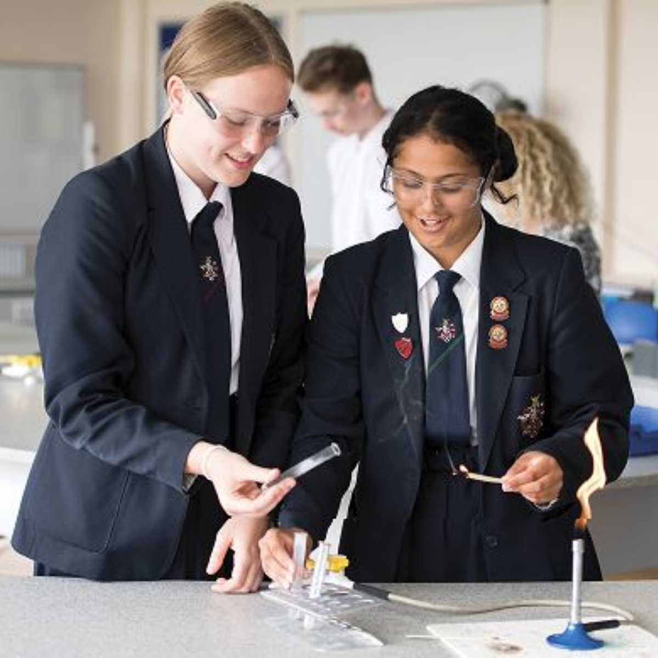
Aims of the evening
To share the ways the Academy is supporting year 11 academically as they move towards the examinations.
To look at the key ways we can support our young people with their well-being and revision during this period.
To provide key dates for examinations and college transfer.

Slide 3

Parent Packs:
A booklet - Parent Guide to GCSE.
Moving on Booklet (College Transfer).
A blank revision guide.
Dates for your diary.
Flyer re. Prom.
Flyer re. Hoodies.
Exam board leaflet.
Provisional Summer exam timetable.
Revision resources - Revision cards, highlighters, post it notes, pens and pencils.

Slide 4
What we are doing to support:
25 hours of lessons per week.
Form time - revision.
Targeted intervention.
Selection of revision sessions.
Homework and suggested revision sites.

Slide 5








Keeping you informed:

Slide 6
Further Support:
Form tutor support.
Subject teacher support.
Counselling.
Careers advice.

Slide 7
What you can do:
Keep an eye on the Academy website.
Take an interest in deadlines, exams, coursework etc
Create the right study environment.
Encourage the right study habits.
Ensure they are equipped to learn.
Monitor their sleep.

Slide 8
Take an interest:
Utilise Go4Schools – get the App.
Look at their exercise books, folders and revision materials.
Look up the exam board information.
Don’t accept one word answers - encourage discussion instead.
Play an active role in revision.

Slide 9
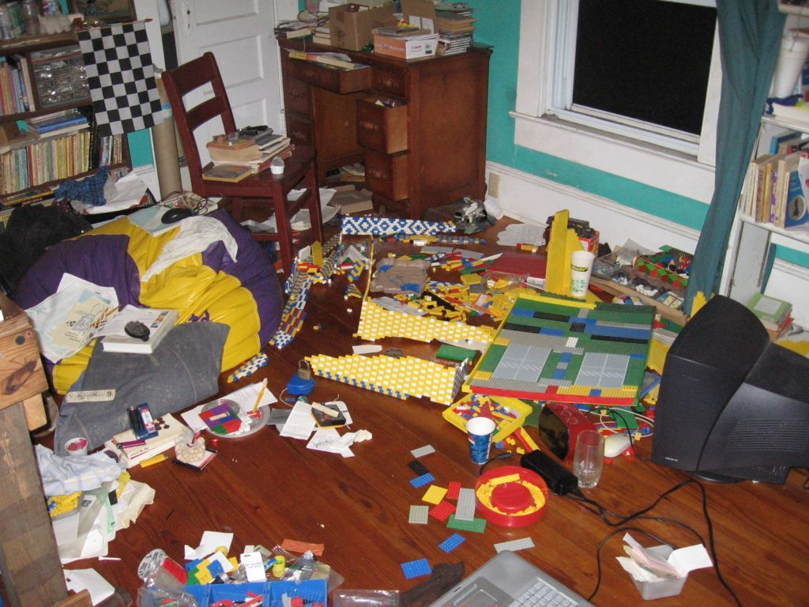
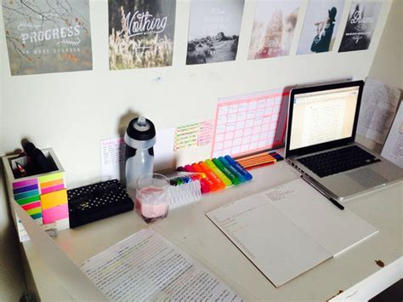
Create the Right Environment:
Calm.
Quiet.
Orderly.
Free from distraction.

Slide 10
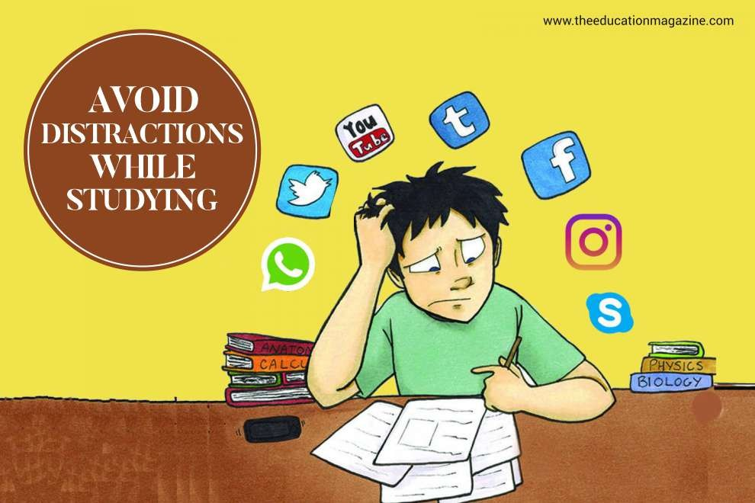
Monitor mobile phone use
Distraction
Reduced Focus and Performance
Cognitive Overload
Increased Anxiety

Slide 11

Monitor their sleep
Limit time on devises for 30 minutes before bed.
No devices in their bedroom overnight.

Slide 12
Check in and Praise often:
Praise work ethic and effort.
Help them set short term targets.
Reward
Factor in time for them to relax and reflect.

Slide 13

Supporting your child’s wellbeing
Sleep
Balanced diet
Exercise
Maintain some hobbies
Keep the little things little
Plan ahead to avoid becoming overwhelmed
Recognise what they have already achieved
One step at a time – trust the process
School interventions

Slide 14
Attendance & Punctuality:
35 weeks
 | 1 | 2 | 3 | 4 | 5 | 6 | 7 |  | 8 | 9 | 10 | 11 | 12 | 13 | 14 | 15 |  |  | 16 | 17 | 18 | 19 | 20 | 21 |  | 22 | 23 | 24 | 25 | 26 |  |  | 27 | 28 | 29 | 30 | 31 | 32 |  | 33 | 34 | 35 | 36
Monday
Tuesday |  |  |  |  |  |  |  |  |  |  |  |  |  |  |  |  |  |  |  |  |  |  |  |  |  |  |  |  |  |  |  |  |  |  |  |  |  | E | X | A | M | S
Wednesday
Thursday
Friday
Saturday
Sunday

Slide 15
Attendance & Punctuality:
26 weeks
 | 1 | 2 | 3 | 4 | 5 | 6 | 7 |  | 8 | 9 | 10 | 11 | 12 | 13 | 14 | 15 |  |  | 16 | 17 | 18 | 19 | 20 | 21 |  | 22 | 23 | 24 | 25 | 26 |  |  | 27 | 28 | 29 | 30 | 31 | 32 |  | 33 | 34 | 35 | 36
Monday
Tuesday |  |  |  |  |  |  |  |  |  |  |  |  |  |  |  |  |  |  |  |  |  |  |  |  |  |  |  |  |  |  |  |  |  |  |  |  |  | E | X | A | M | S
Wednesday
Thursday
Friday
Saturday
Sunday

Slide 16
Attendance & Punctuality:
26 weeks = 131 school days
 | 1 | 2 | 3 | 4 | 5 | 6 | 7 |  | 8 | 9 | 10 | 11 | 12 | 13 | 14 | 15 |  |  | 16 | 17 | 18 | 19 | 20 | 21 |  | 22 | 23 | 24 | 25 | 26 |  |  | 27 | 28 | 29 | 30 | 31 | 32 |  | 33 | 34 | 35 | 36
Monday
Tuesday |  |  |  |  |  |  |  |  |  |  |  |  |  |  |  |  |  |  |  |  |  |  |  |  |  |  |  |  |  |  |  |  |  |  |  |  |  | E | X | A | M | S
Wednesday
Thursday
Friday
Saturday
Sunday

Slide 17
Attendance & Punctuality:
128 school days
 | 1 | 2 | 3 | 4 | 5 | 6 | 7 |  | 8 | 9 | 10 | 11 | 12 | 13 | 14 | 15 |  |  | 16 | 17 | 18 | 19 | 20 | 21 |  | 22 | 23 | 24 | 25 | 26 |  |  | 27 | 28 | 29 | 30 | 31 | 32 |  | 33 | 34 | 35 | 36
Monday
Tuesday |  |  |  |  |  |  |  |  |  |  |  |  |  |  |  |  |  |  |  |  |  |  |  |  |  |  |  |  |  |  |  |  |  |  |  |  |  | E | X | A | M | S
Wednesday
Thursday
Friday
Saturday
Sunday
Notes:
Nov long weekend
Early May bank holiday

Slide 18
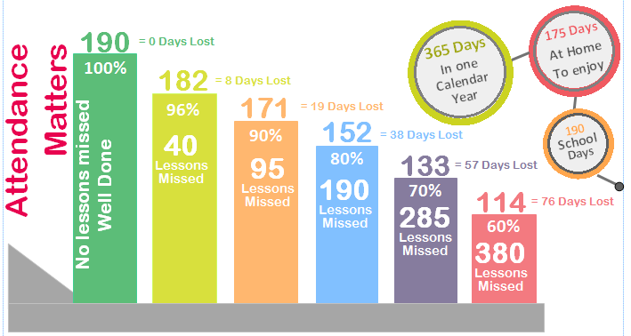
Attendance & Punctuality
Students with over 90% attendance are more likely to gain five or more GCSEs at 5-9 (or equivalent) qualifications.
Students with less than 85% attendance at school are unlikely to gain five GCSEs at 5-9.

Slide 19
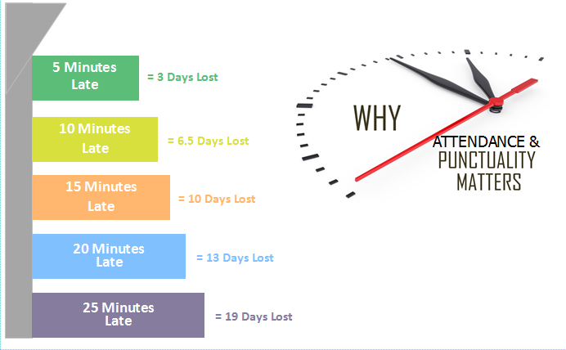
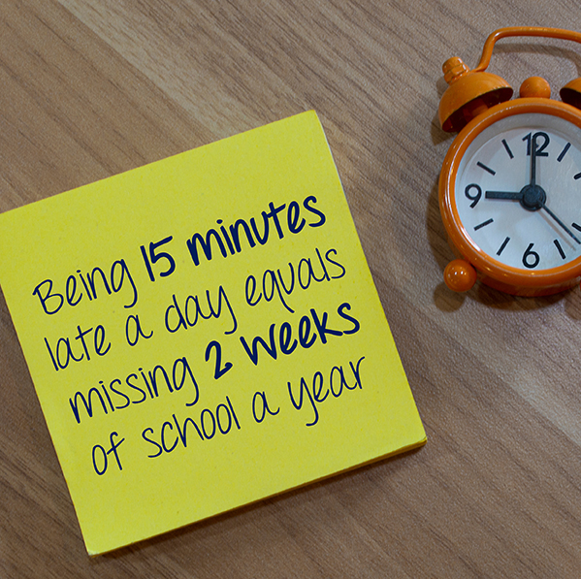
Attendance & Punctuality

Slide 20
Effective Study and Revision Tips:
Use a revision timetable to plan and sequence the periods to study.

Slide 21
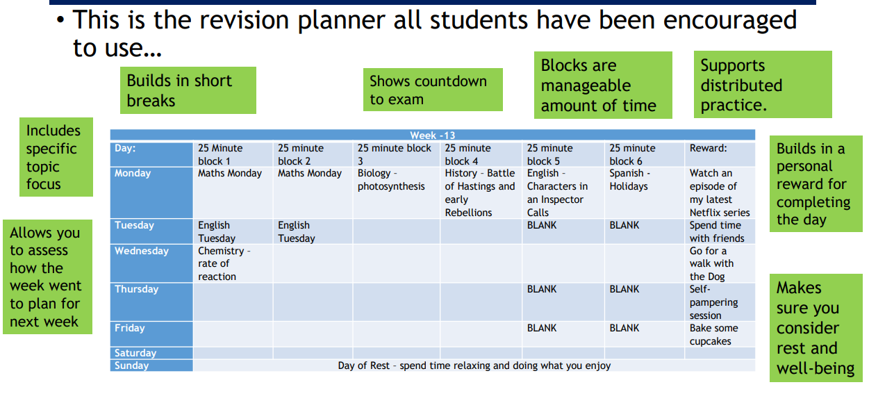

Slide 22
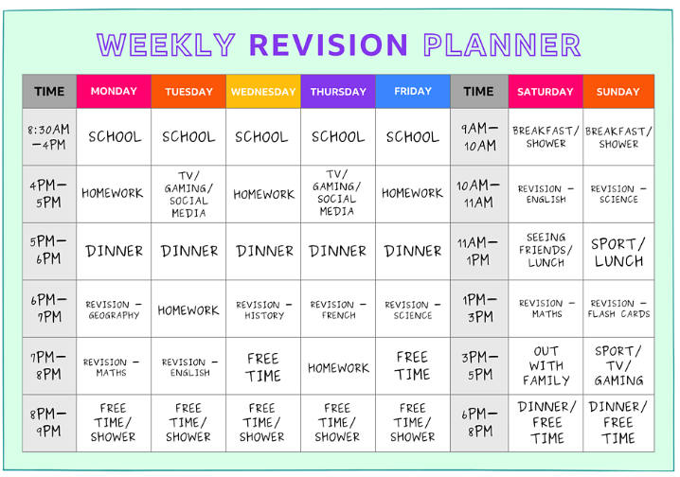
Write in when you have school, clubs, meals, free time etc. Be realistic with what and when you will revise.
Revising in 30-40 minute chunks is very effective and will help you maintain a higher level of focus.
Remember to book in breaks for yourself
Tip: Be specific with what you are revising. English: Macbeth- ambition theme, Biology: Cell structure, French: Conditional tense

Slide 23
Effective Study and Revision Tips:
Active Revision
Choose the topic – make sure it’s narrow enough to condense effectively.
Gather information and focus on the main points.
Organise content – avoid overlapping information. Keep it simple.
Use visual aids.
Test yourself.
Dual code information – using verbal and visual materials to aid memory.
Use a study-buddy to test each other.

Slide 24
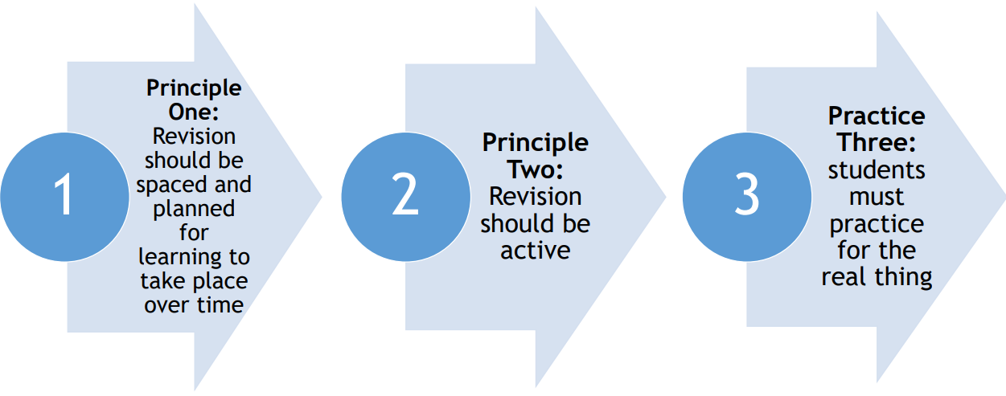
Effective Study and Revision Tips:

Slide 25
Effective Study and Revision Tips:

Slide 26
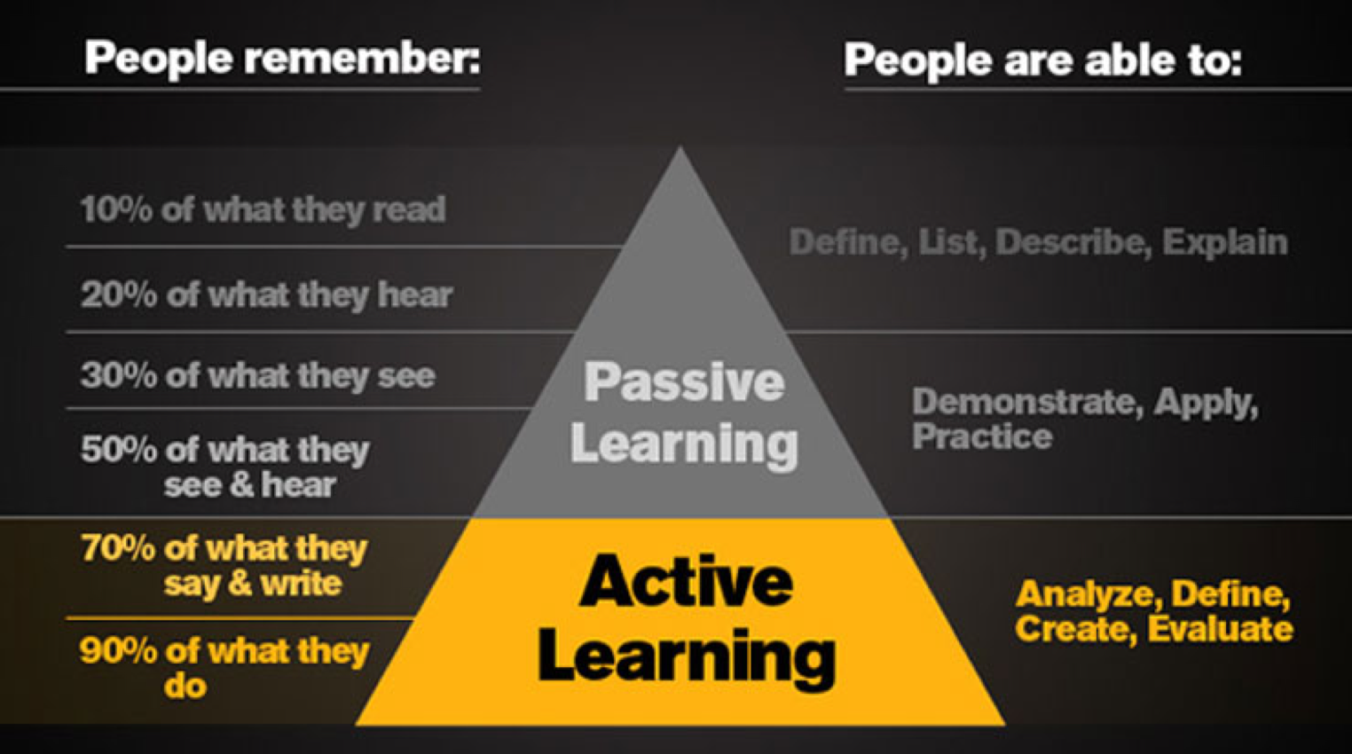


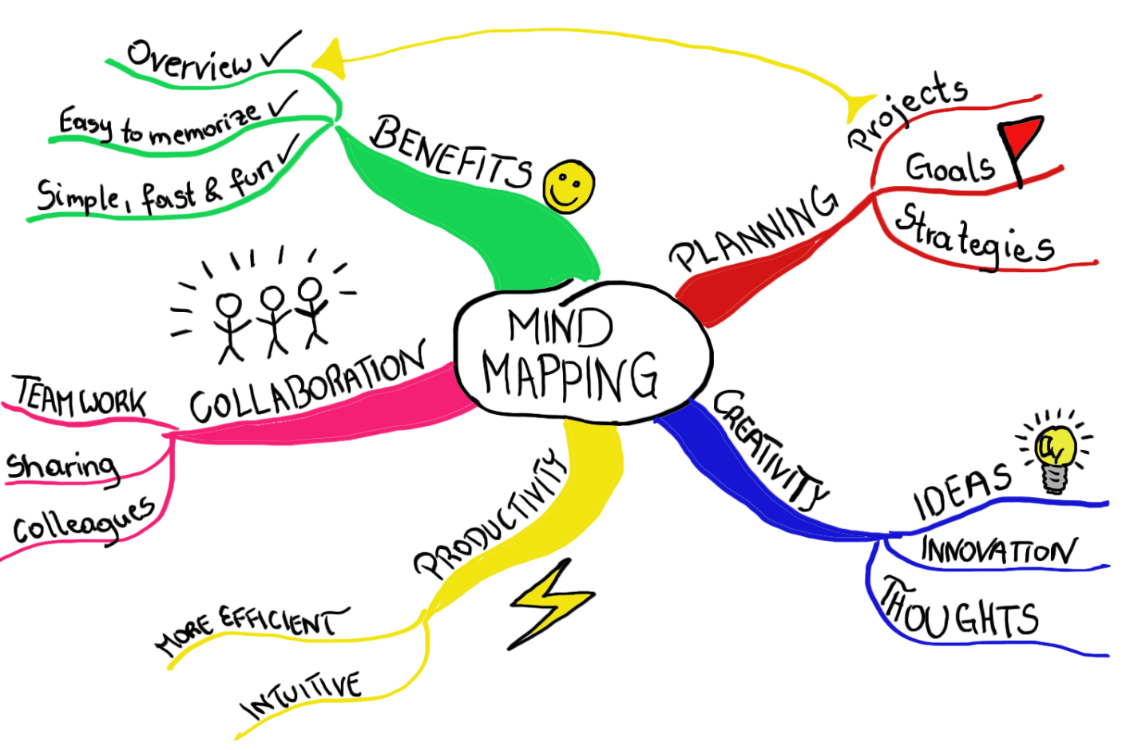
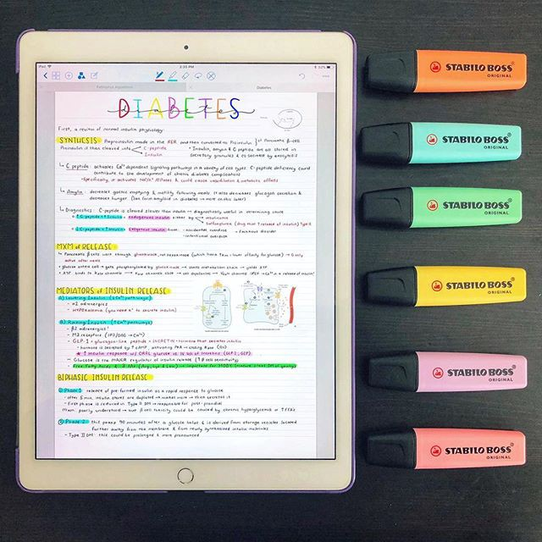
How to revise

Slide 27
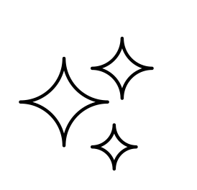
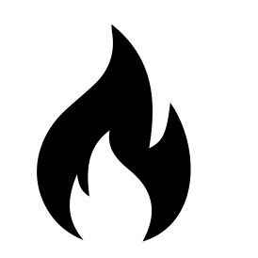

“_____ like the _____ flower, / But be the _____ under't’” Lady Macbeth
LOOK
INNOCENT
SERPENT
Give yourself a decent pause before flipping straight over to the answer. The work your brain does during this moment actually strengthens your brain, even if you don’t get it right!
Prioritise the ones you cannot do. If you don’t get the answer, revisit that card again at the end of your revision session, have another try at recalling the answer.
Do keep going over all your cards, even the ones you are best at. Revisiting this information is still valuable.
Get other people to test you!
““Stars hide your fires, Let not light see my black and deep desires”
Romeo
Why is Macduff an important character in ‘Macbeth’?
He is honourable and seeks to serve the crown for Scotland
He discovers Duncan’s body and is the first to be wary of Macbeth
He behead Macbeth as a traitor and restores order to Scotland
He offers another perspective on masculinity: he is more emotional and does not shy away from grief

Slide 28
Effective Study and Revision Tips:

Slide 29
Effective Study and Revision Tips: Application
Use past-papers
Complete without notes
Timed conditions – hand written
Self assess with answers
Highlight areas of concern
Re-build revision plan

Slide 30
Head of English Ms D Connolly

Slide 31
IN YEAR 10…
…the pupils studied most of the content for their English Literature GCSE.
A Christmas Carol
Macbeth
A Modern Text (An Inspector Calls or Blood Brothers)
and some of the 15 Power & Conflict Poems they have to know for the exam.
In Year 11 they will prepare for their English Language exam, finish the Power & Conflict Poems, record their Spoken Language coursework and look at some Unseen Poetry
It’s almost certain that they will need to revise their understanding of the Literature texts they studied in Year 10.

Slide 32
So if they tell you…
“You can’t really revise for English”
They can.
We will upload to the school website, this PowerPoint which explains how they can revise for Literature.
There will also be links to practice papers, revision sites, suggested films and revision guides.

Slide 33
“How do you even revise for English Miss?”
What works?
Retrieval Practice
Work on one text at a time
Try to retrieve what you’ve already got in your long term memory
KNOWING AND UNDERSTANDING THE TEXTS IS MOST IMPORTANT. MAKE SURE YOU KNOW AND UNDERSTAND EACH TEXT. YOU CAN USE BOOKS/REVISION GUIDES, ONLINE RESOURCES OR WATCH FILM VERSIONS OR YOUTUBE TUTORIALS.

Slide 34
Example: A CHRISTMAS CAROL
FIVE STAVES OR CHAPTERS – bullet point everything that you can remember that happens in each stave – one stave at a time.
TEN MAIN CHARACTERS – Write down what you know about each of them – one at a time.
CONTEXTUAL INFORMATION – Write down what you can remember about the world Dickens was living and writing in and why Dickens wrote this story.
THEMES – Write down any themes you can remember.
See where your gaps are and then go online, find the missing info and write it into your notes. Once your notes are complete – write them onto a revision card or section in a notebook.
The same process works for Macbeth, their Modern Text, and each of the poems they have studied.
30 minutes max.

Slide 35
“HOW ARE WE SUPPOSED TO REMEMBER ALL THOSE QUOTES MISS?”
The repetition and the adverb show how emphatic Mr Birley is being
For novels and plays - three or four quotes for each character and each theme.
For the poetry - three or four key quotes for each of the poems from the anthology.
Be thoughtful with your choice of quotes. If one of the things you have said in your character notes for Mr Birling is that he is arrogant and ignorant - what would be a good quote to memorise?
Add your quotes to your notes and practise ‘exploding them’ – Who said them? To who? Why? What language features do they include? Why have those language features been used? What effect do they create?
‘unsinkable, absolutely unsinkable’
The fact he is speaking about the Titanic is dramatic irony

Slide 36
NEXT STEPS
Practise writing essays, parts of essays, paragraphs of analysis, introductions to essays, contextual links.
Pupils who do well in exams usually have a clear idea about what they are going to write before they even go into the exam.
Once you have practised, you can tweak what you have written to fit other similar exam questions.

Slide 37
Reading
Use practice papers that include extracts from modern times as well as 19th /20th Century. Read texts from a range of genres.
Pick out language features and powerful words and practise ‘exploding’ them in the same way as you have for Literature
Think about the overall structure of the text – how does it begin? End? Why?

Slide 38
Creative Writing
Take work you’ve done in lesson or in exams and improve it at home.
Never fail to plan where your writing is ‘going’ before you begin.
Upgrade your vocabulary.
Practise writing an ‘all purpose’ intro paragraph – that will fit various questions: a positive description of sunny day or a gloomy, rainy day.

Slide 39
What else?
As we get closer to the exam, English teachers will start to offer after school intervention.
Punctuality and 100% attendance to your lessons.
Ensuring you have what your need: a pen, a highlighter, your anthology.
Full participation in lessons.
Completion of all homework assignments to the best of your ability.
OUR FIRST MOCK EXAM IS ON NOVEMBER 10th (am) AND IT WILL BE ON ENGLISH LANGUAGE PAPER 1.
ENGLISH LANGUAGE PAPER 2 AND A LITERATURE PAPER
WILL BE EXAMINED IN JANUARY.

Slide 40
Mathematics: Mr G Dordoy (AHT)

Slide 41
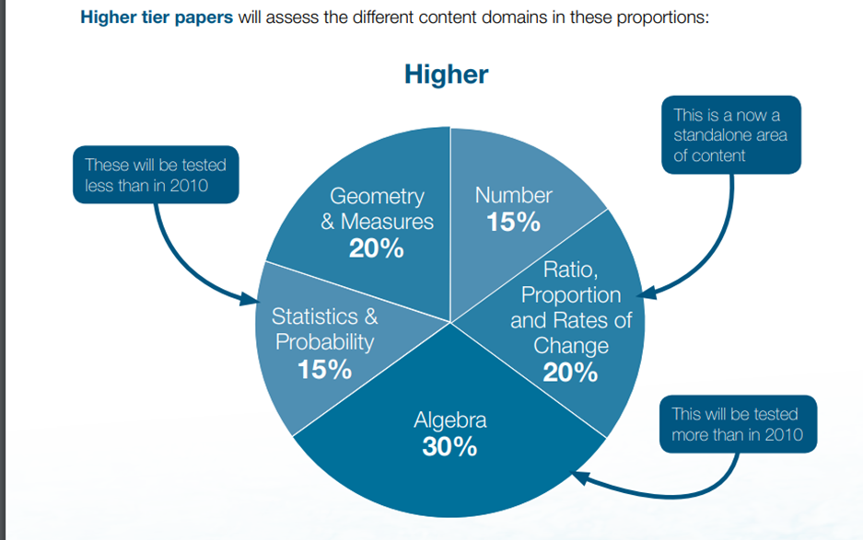
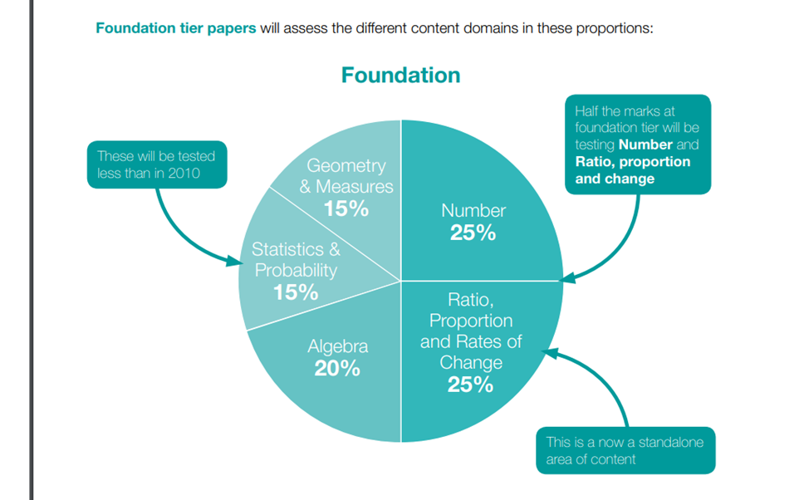
GCSE Breakdown – Foundation/Higher

Slide 42
How to prepare for the GCSE
Best way to revise Maths is to do Maths.
3-5 Hours revision (outside of classwork and homework).
Sparx Maths.
Maths Genie and CorbettMaths.
Timed exam practice.
Teacher help.

Slide 43
Barriers to Success
Copying the work from a friend.
Looking at the mark scheme.
Only revising topics, you are confident at.
Last minute revision.
AI

Slide 44
The Negative Impact of AI
Student A
Student B
Too many students are using AI for their homework.
It doesn’t give the teacher a true reflection of their understanding.

Slide 45
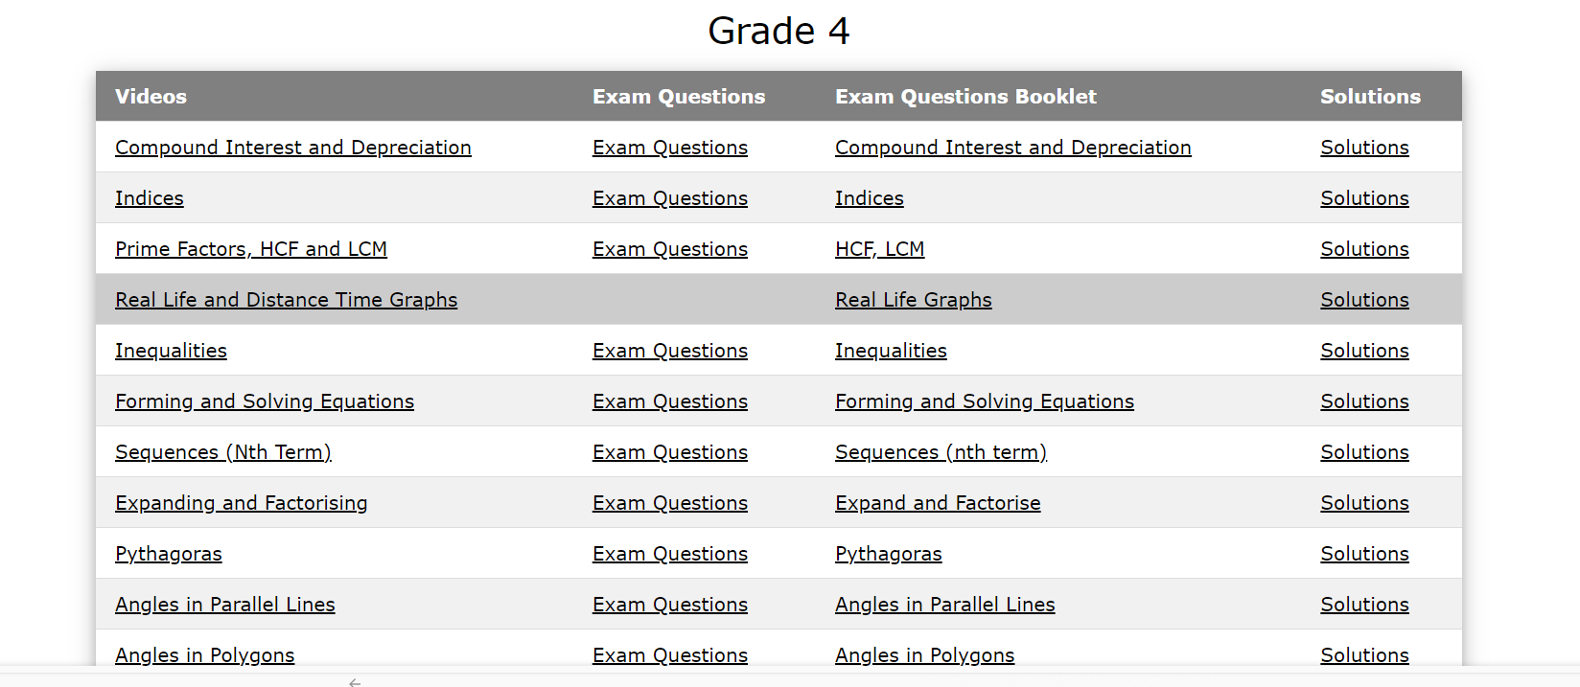
Maths Genie

Slide 46
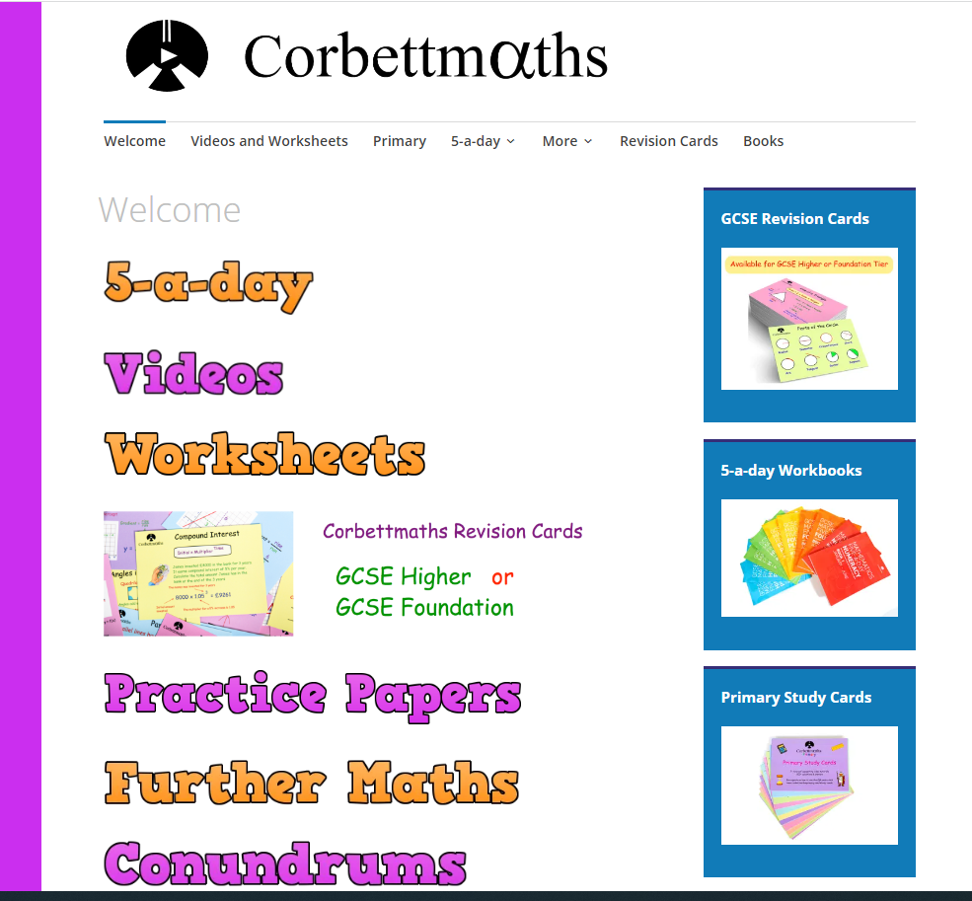
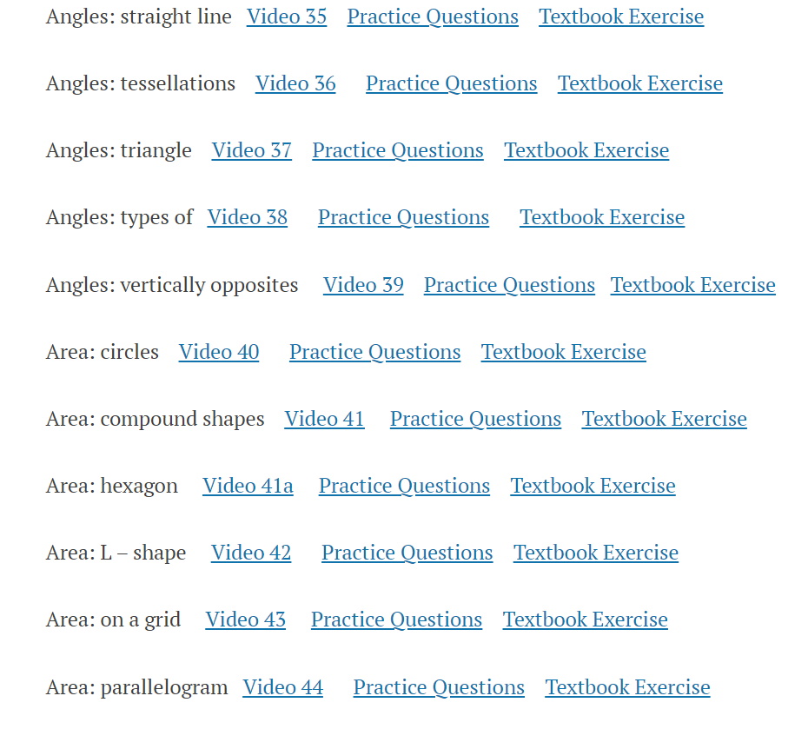
Corbettmaths

Slide 47
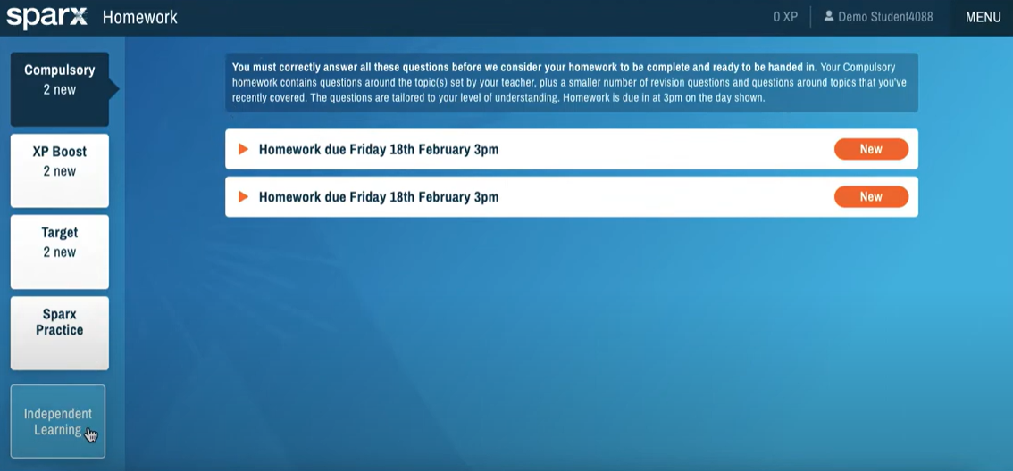
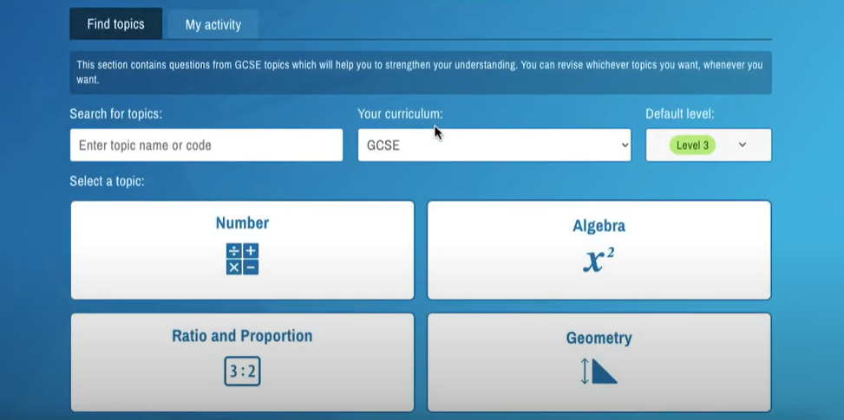
Sparx Maths

Slide 48
Science:

Slide 49
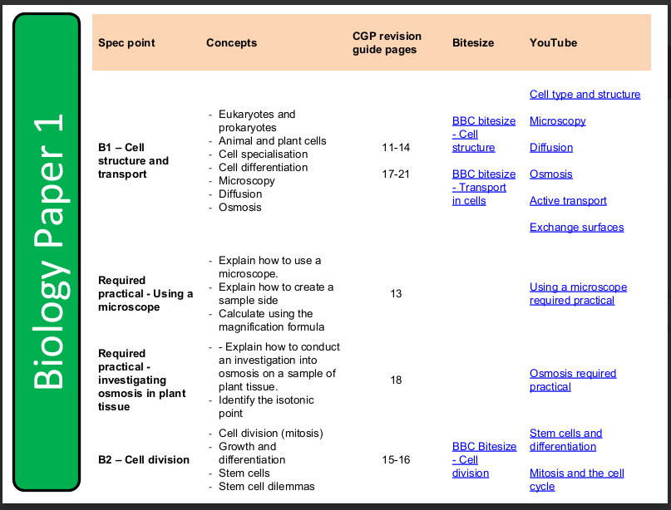
Year 11 Science google classroom
Class code: rfdokb2
Course overview – A full breakdown of each unit including revision guide pages, links to BBC bitesize and YouTube videos on almost every single part of the course.

Slide 50
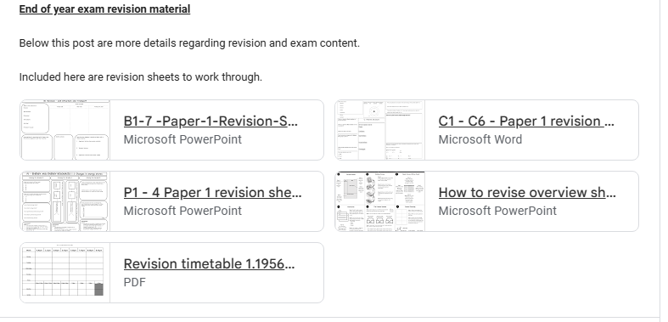
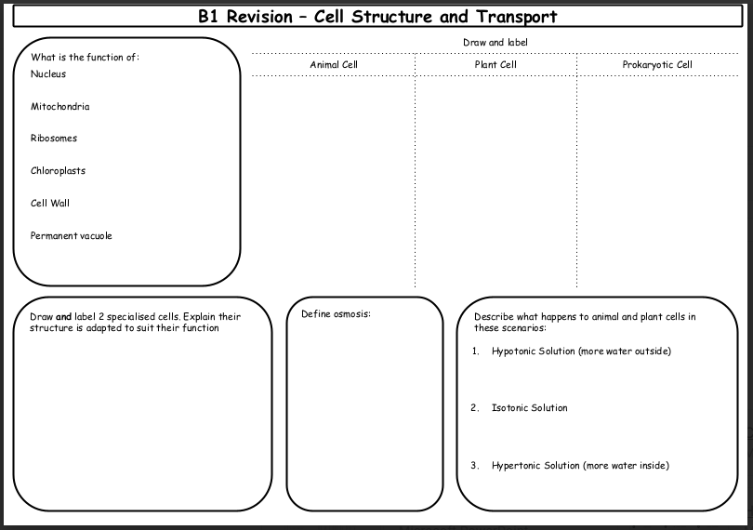
Year 11 Science google classroom
Revision material – Revision mats and materials for almost the entire of the paper 1 content

Slide 51
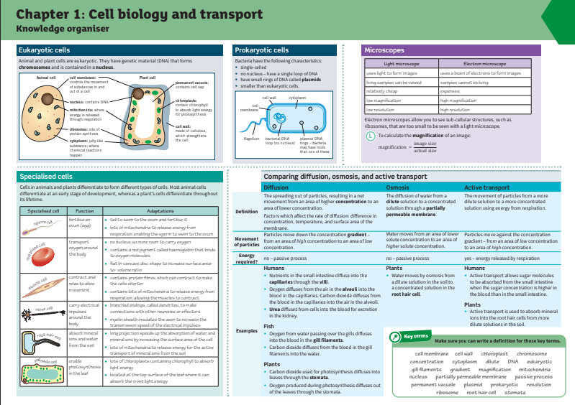
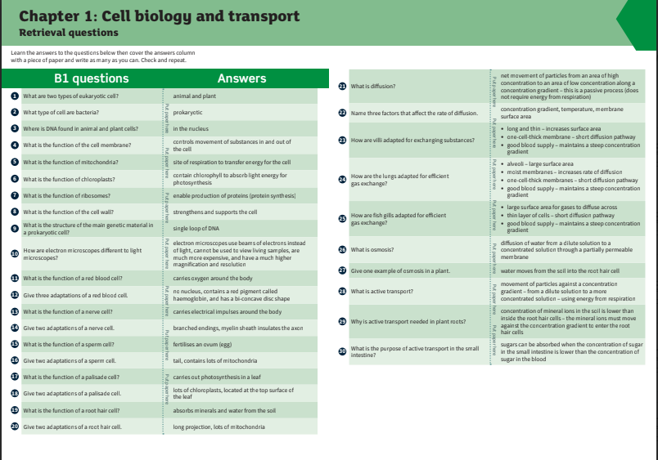
Year 11 Science google classroom
Knowledge organisers – Summary of key information and quick-fire questions on core parts of each topic.

Slide 52
September | Year 11 begins | Predicted Grades
October | Form Tutors Writing references | Parents Information evening
November |  | College open evenings | Mock exams: 10th – 27th Nov | Mock exams: 10th – 27th Nov
December |  | College applications deadlines – vary from college to college
January | Mock results published: 7th Jan | Year 11 Parents Evening: 8th Jan | Predicted Grades College applications deadlines References requested and sent
February | College interviews (Feb-May)
March | Spring Mock Exams 2nd-6th March
April | Final predicted grades
May | GCSE EXAMS 5th May onwards
June
July | Prom – Thursday 9th July 2026
August | GSCE Results day Places offered dependent on grades
Academic overview ‘25-26

Slide 53
College Transfer: Ms Hampton

Slide 54
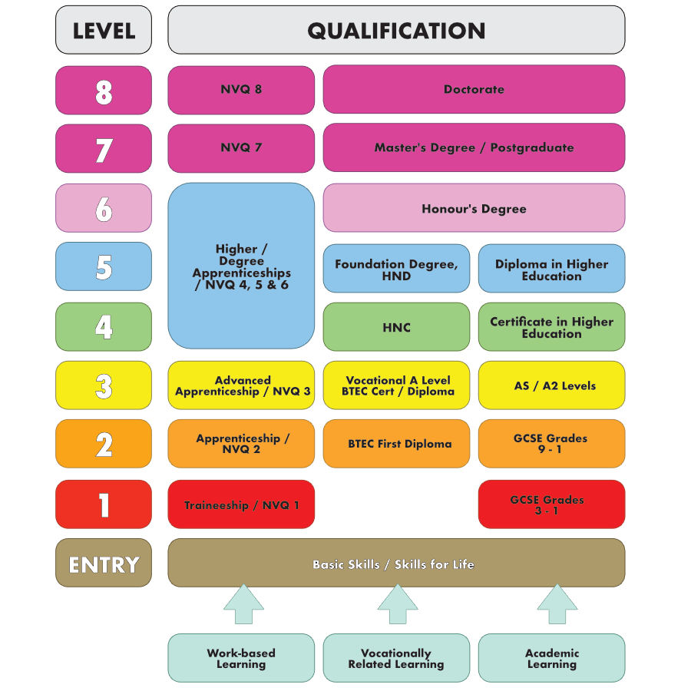
College Transfer: Qualifications framework

Slide 55
College Transfer: Where can pupils go next?
School Sixth Form.
Sixth form Colleges.
Colleges of Further & Higher Education.
Apprenticeships.
Traineeships.

Slide 56
College Transfer:
What Courses Could Pupils Choose?
Full-time Education (School or College).
Apprenticeship or traineeship.
Part-time education or training combined with one of the following:
  Employment or self employment for 20 hours or more a week.
  Volunteering for 20 hours or more a week.

Slide 57

Where do EPA pupils move on to?
2024:
168 pupils were in Full Time Education
7 pupils went into an Apprenticeship
55 Pupils went to a sixth form college
54 Pupils went to a Further Education College
59 pupils went to a School Sixth Form
1 pupil went into Employment with training

Slide 58
College Transfer:
What Courses Could Pupils Choose?
BTECs are designed for young people interested in a particular sector or industry but who are not yet sure what job they’d like to do.
You could study a BTEC at Level 2 or 3, either alongside academic qualifications or as part of a wider programme (such as an apprenticeship). You can also study a BTEC as a standalone course.
Advanced level qualifications (A levels) are subject-based qualifications that can lead to university, further study, training, or work. You can normally study three or more A levels over two years. They’re usually assessed by a series of examinations.
You need:
At least 5 GCSEs at grades 9 to 4/A* to C
At least grade 6 in the subject specific subjects you want to study

Slide 59
College Transfer: What Courses Could Pupils Choose?
T Levels are new two-year courses equivalent to three levels, which will be available to students in England.
T Levels are designed by employers, and will offer around 1,800 hours of study over two years. This will include a 45-day work placement, so T Levels will be more suited to students who know what occupation or industry they want to move into.
What T Level subjects are available?
T levels have been introduced over 5 years. T levels are being offered locally by New City College, Barking and Dagenham College and South Essex College in subjects such as Engineering, construction, Health and Digital Production.

Slide 60
College Transfer:
Apprenticeships
An apprenticeship is a paid job where the employee learns and gains valuable experiences.
Alongside on-the-job training, apprentices spend at least 20% of their working hours completing classroom-based learning with a college, university or training provider which leads to a nationally recognised qualification.
An apprenticeship includes:
paid employment with holiday leave
hands-on-experience in a sector/role of interest
at least 20% off-the-job training
formal assessment which leads to a nationally recognised qualification
Notes:
How much training is offered?
Will there be any qualifications?
What experience will you gain?
What are the job/ career prospects?
What is the potential for continued professional development or training
Apprenticeships can be found on the gov website or direct from employers.

Slide 61








Where can pupils study in Havering?
The Campion School
Coopers' Company and Coborn School
Sacred Heart
New City College
Harris Academy Rainham
The Frances Bardsley Academy
Drapers Academy
St. Edwards

Slide 62









Where can pupils study outside Havering?

Slide 63
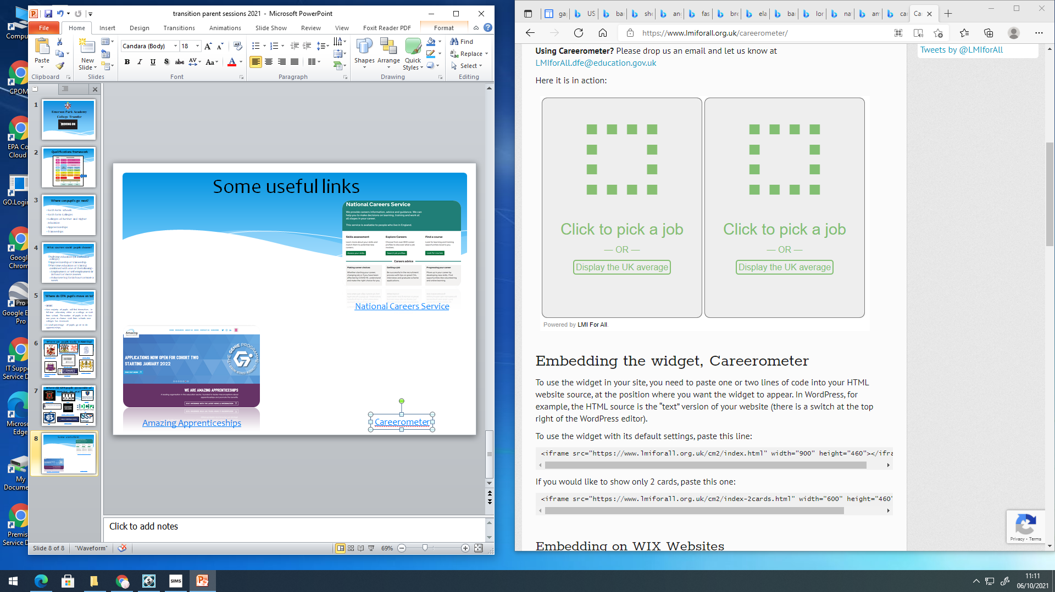
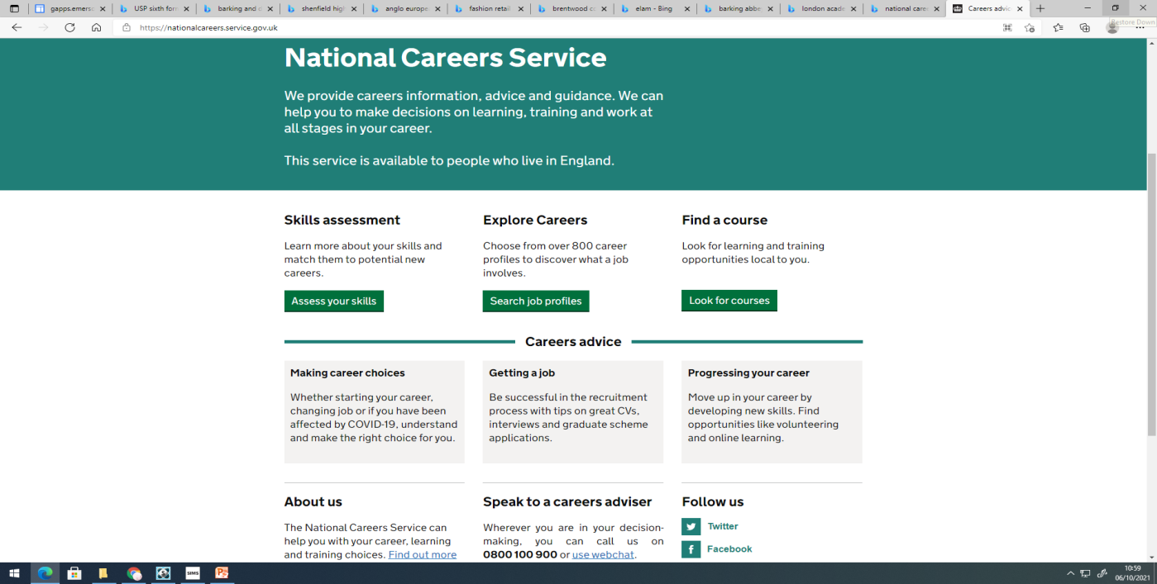

College Transfer:
Useful Links
Careerometer
National Careers Service
Amazing Apprenticeships

Slide 64
Dates for your diary
Coopers’ Company & Coborn School | Wednesday, 19th November, 4pm
Drapers’ Academy | Tuesday, 11th November, 5pm
Harris Academy Rainham | Thursday, 13th November, 5pm
Sacred Heart of Mary Girls’ School | Thursday, 13th November, 5pm
St. Edward’s Church of England Academy | Thursday, 13th November, 6pm
The Campion School | Thursday, 9th October, 6pm
The Frances Bardsley Academy for Girls | Thursday, 20th November, time TBA
New City College, all campuses | Saturday, 22nd November, 10am
Shenfield High School | Thursday, 13th November, 6pm
Brentwood County High | Thursday, 20th November, 5pm
St. Martins School | Thursday, 16th October, 5.30pm
Barking & Dagenham College, Rush Green Campus | Saturday, 4th October, 10am
Fashion Retail College | Saturday, 18th October (book on website)
East London Arts and Music (ELAM) | Applications are open but not information about open event
London Academy of Excellence | Thursday, 22nd January, (online) and Thursday, 29th January, 4pm (in-person)

Slide 65
Post 16 application process
Students can and should apply to as many different institutions as they want to.
Students should have realistic expectations in terms of the grades they will achieve in August 2026 and include these if asked.
Pupil references are initially written by the Form Tutor/HOY. Initial predicted grades are sent alongside references directly to the institutions applied to.
Attendance and punctuality figures are added from school records.

Slide 66
What if they don’t make the grade?
Students must re-sit English & Maths GCSE until they gain a 4 or above.
Until they are 18
Regardless of the course or apprenticeship they are on.
Sixth Forms set their own entry requirements, and they may decline your place or ask you to choose different courses should you not meet the agreed standards.
Some will negotiate or allow you to try courses.
Some subjects such as maths or physics may have high minimum grades (7-9) that they will not negotiate on due to the difficulty of the courses.
All students are able to access a course at Havering Sixth Form College or Havering College (New City College)
Level 2 access courses are available for many vocational qualifications.
These increase the study time by 1 year but allow the learner to build skills and qualifications.

Slide 67


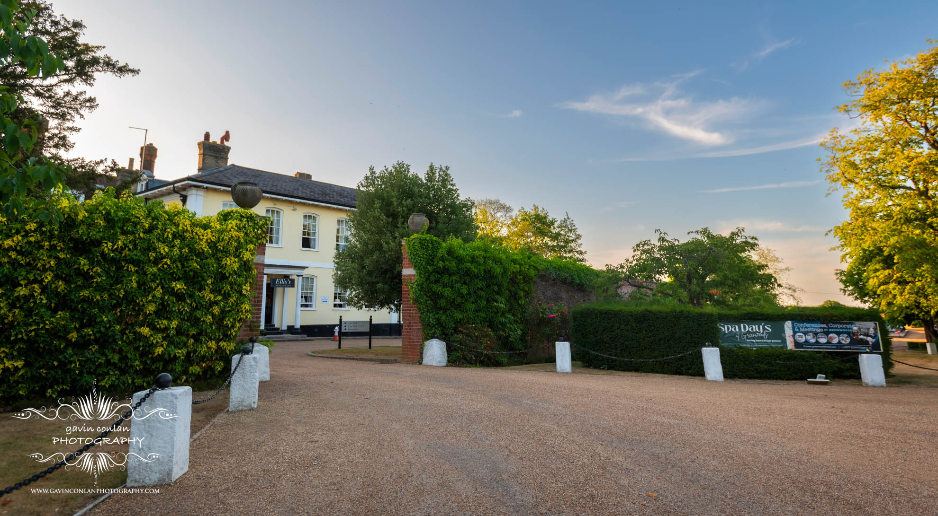
Prom 2026

Slide 68
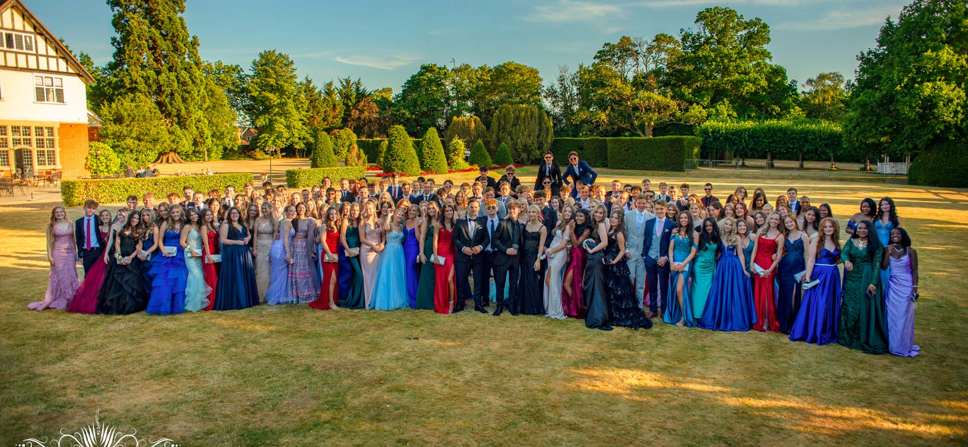
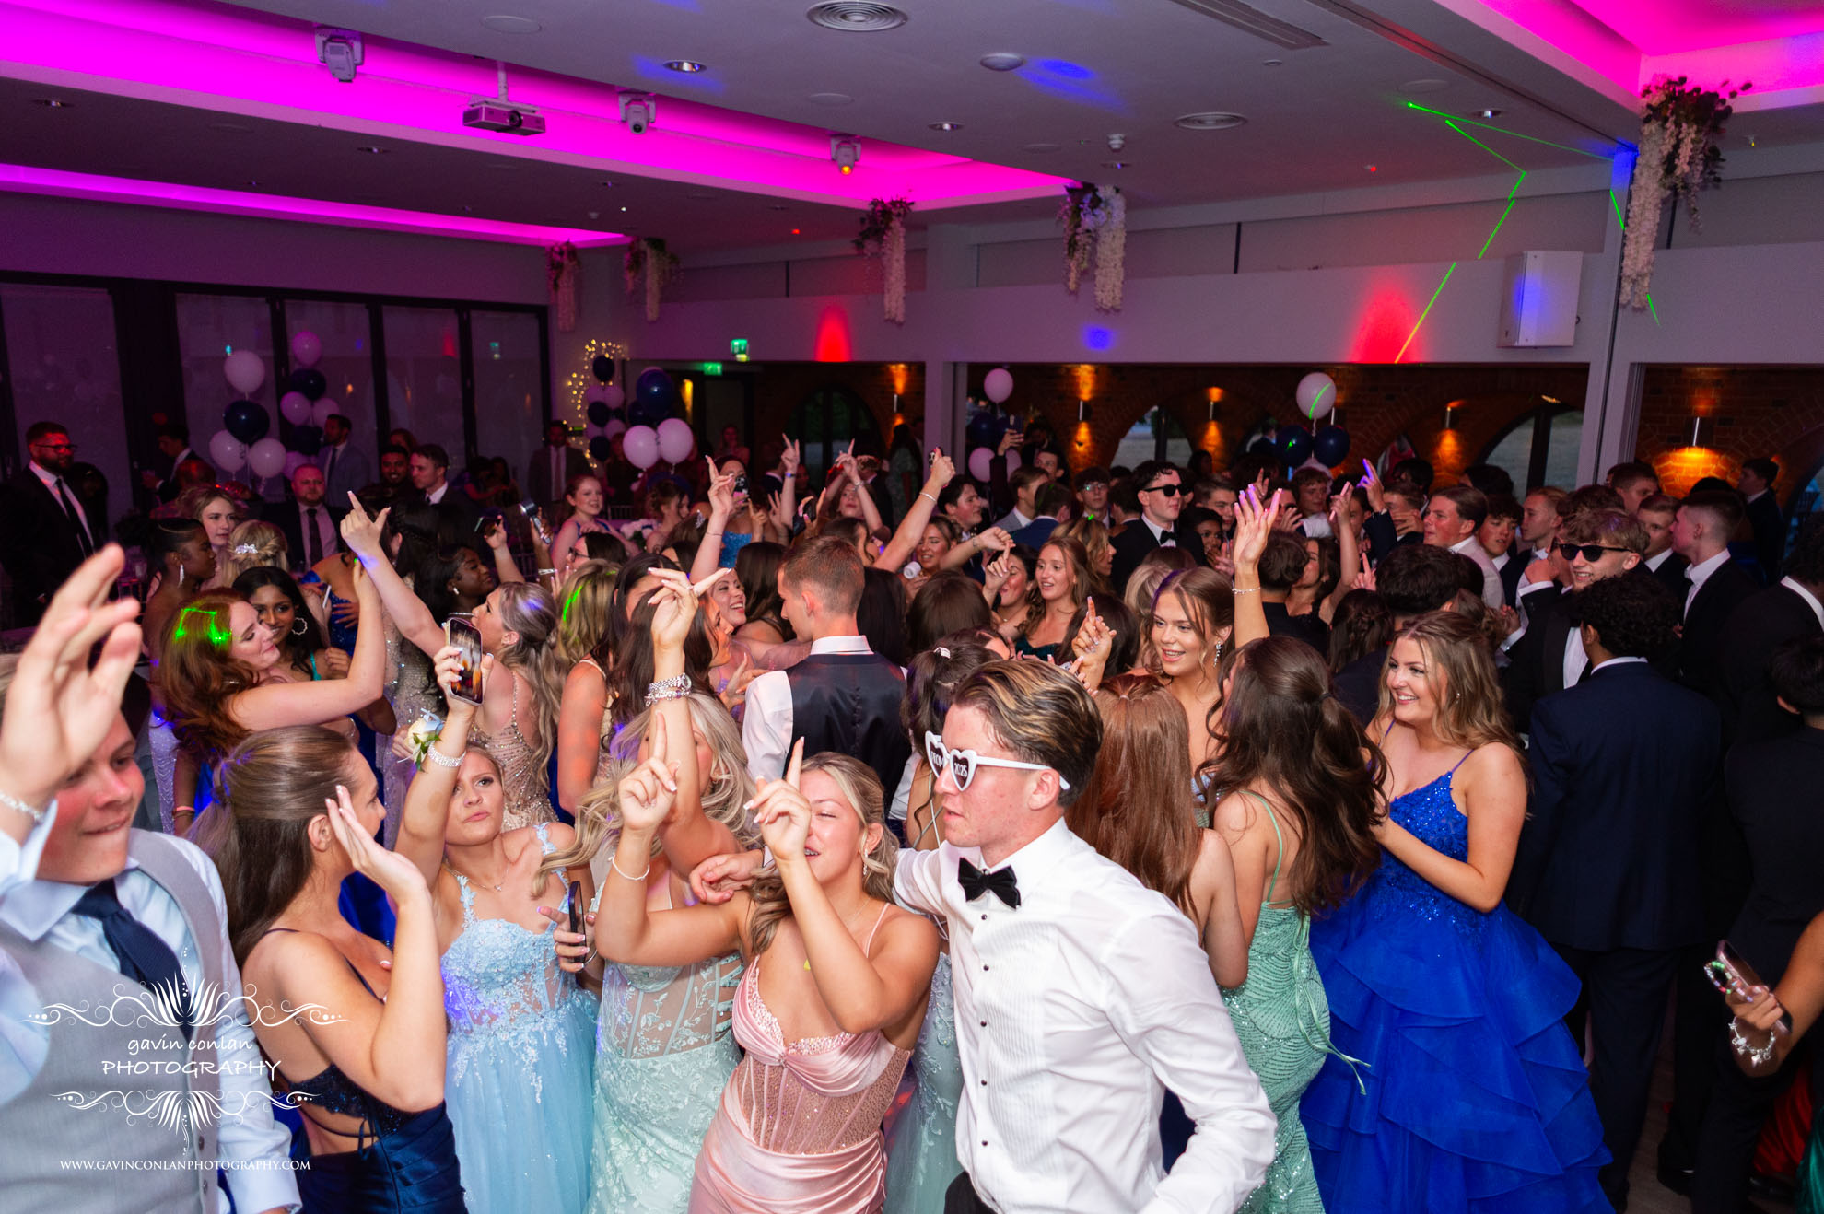
Celebrations: Passport to the Prom.
A formal school event.
A reward for hard work, good attendance, punctuality and consistently meeting expectations.
Pupils gain points across the year and must have:
60 overall points as a minimum.
They must achieve a minimum of 95% attendance.
They must have good punctuality both to school and lessons.
Prom photo

Slide 69
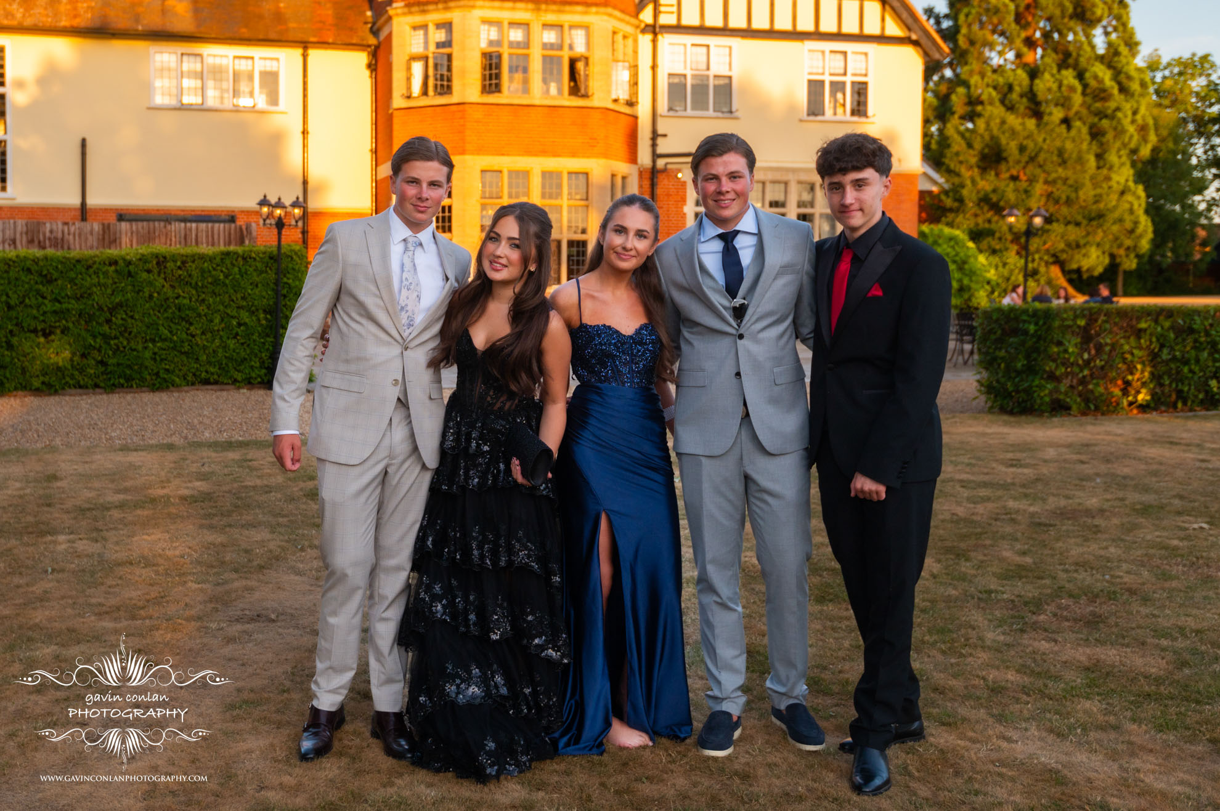
Passport to the Prom.
How do I gain points?
Prom photo
Attendance per month 96-100% | 3 points
Punctuality per month: 0 late marks | 3 points
No sanctions for behaviour | 3 points
Consistent attendance at clubs | 2 points
Representing the Academy -e.g Sport, Drama or Music | 2 points
Completion of Duke of Edinburgh Award | 5 points
Volunteering | 3 points

Slide 70
Passport to the Prom.
How do I lose points?
Prom photo
Arriving late | -2 points
Poor or incorrect uniform | -2 points
Behaviour
Low Level | - 1 point
Detention | - 2 points
Serious failure to comply | - 4 points
Truancy | - 3 points
Isolation | - 5 points

Slide 71
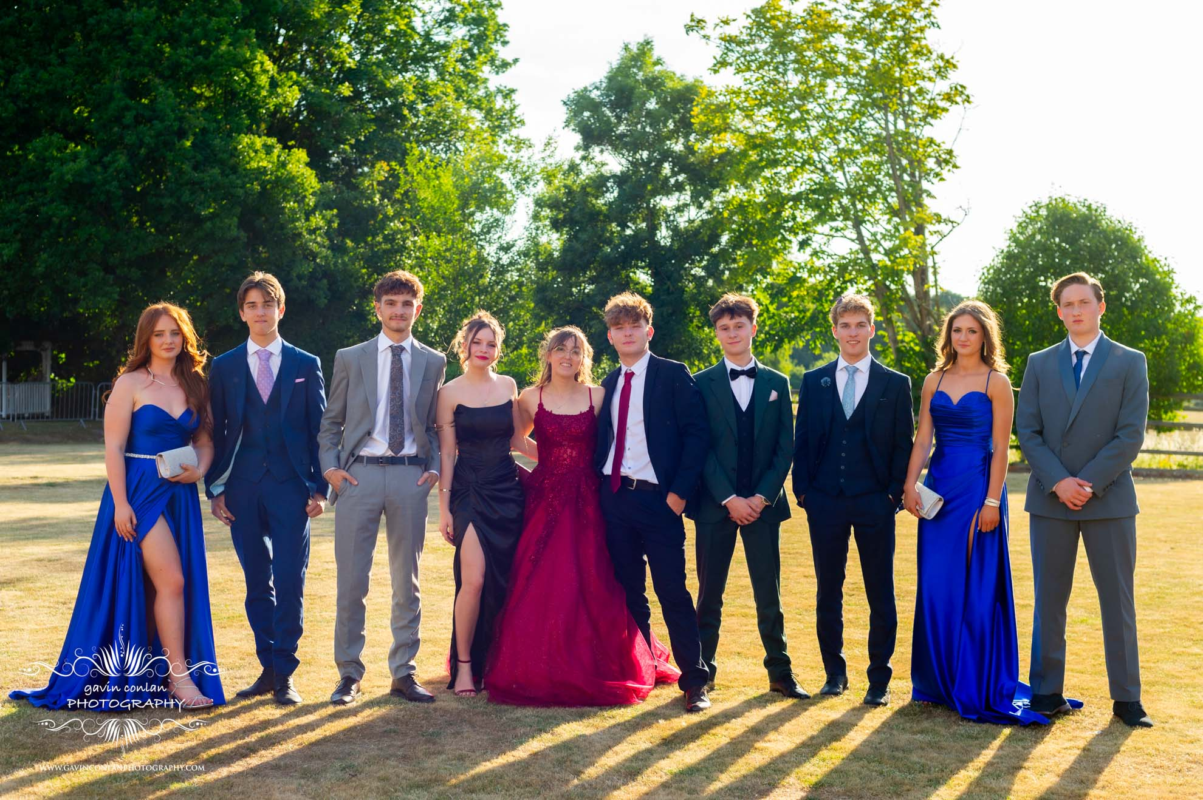

Passport to the Prom.
Prom photo
The two students who have the most points by Tuesday 5th May 2026 will have their Prom ticket paid for by the Academy.

Slide 72
The Power of Parental Support
“Parental support is eight times more important in determining a child’s academic success than social class, according to a new study. The campaign for learning found that parental involvement in a child’s education can be the difference between a 9 and a low pass at GCSE (TES)”

Slide 74




Online shop opening soon!

