Slide 1


Year 9 Options Evening
Making the Right Choices
12th March 2026

Slide 2
The Core Subjects
English and English Literature (2 GCSEs)
Mathematics
Combined Science(2 GCSEs)
Physical Education (Non examination)
Religious Education, Careers Education, PSHE and Citizenship (via tutor time and drop down days).

Slide 3
Other Subjects Offered:
GCSE Art and Design: Fine Art | GCSE Design and Technology: Timbers | GCSE Music
GCSE Art and Design: Photography | GCSE Drama | GCSE Separate Sciences
GCSE Business | GCSE Geography | GCSE Spanish
GCSE Citizenship Studies | GCSE Food Preparation and Nutrition | BTEC Sport
BTEC Construction and Built Environment | BTEC Health and Social Care | GCSE Sport Science
Cambridge National IT: Creative i-media | GCSE History | GCSE Psychology
GCSE Computer Science | BTEC Media Studies

Slide 4
Government Recommendations:
All pupils study a minimum of 8 GCSE/BTEC/Cambridge National subjects.
The English Baccalaureate is a measurement upon which secondary schools will be judged nationally.
90% of pupils will study a Modern Foreign Language by 2025.
All pupils will receive an Attainment 8 Score which will be calculated using 8 GCSE/BTEC/VCert grades.
All pupils will have an individual Progress 8 Score upon which secondary schools will also be judged nationally.

Slide 5
The English Baccalaureate
The English Baccalaureate (EBacc) is a school performance measure which focuses on core academic subjects (Grades 9-5). The EBacc is made up of:
English
Mathematics
History or Geography
The Sciences (Computer Science is included in this)
A Language
*The Government’s intentions were that by 2022, 75% students will study the Ebacc subjects, increasing to 90% by 2025.

Slide 6
Child A | Child B | Child C | Child D
English | English | English | English
Mathematics | Mathematics | Mathematics | Mathematics
Combined Science | Combined Science | Combined Science | Triple Science
Combined Science | Combined Science | Combined Science | Triple Science
Choice 1: Geography | Choice 1: History | Choice 1: Spanish | Triple Science
Choice 2: Spanish | Choice 2: Textiles | Choice 2: Sports Science | Choice 2: History
Choice 3: Art | Choice 3: Timbers | Choice 3: Food | Choice 3: Geography
Choice 4: Music | Choice 4: Geography | Choice 4: Media | Choice 4: Spanish
English Literature | English Literature | English Literature | English Literature

Slide 7
Why is it important now?
Some 6th Forms - particularly those attached to a school are already requesting the EBacc package as part of their entry criteria.
Some Universities, especially the Russell Group Universities, request the EBacc package as part of their entry criteria.
Increasingly, certain career paths are expecting that the EBacc subjects have been studied.
Studying subjects included in the EBacc provides students with greater opportunities in further education and can also help improve a child’s performance in English and Maths.

Slide 8
Why is it important that every student studies at least one of the Ebacc subjects?

Slide 9
The Attainment 8 measure
The Attainment 8 score is an average point score across eight subjects.
English and Maths are worth double so the calculation is averaged using 10 subjects.
For the calculation, subjects studied as 3, 4 and 5 must be a combination of the EBacc subjects.
If a pupil does not have an EBacc subject included in their choices, their score for box five will be 0. This will decrease their average point score, resulting in a lower Attainment 8 score.
If a pupil studies less than 8 subjects, their average point score will still be calculated in the same way as every other pupil, resulting in a lower Attainment 8 score.

Slide 10
Ebacc qualifications
‘Open’ qualifications
1
2
3
4
5
6
7
8
English
Maths
Science
Science
Science
History
Geography
Spanish
Choice 2
Choice 3
Choice 4
For the calculation, subjects studied as 3, 4 and 5 must be a combination of the EBacc subjects.
If a pupil studies less than 8 subjects, or does not have an EBacc subject for number 5, their average point score will lower.
All pupils study at least 9 qualifications at Emerson Park (including two Sciences).
All pupils must study either History, Geography, Spanish or Separate Sciences.

Slide 11
What will our students study?
A typical student will study:
English Language (and English Literature)
Mathematics
Combined Sciences (two qualifications)
Geography or History or Spanish or Separate Sciences
plus
Optional Subject
Optional Subject
Optional Subject

Slide 12
What Happens Next?
Visit the different subject areas this evening and ask lots of questions.
Read the booklet together.
Options Interviews: 16th March 2025 – 27th March 2026.
Do some research.
Deadline for the Option form is Monday 13th April 2026

Slide 13
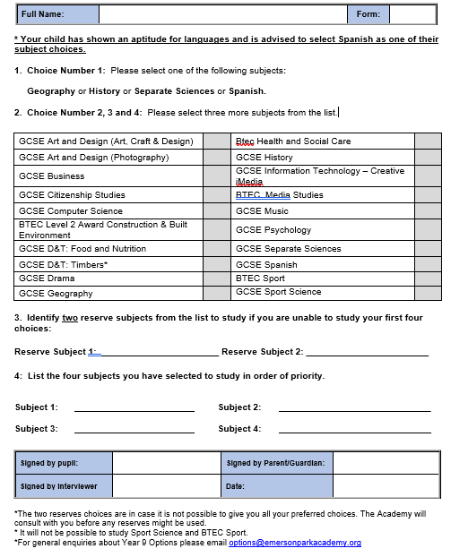

Slide 14
When making choices….
Do……. |  | Do Not……..
Think about the subjects for which you have the greatest aptitude. |  | Select subjects based on friendship groups.
Think about the subjects you enjoy and will be enthusiastic about. |  | Select subjects just because the teacher is well liked.
Think about which subjects will be of greatest value for the future. |  | Select subjects just because you haven’t studied them before.

Slide 15
Questions:
Please email subject leaders for specific questions about a qualification or the course content. Email addresses can be found in the Options Booklet.
For other questions linked to the Options process or combination of choices, please email: options@emersonparkacademy.org

