Slide 1
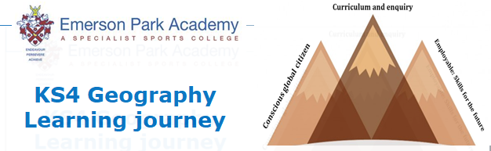
Pre-release
and familiar fieldwork
Natural resources
Economic world
The living world
Y11
Physical landscapes:
Rivers
Familiar Fieldwork
Physical landscapes:
Coasts
Y10
Natural Hazards
Urban issues
and challenges

