Slide 1






Welcometo Emerson Park Academy

Slide 2
Transition Days – Updated times to due Met Red Extreme Heat Warning
8.50 am – 1.00pm (if leaving with sibling 12.35pm) – Lunch is not provided if leaving at 12.35pm
Bring a snack for break time
Current School Uniform or PE Kit
Trainers
Water Bottle
Sun Block
Lunch/FSM – no more than £5 cash
Menu – in packs
Phones – at own risk – must be off during school day
Completed Forms – re collection
Complete Applica forms
Medical issues – please email
Road Restrictions 8.20am - 9.15am
Nut Free School

Slide 3
Uniform and Standards – September 2026

Slide 4
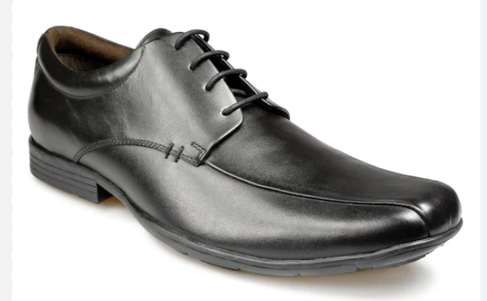
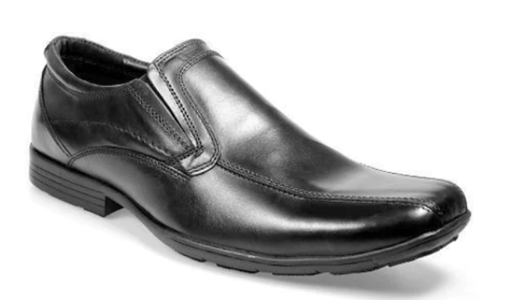
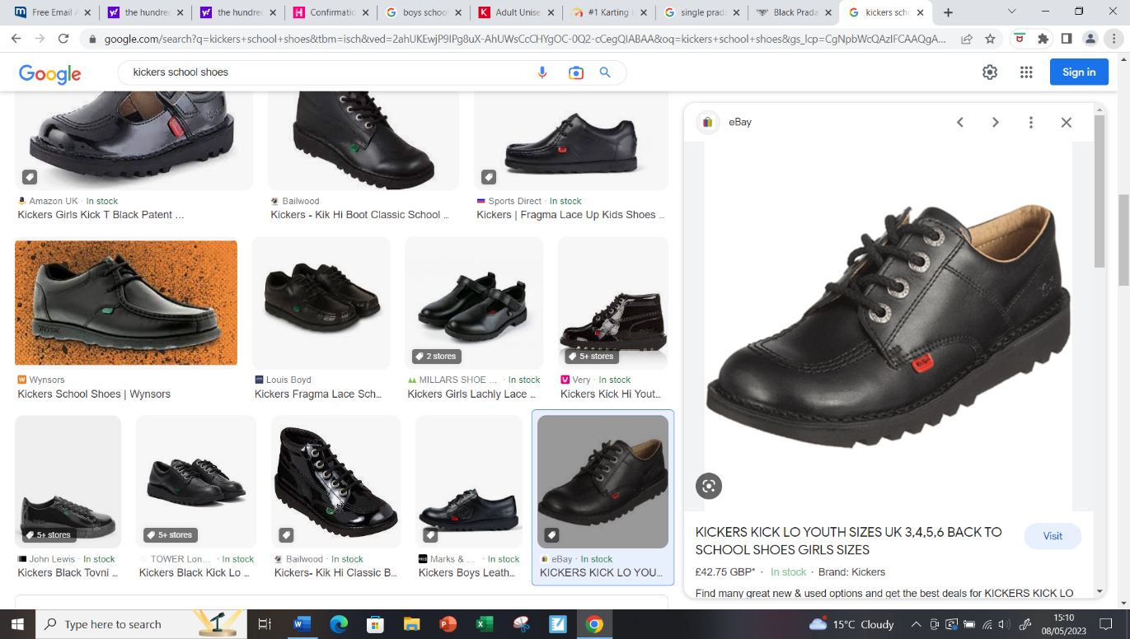
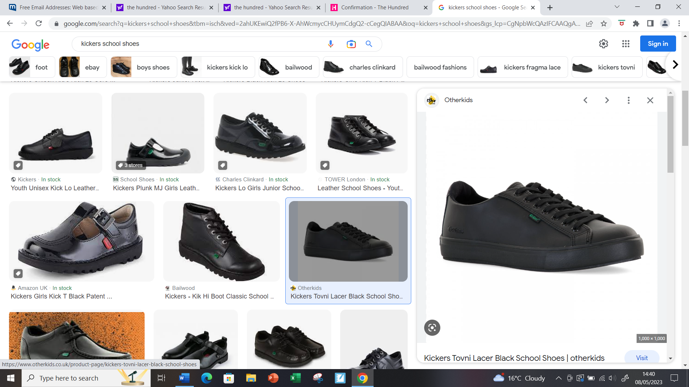
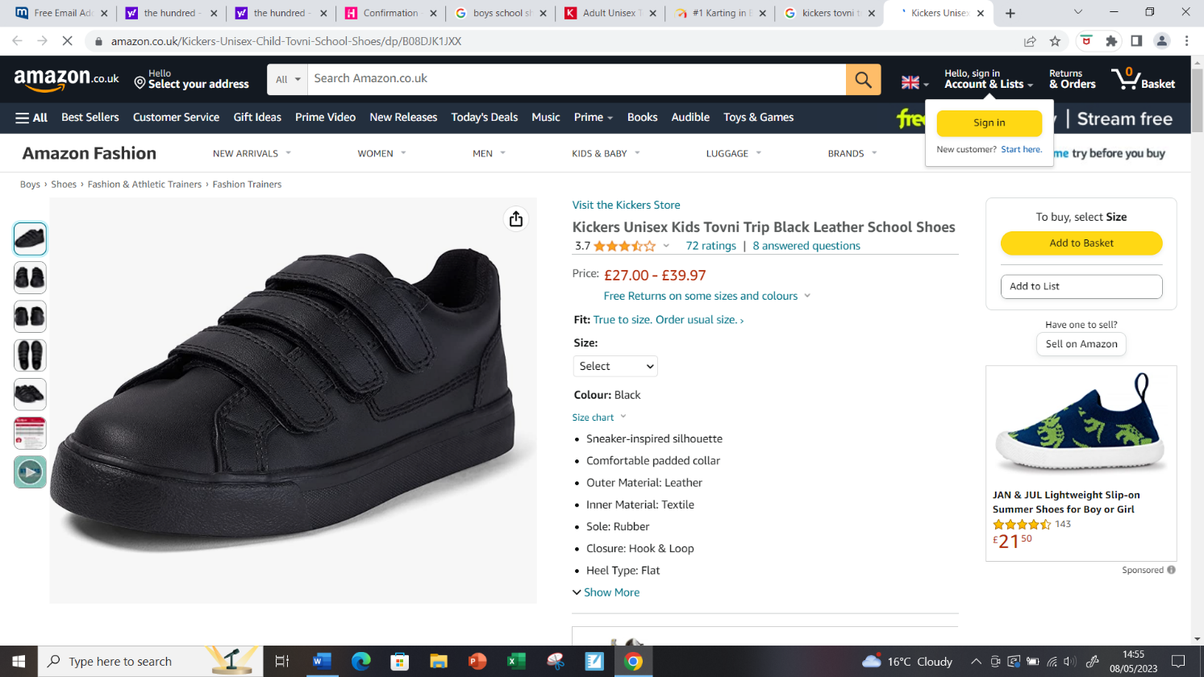
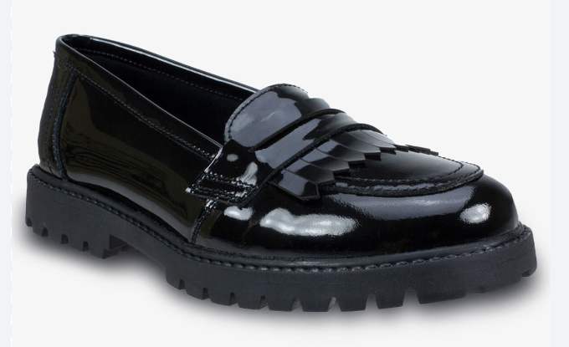
Footwear
Pupils must wear plain black leather shoes with an enclosed toe

Slide 5
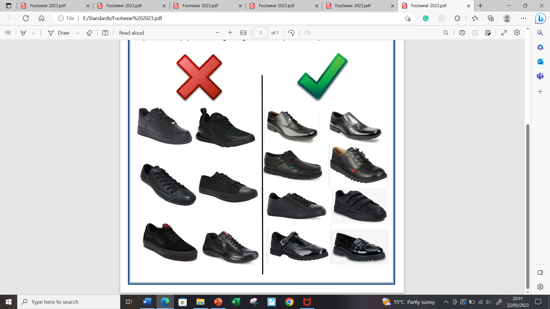
Footwear not allowed
All types of trainers
Any sports logo on footwear
Converse type shoes
Plimsoll-like shoes
Designer shoes/trainers e.g. Prada

Slide 6
Uniform
Blazer must be worn at all times
Ties can be borrowed from the Behaviour Support Team – old H block(this is a short-term solution)

Slide 7
Y7 black coat only
Girls white knee high socks/black tights
Boys black/dark socks
Bags
PE Trainers
Hair Bands

Slide 8
Jewellery/Make up
Jewellery of any kind is not permitted, except for a watch
Acrylic/painted nails are not permitted
No unnatural hair colours
No make-up

Slide 9
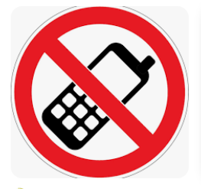
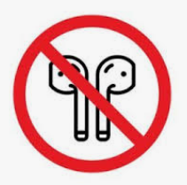
We are a phone free school!
Phone policy September

Slide 10
Attendance
First Day 3rd September 2026
Term dates – in pack
High Expectations – Handout
Rewards
Parent Pay Reminder

